Slide 1
DOIs for dynamic datasets
Implementation and plans for EBAS
S-ENDA Workshop 30 Sept 2022

Slide 2
Key question: Granularity
Extreme cases:
One DOI for the whole database (or for different states in time)
One DOI for each file added
One DOI for each measurement
Although this would be rather simple to implement, we did not think it would add the maximum benefit.

Slide 3
Dataset granularity in EBAS
Dataset granularity in EBAS
Originally, a dataset in EBAS was a single variable time series
A dataset has a specific set of core metadata (if one of those changes → new dataset)
Example: Timeseries of hourly mean concentrations of elemental carbon
→ Dataset in the data model
Later (2014) we added the possibility to insert and export multiple variables in one file, collecting what “belongs” together.
Basically, all variables from one instrument (at the same time scale).
Collection of N datasets for a time range (e.g. one year)
Example: One year of hourly mean concentrations of elemental carbon, organic carbon and total carbon, as well as ambient temperature and pressure.
→ Submission

Slide 4
Submission (short and wide) / Dataset (long and narrow)
Year n
Submission
Year n+1
Submission

Slide 5
Combination: long series of multiple variables
→ This is what users would call a dataset
Submission
Submission
Submission series: Sequence of Submissions which contain exactly the same datasets.
Submission

Slide 6
Use cases for DOIs
Use cases:
Reference each file inserted into the database (Submission)
Usually yearly data for one instrument
Finest granularity object in the DOI implementation
Contains attribution information (who was PI in year x)
Reference a submission series
Data of one instrument over long time
Consist of multiple submissions
Change over time (additions, deletions, updates)
“Concept” of the submission series
Example “Measurements of instrument x at station y”
Data citation: tracking different versions of submission series
E.g., citing the very specific data used in a publication
Example: “Measurements of instrument x at station y as in the database at time instant z”

Slide 7
Use cases for DOIs
Use cases:
Reference each file inserted into the database (Submission)
Usually yearly data for one instrument
Finest granularity object in the DOI implementation
Contains attribution information (who was PI in year x)
Reference a submission series
Data of one instrument over long time
Consist of multiple submissions
Change over time (additions, deletions, updates)
“Concept” of the submission series
Example “Measurements of instrument x at station y”
Data citation: tracking different versions of submission series
E.g., citing the very specific data used in a publication
Example: “Measurements of instrument x at station y as in the database at time instant z”
Needs versioning!

Slide 8
Bitemporal database
EBAS Database is since 2014 bitemporal
Valid time (application time): The usual time ranges (measurement start/end times, metadata validity ranges…)
System time (transaction time): Time range for when the record was stored in the database
Nothing is ever deleted, only the system time range is changed
→ Every historic state of the database can be reproduced

Slide 9
Putting the pieces together
DOIs in EBAS by Example

Slide 10
New submission to EBAS
Submission

Slide 11
New submission to EBAS
Submission
DOI
Submission

Slide 12
Submission Series
Submission
DOI
Submission

Slide 13
Submission Series
Series Concept
DOI
Submission
DOI
Submission
Series State
DOI

Slide 14
HasVersion
Submission Series
HasPart
Series Concept
DOI
Submission
DOI
Submission
Series State
DOI
IsPartOf
IsVersionOf
DataCite metadata: relationTypes

Slide 15
Submission Series
Series Concept
DOI
Submission
DOI
Submission
Series State
DOI
New submission
Submission

Slide 16
Submission Series
Series Concept
DOI
Submission
DOI
Submission
Series State
DOI
New submission
Submission
DOI
Submission

Slide 17
OLD STATE
Submission Series
Series Concept
DOI
Submission
DOI
Submission
Series State
DOI
Submission Series
Submission
Series State
DOI
Submission
DOI
Submission
NEW STATE

Slide 19
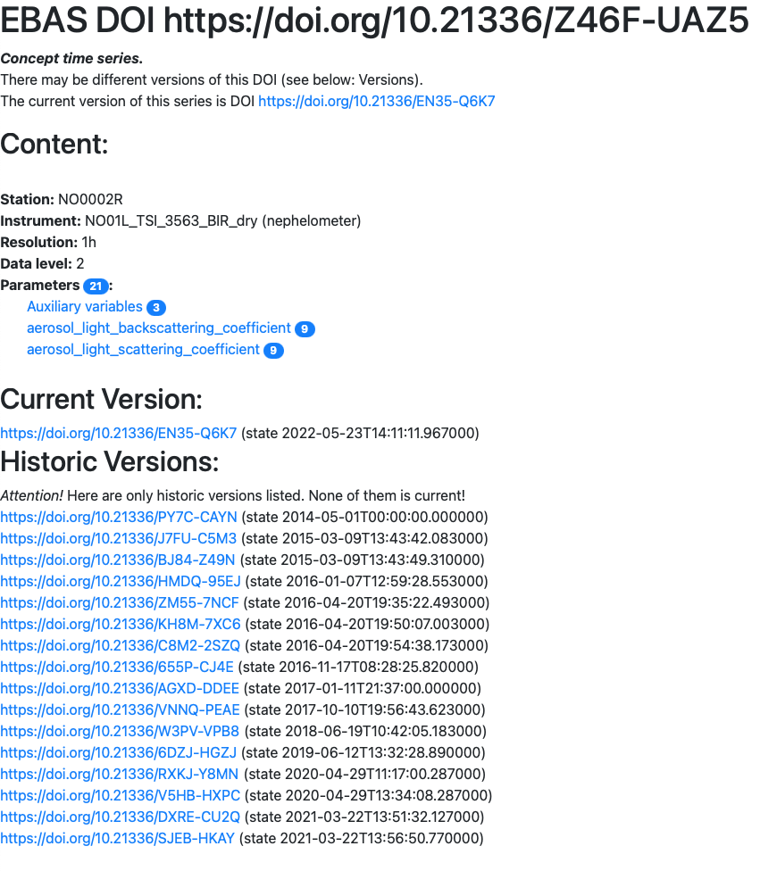

Slide 20
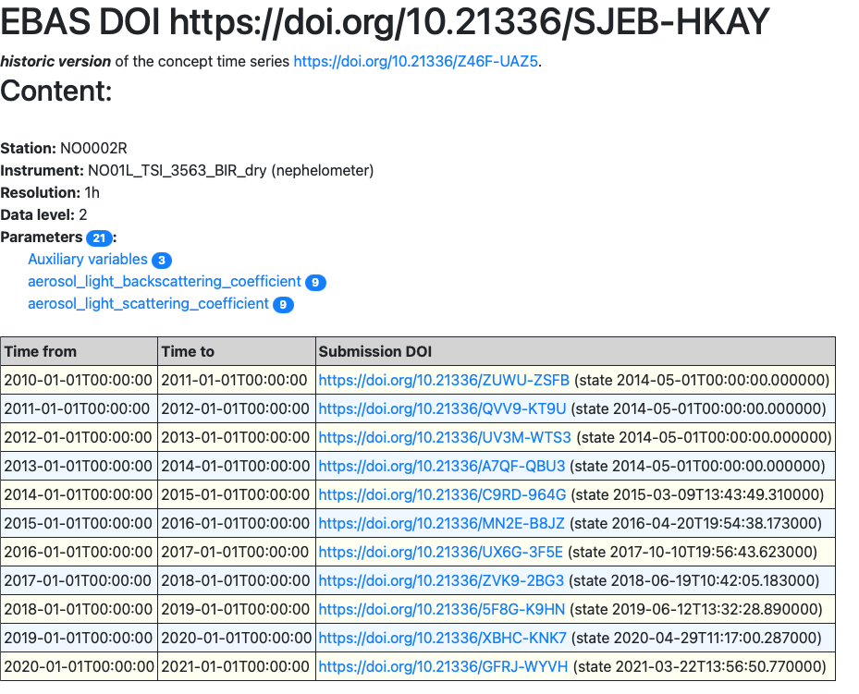

Slide 21
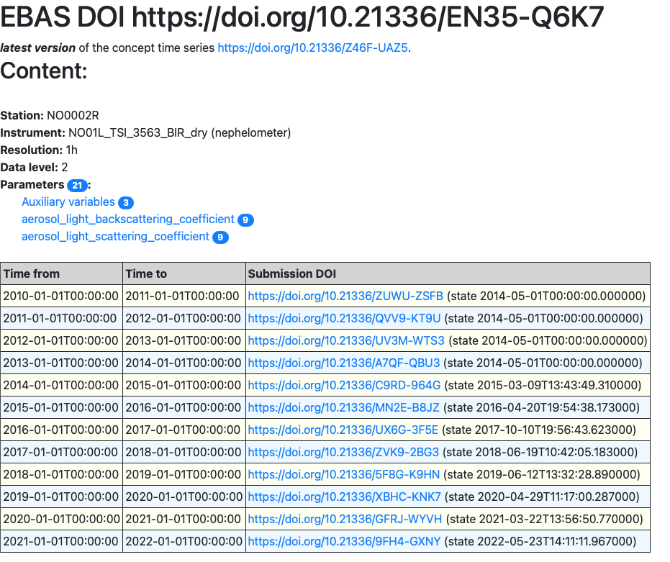

Slide 22
Special Case: Near real time data
Problem: NRT data come with much higher frequency (usually one submission for each datapoint = hourly)
This would mean one Series State DOI for each measurement
Solution: Only a Series Concept DOI
Referencing the version is moved to the point of data access
Citation must include both, the DOI and a time reference (accessed at)
The bitemporal storage can be used to reproduce the data version at any point in time

