Slide 1
Training session - EVDC and FRMs
Ann Mari Fjæraa, Lise Eder Murberg, Yong Lin, Paul Eckhardt
ESA-EVDC and Climate and Research Institute NILU

Slide 2

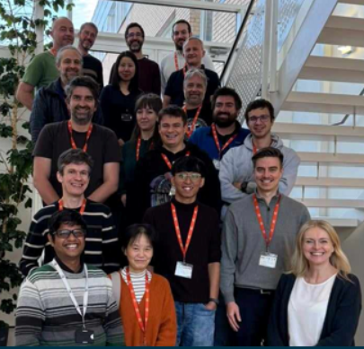
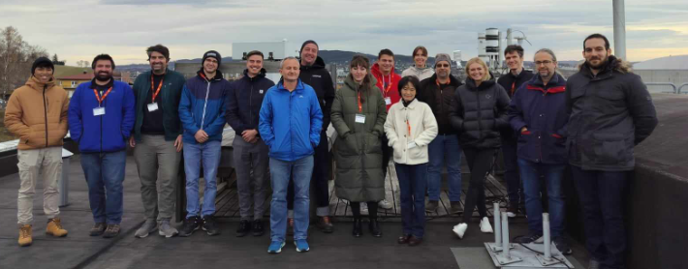
Outline
EVDC overview
Cal/Val data collections
Hands-on demo and notebooks
The EVDC training offers a practical introduction to how the ESA Atmospheric Validation Data Centre (EVDC) supports satellite Cal/Val activities.
You will learn to understand how EVDC facilitates data sharing, harmonization, and accessibility for validation purposes, helping scientists and project teams ensure traceability, transparency, and quality in satellite product evaluation.

Slide 3
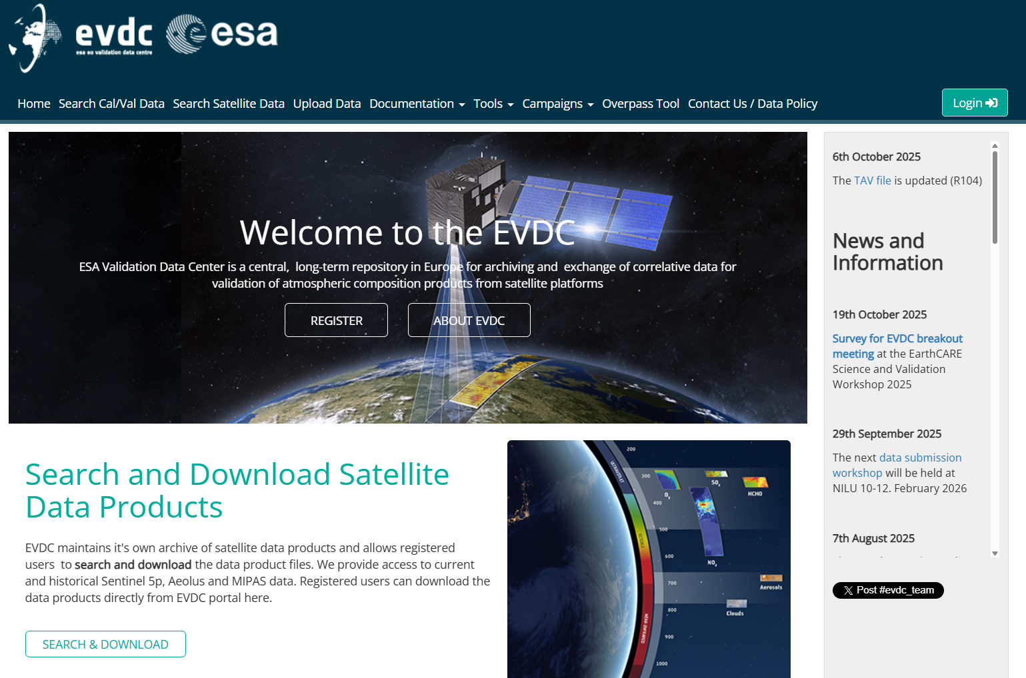
EVDC – ESA (Atmospheric) Validation Data Center
https://evdc.esa.int/
Online repository for archiving and exchanging data used to validate atmospheric composition products from Earth Observation satellites
“Cal/Val data”
“In-Situ data”
“Ground truth”
1.9 million individual files
Aircraft, balloon, drone, groundbased, and ship platforms

Slide 4
EVDC – ESA (Atmospheric) Validation Data Center
https://evdc.esa.int/
Navigation panel
Search for Cal/Val data
Search for Satellite data
Upload, documentation, tools, campaigns…. (mainly for data submitters)
Overpass tool
Data protocols and login button
Starting with the «Search Cal/Val data»

Slide 5
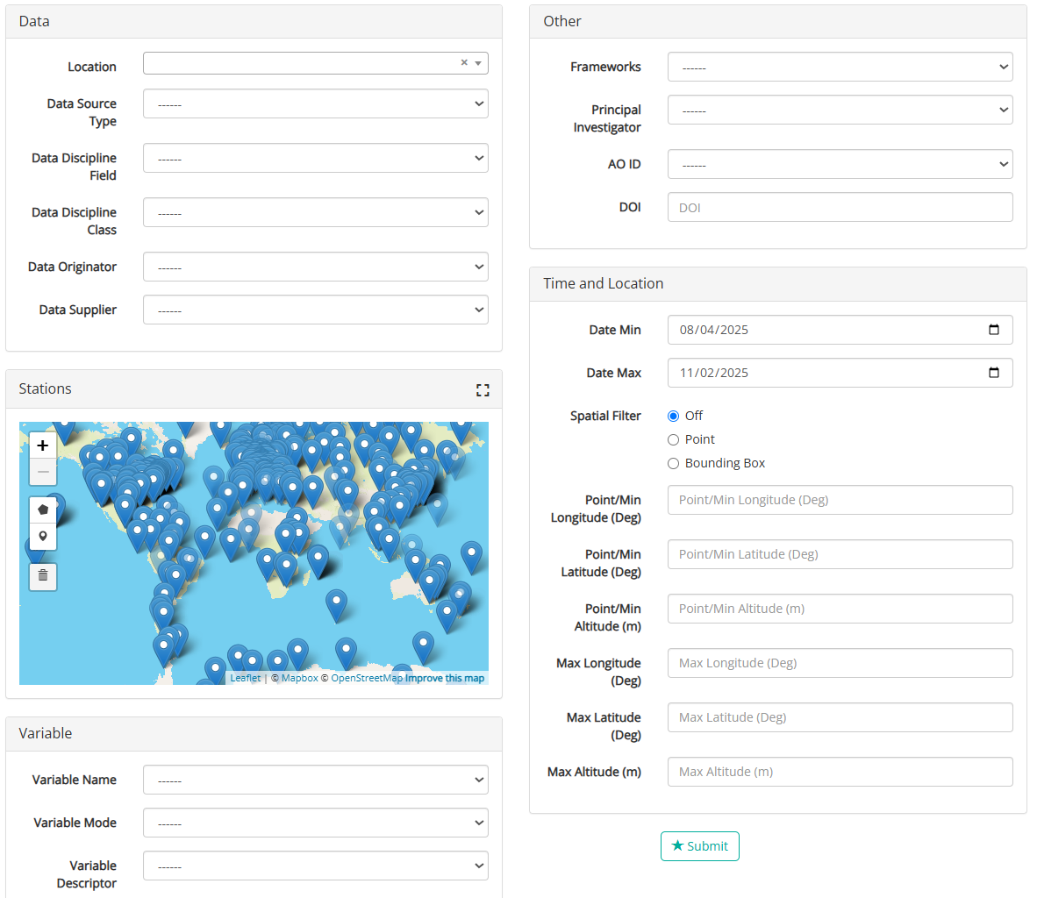
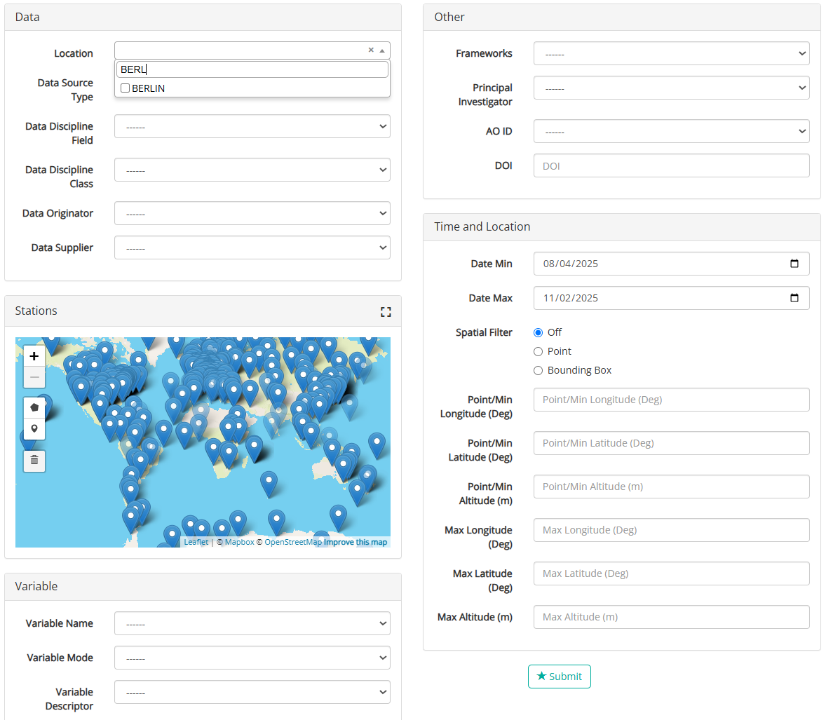
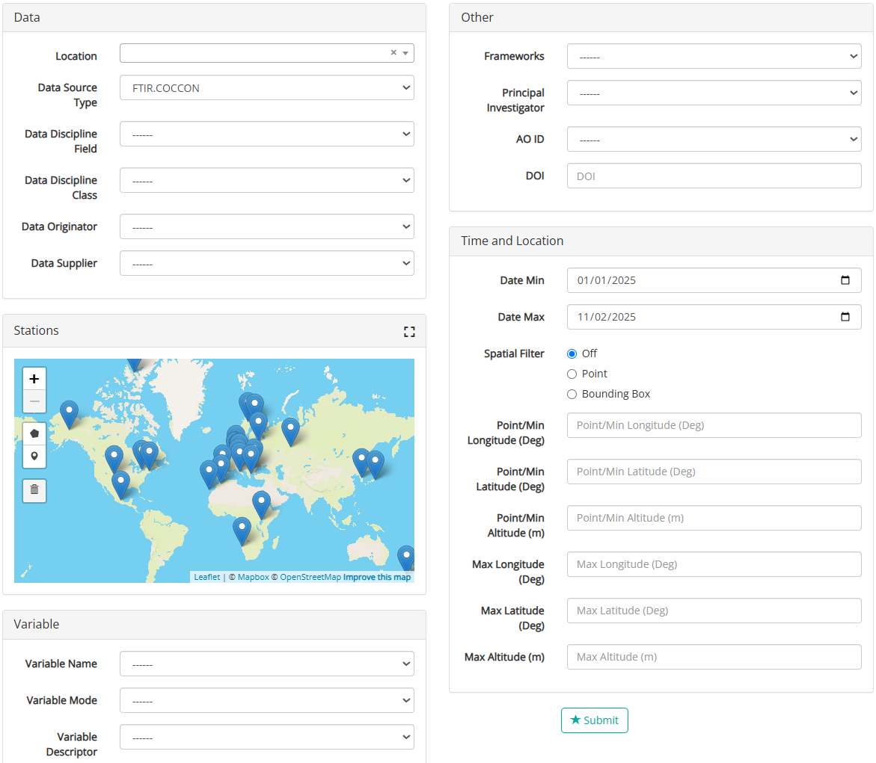
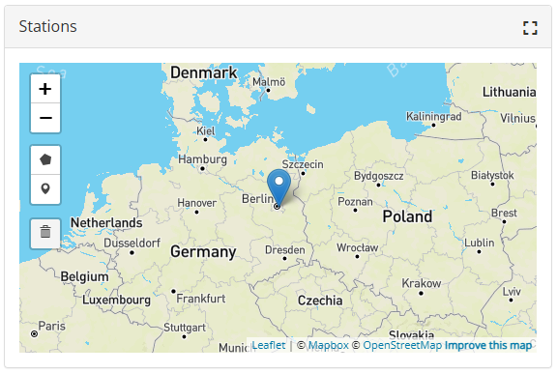
EVDC – Search for In-situ Data
Points to note:
Users are allowed to browse data in EVDC without logging in.
Even being logged in, some data may be restricted or have e.g. 6 months embago.

Slide 6
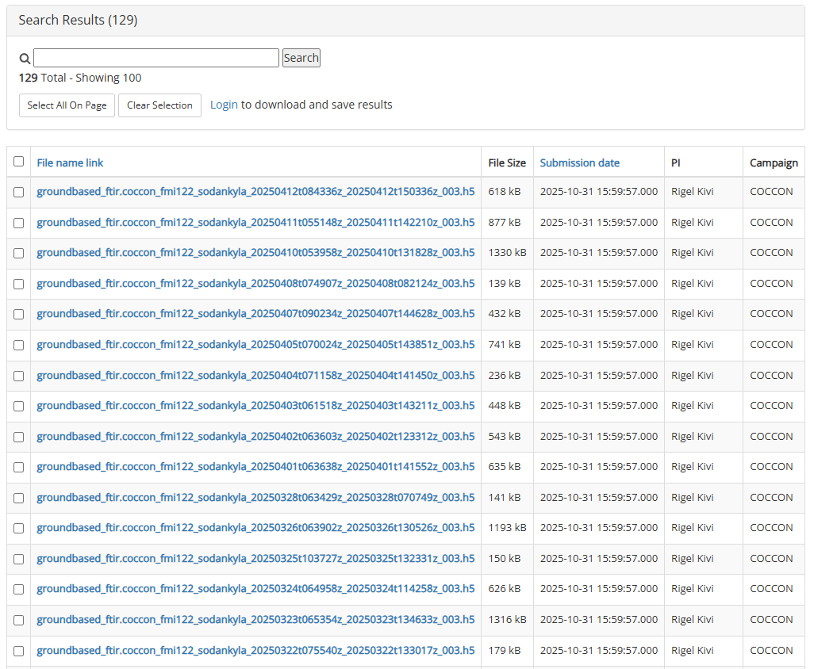
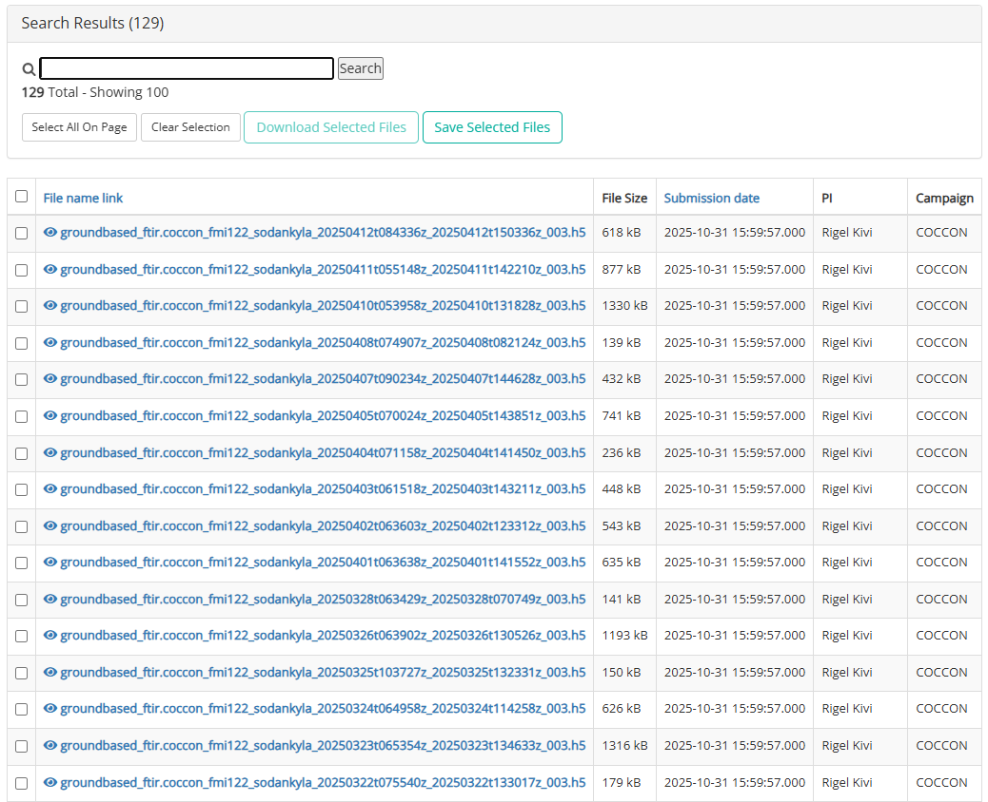
EVDC – Search for In-situ Data
Slide Text
Not logged in
Logged in

Slide 7
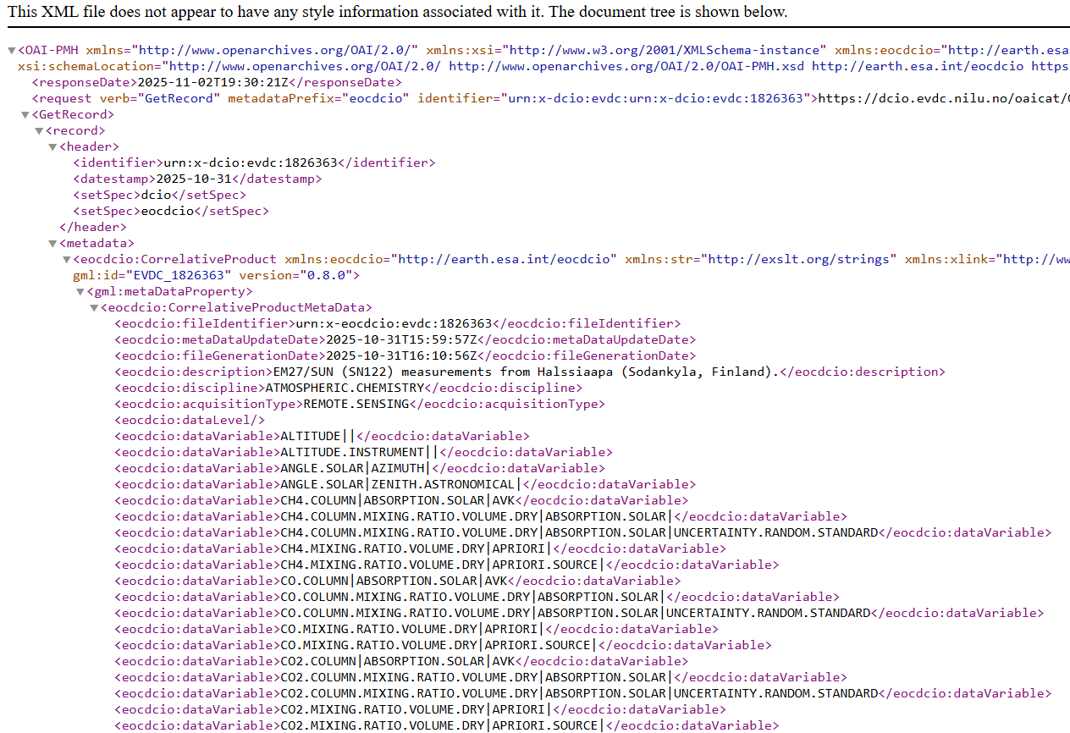
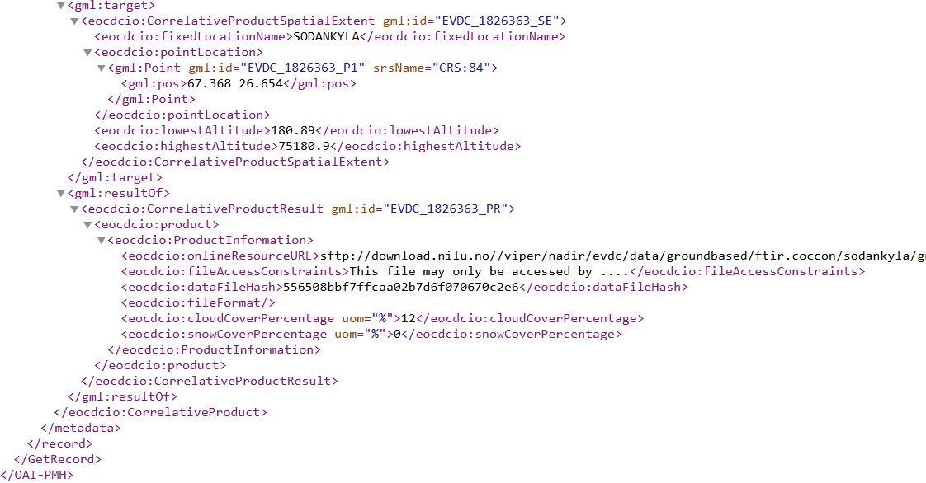
EVDC – Search for In-situ Data
Or… you can use the API
Request dcio.evdc.nilu.no/oaicat/OAIHandler?verb=GetRecord&metadataPrefix=eocdcio&identifier=urn:x-dcio:evdc:urn:x-dcio:evdc:1826363

Slide 8
EVDC – Search for In-situ Data
Or… you can use the API
Request dcio.evdc.nilu.no/oaicat/OAIHandler?verb=GetRecord&metadataPrefix=eocdcio&identifier=urn:x-dcio:evdc:urn:x-dcio:evdc:1826363
OAI-PMH stands for Open Archives Initiative Protocol for Metadata Harvesting.
OAI-PMH allows one system (a harvester) to gather metadata records from another system (a data provider) without manual export/import steps.
What is new/updated/deleted in the archive since your last visit

Slide 9
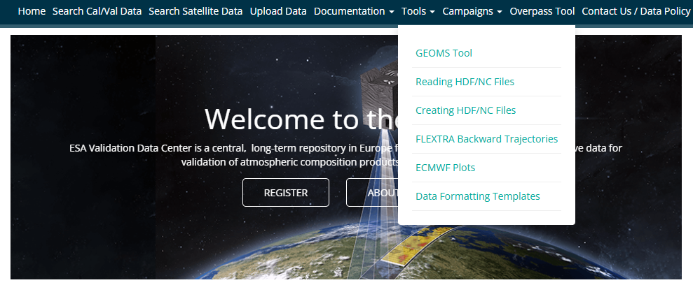
EVDC – Data formatting requirements
EVDC supports .hdf, .h5 and .nc file formats
In order to fit the data into the OAI-PMH; a minimum set of metadata is required
EVDC take advantage of the Generic Earth Observation Metadata Standard (NASA, NDACC)
Supported by a set of pre-defined metadata templates
Data originator
Location
Instrument type
Data variables
DOI
EVDC offers to coin DOIs and host landing
pages, self assignment via jupyter notebook

Slide 10
EVDC – Search for In-situ Data
Slide Text

Slide 11
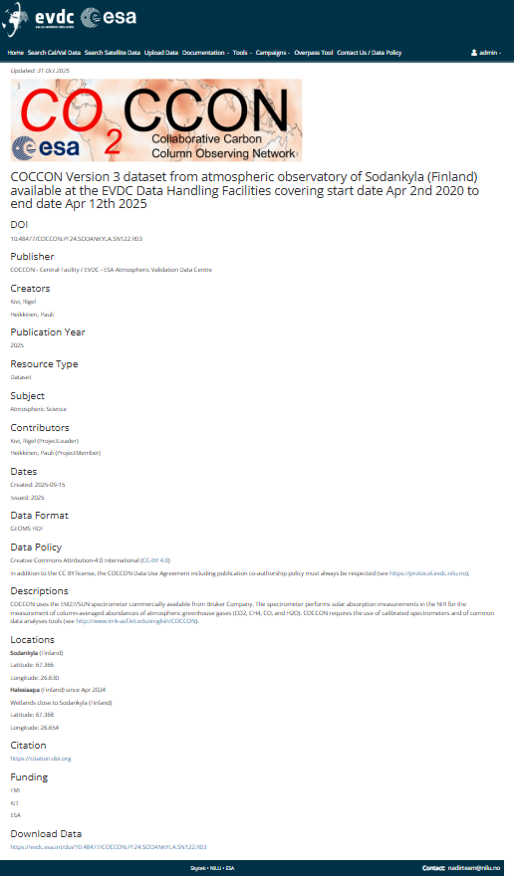
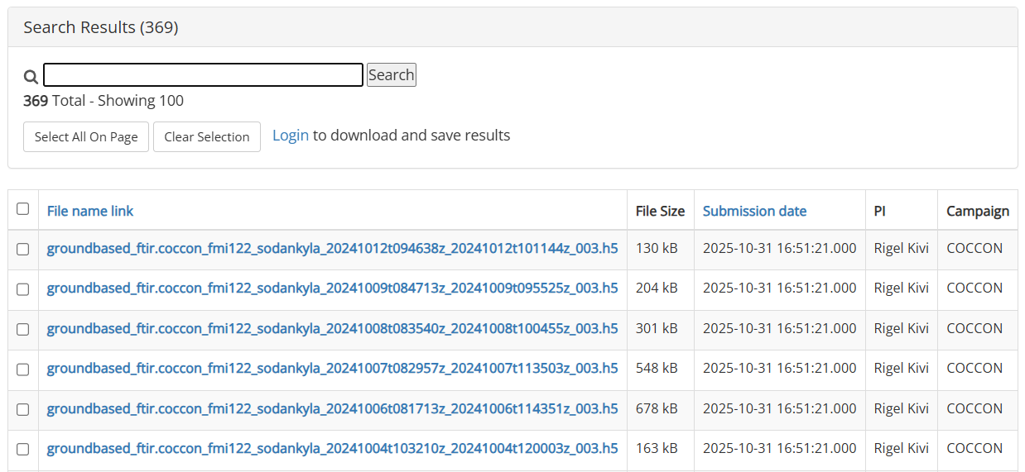
EVDC – DOI and landing pages
Slide Text

Slide 12
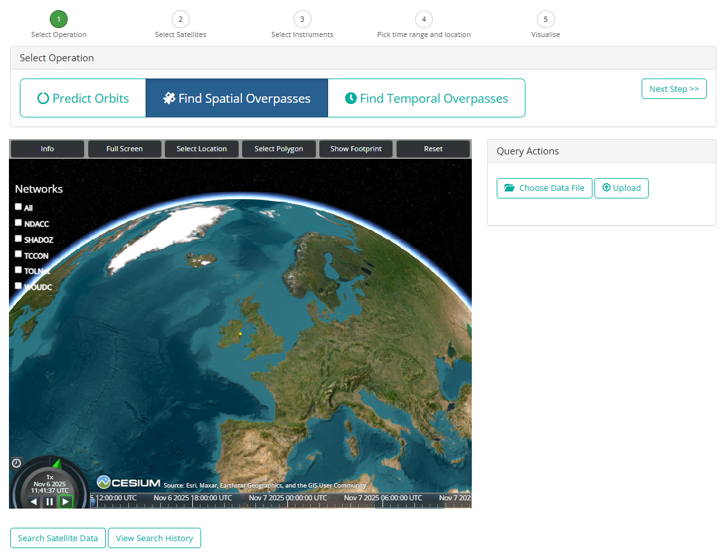
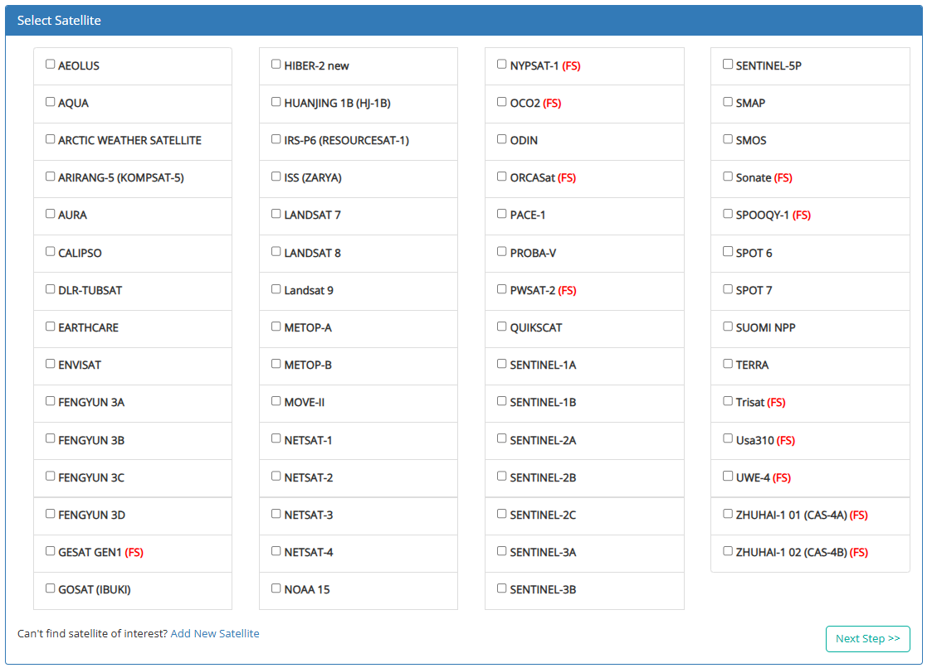
EVDC – Overpass tool
https://evdc.esa.int/orbit/
The Orbital Prediction and Overpass Tool (OPOT) generates and visualizes satellite’s overpasses.
Search for overpasses by satellite/instrument, as well as for joint overpasses between two satellites
Download overpass data as CSV, KML or JSON
Plan campaigns for satellites which have yet to launch by defining virtual satellites

Slide 13
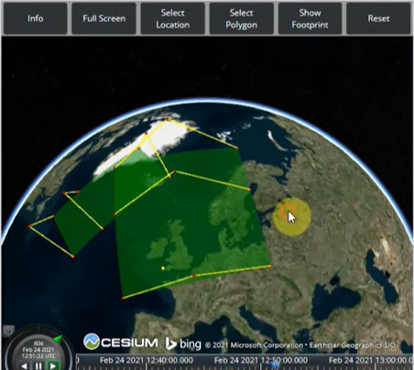
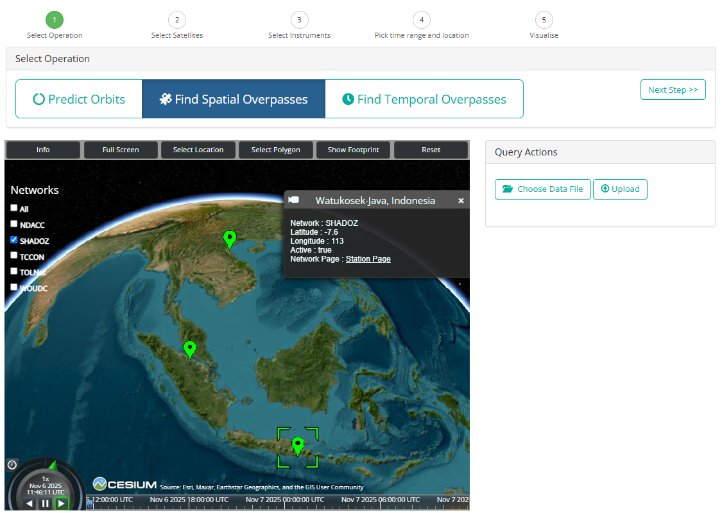
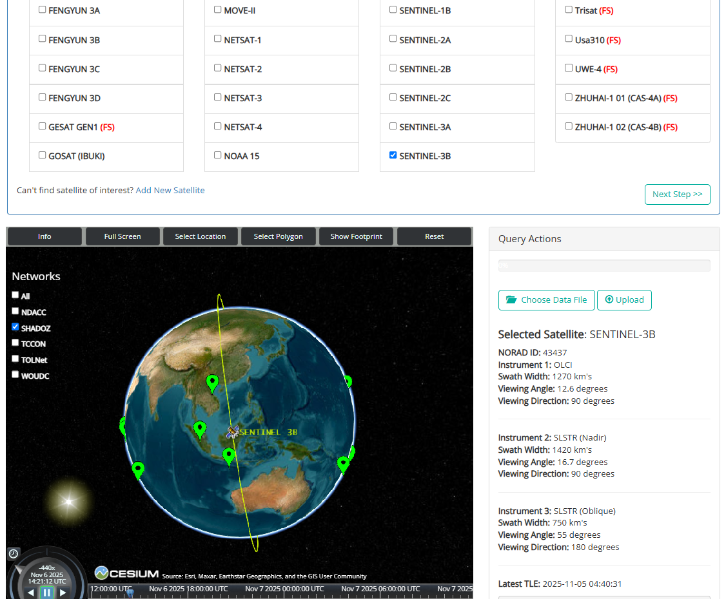
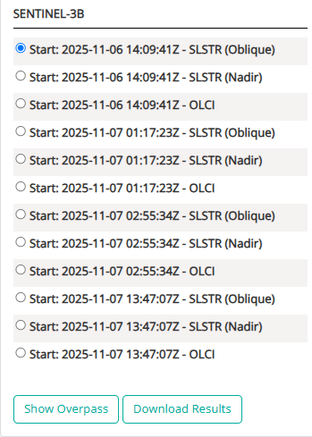
EVDC – Overpass tool
https://evdc.esa.int/orbit/
List overpasses
Find overpasses of two satellites at the same time
For point of interest
For any points the satellites overlap
Download the overpass trajectories
E-mail service to push information to users

Slide 14
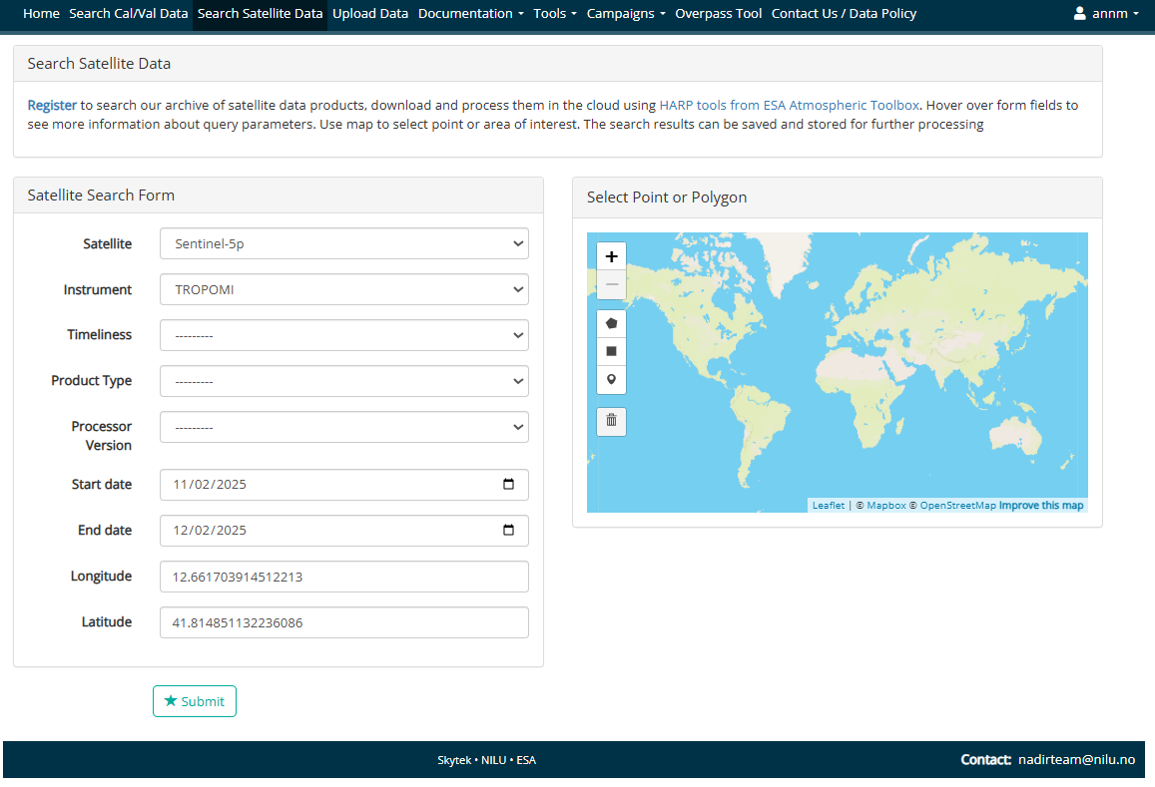
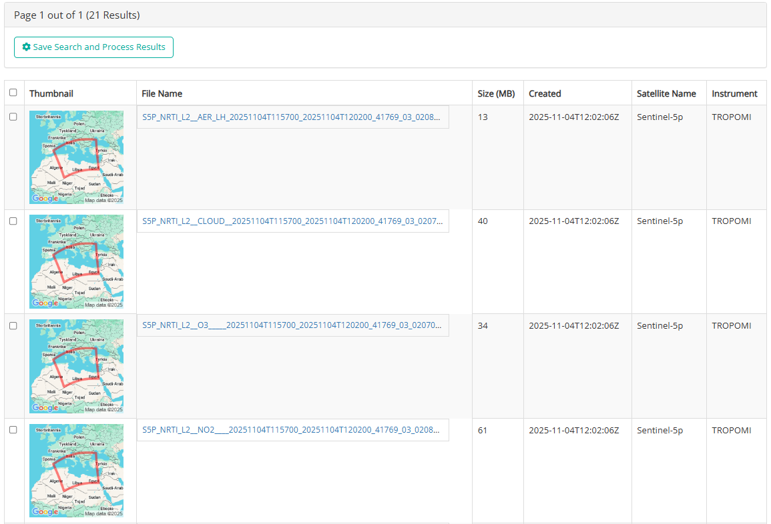
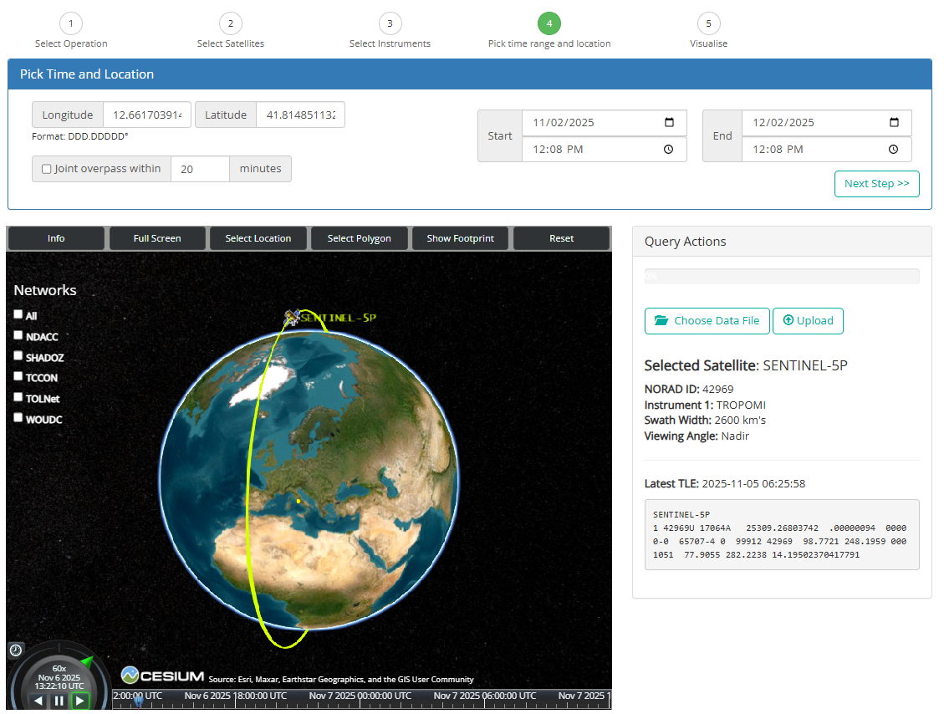
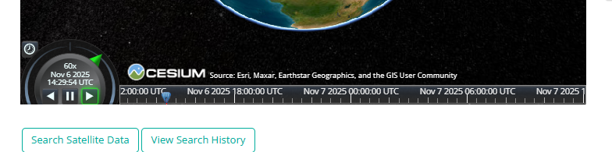
EVDC – Overpass tool
https://evdc.esa.int/orbit/
For some selected satellites; direct download of satellite overpass data

Slide 15
v
Homeless data and/or contributing datasets
Functionalities for
Adding Cal/Val data from other sources, and data that are not accessible elsewhere, or stored in any official archive.
Making data from other main archives visible in the portal, with download from primary source.
Expert panel for Data Center Inter Operabilities (DCIO)
Group of Network PIs (e.g. NDACC, PGN, COCCON), Research Infrastructure representatives (e.g. ACTRIS), and appointed delegates from the Entrusted Entities (ESA, NASA, EUMETSAT)
New participants welcome

Slide 16
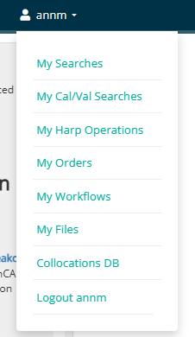
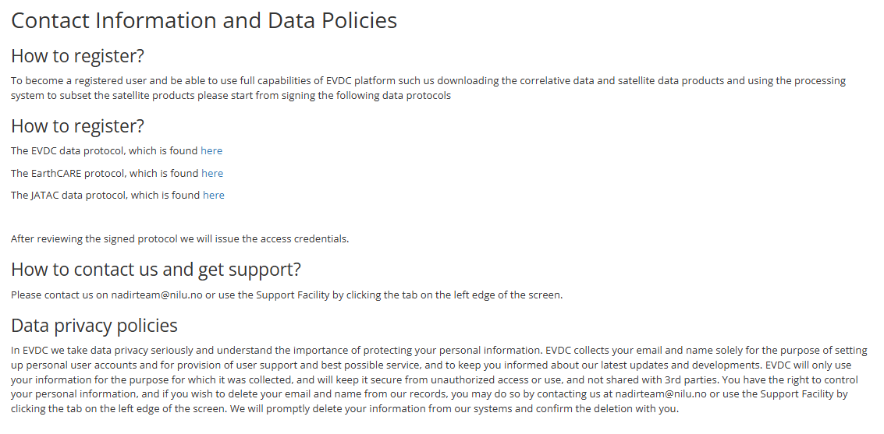
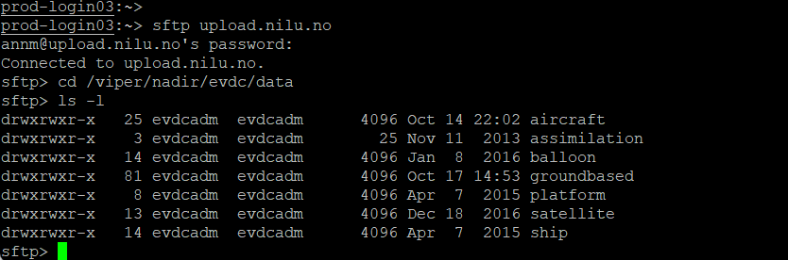
v
Login and practical demo
https://evdc.esa.int/contact-us/
evdccourse
iO527JCu33PxcE3Yv
Access to:
Web portal
Sftp to upload.nilu.no and download.nilu.no
OAI-PMH harvester / API

Slide 17
Newsletter, Training and Feedback
Newsletter
Training in Oslo
Feedback survey

