Slide 1
New data portal within ACTRIS and VRE
Lise Eder Murberg (NILU)
ASCENT Meeting 03.june 2025

Slide 2

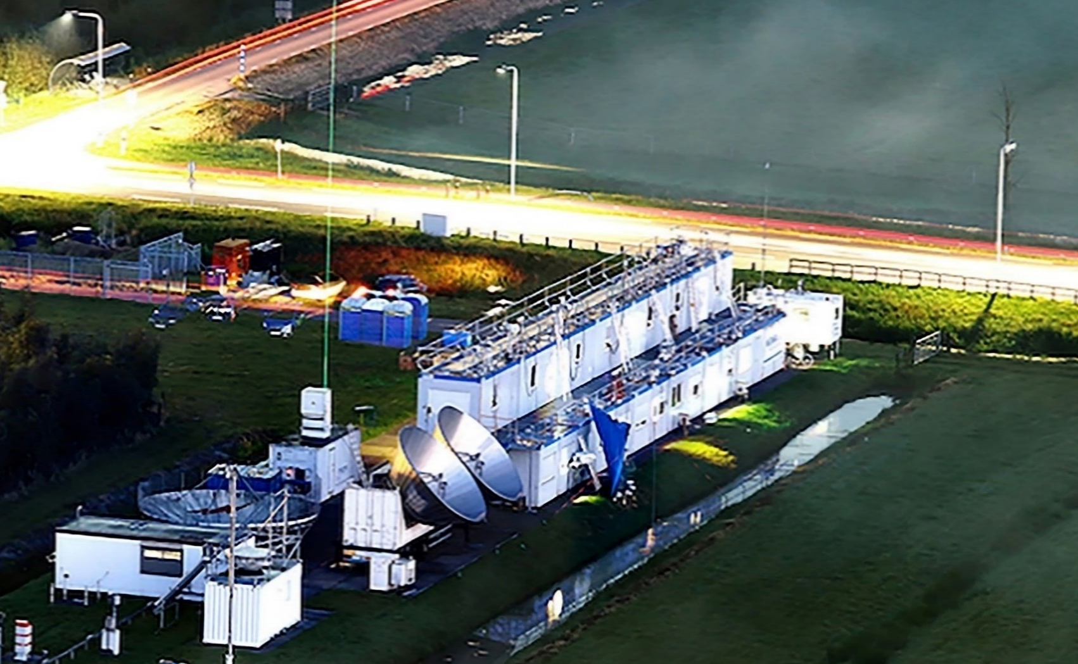
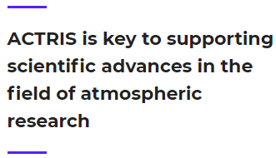
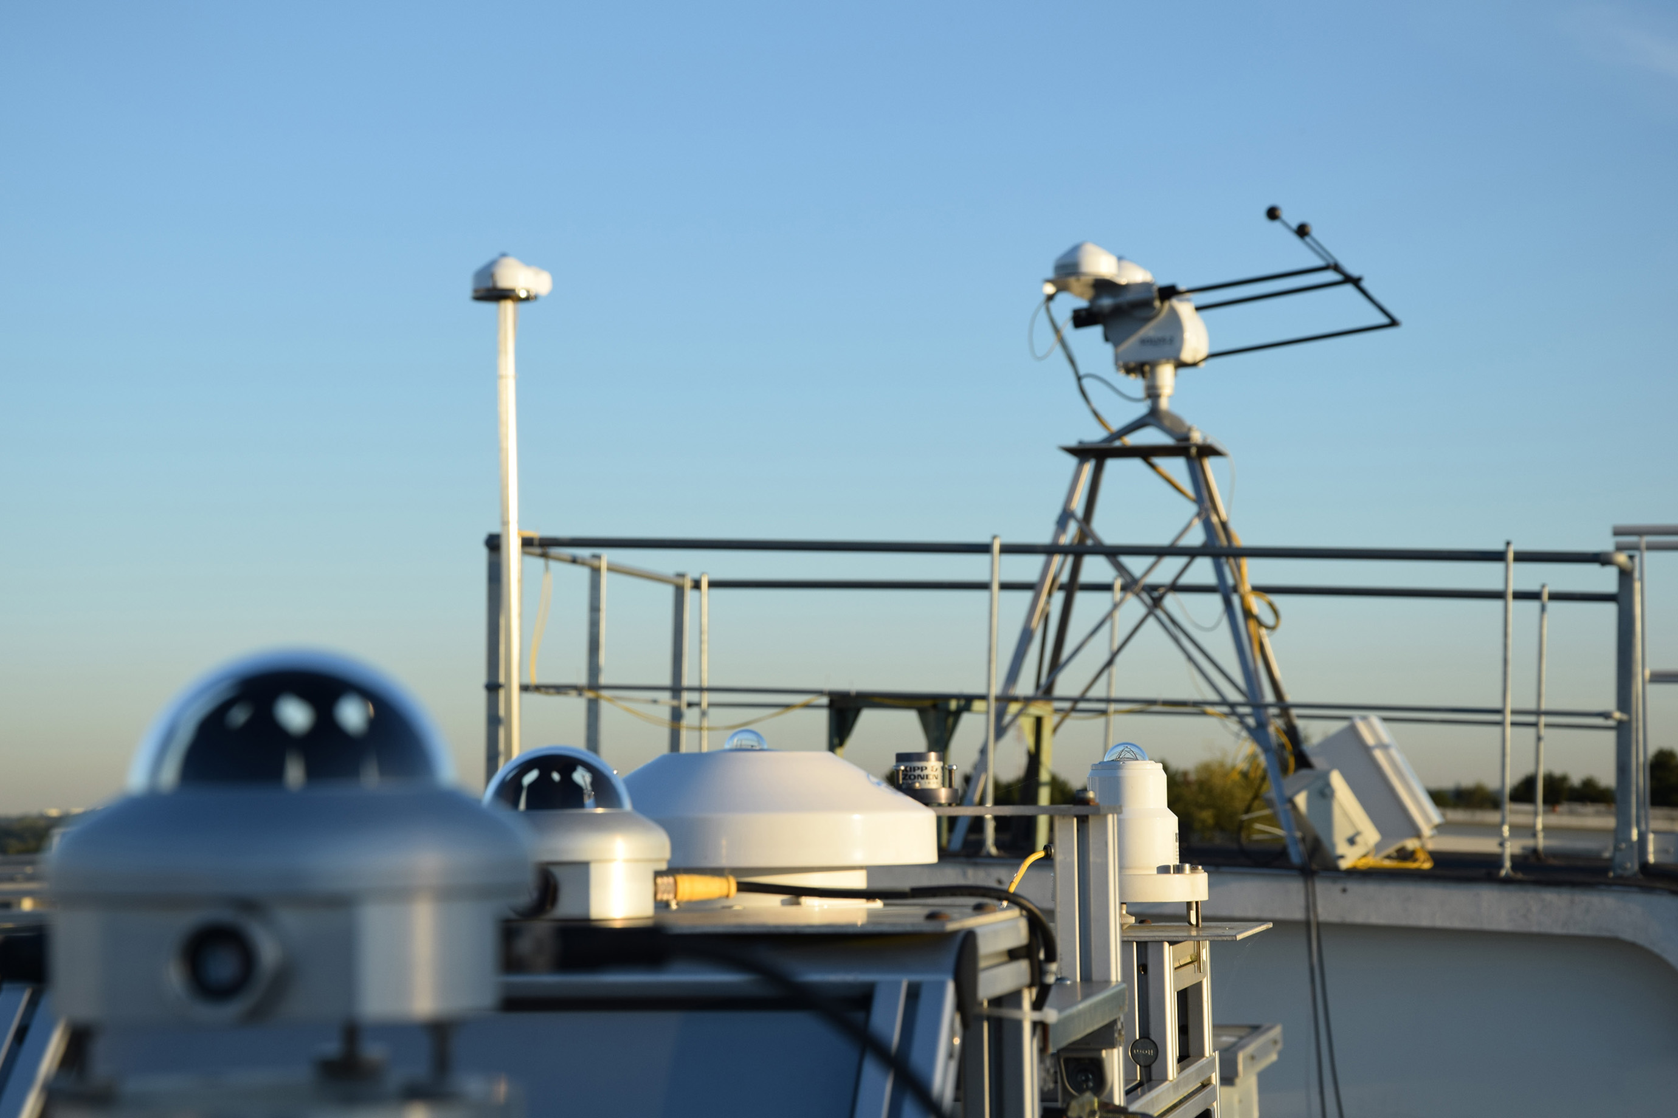
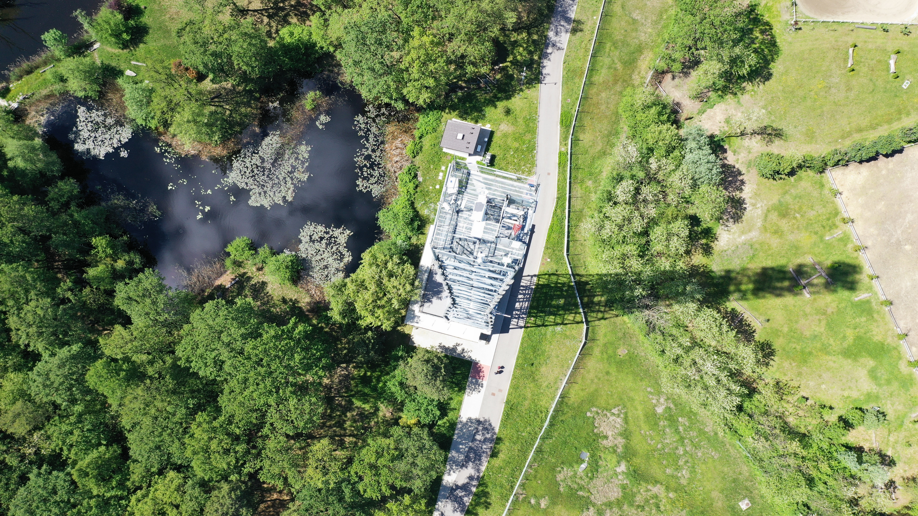
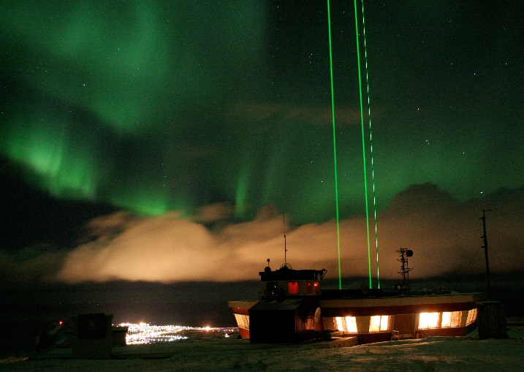
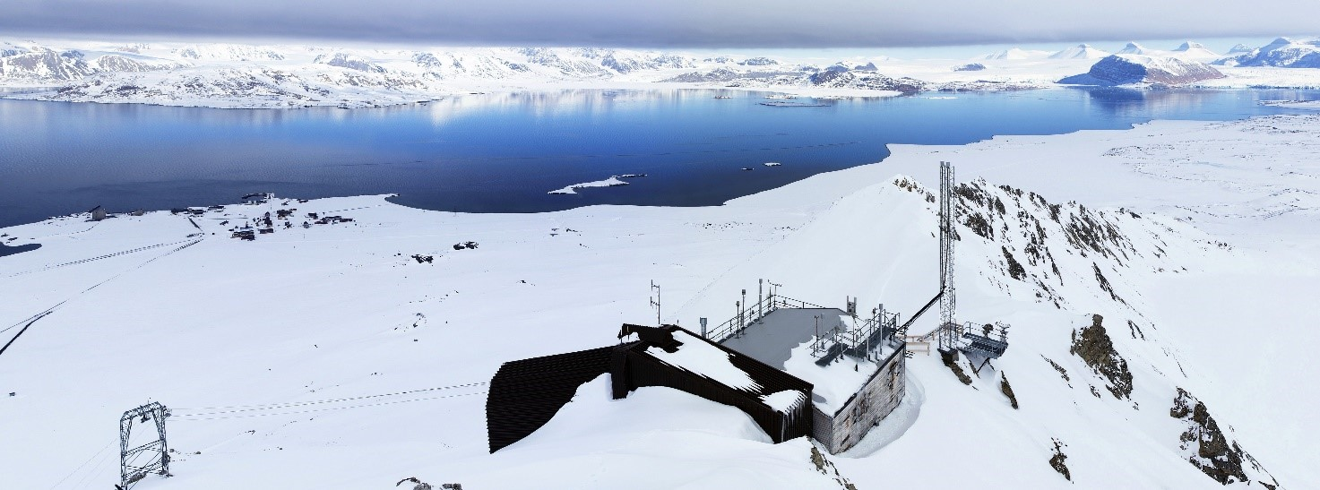
What is ACTRIS?
Aerosol Cloud and TRace gas Research Infrastructure
ACTRIS is a pan-European distributed research infrastructure producing high-quality data and information on short-lived atmospheric constituents and on the processes leading to the variability of these constituents in natural and controlled atmospheres.

Slide 3


Short-lived atmospheric constituents
< 150 atmospheric variables
Composition
Properties
Processes
Emissions
Transport
Removal
Trends
Feedbacks

Slide 4
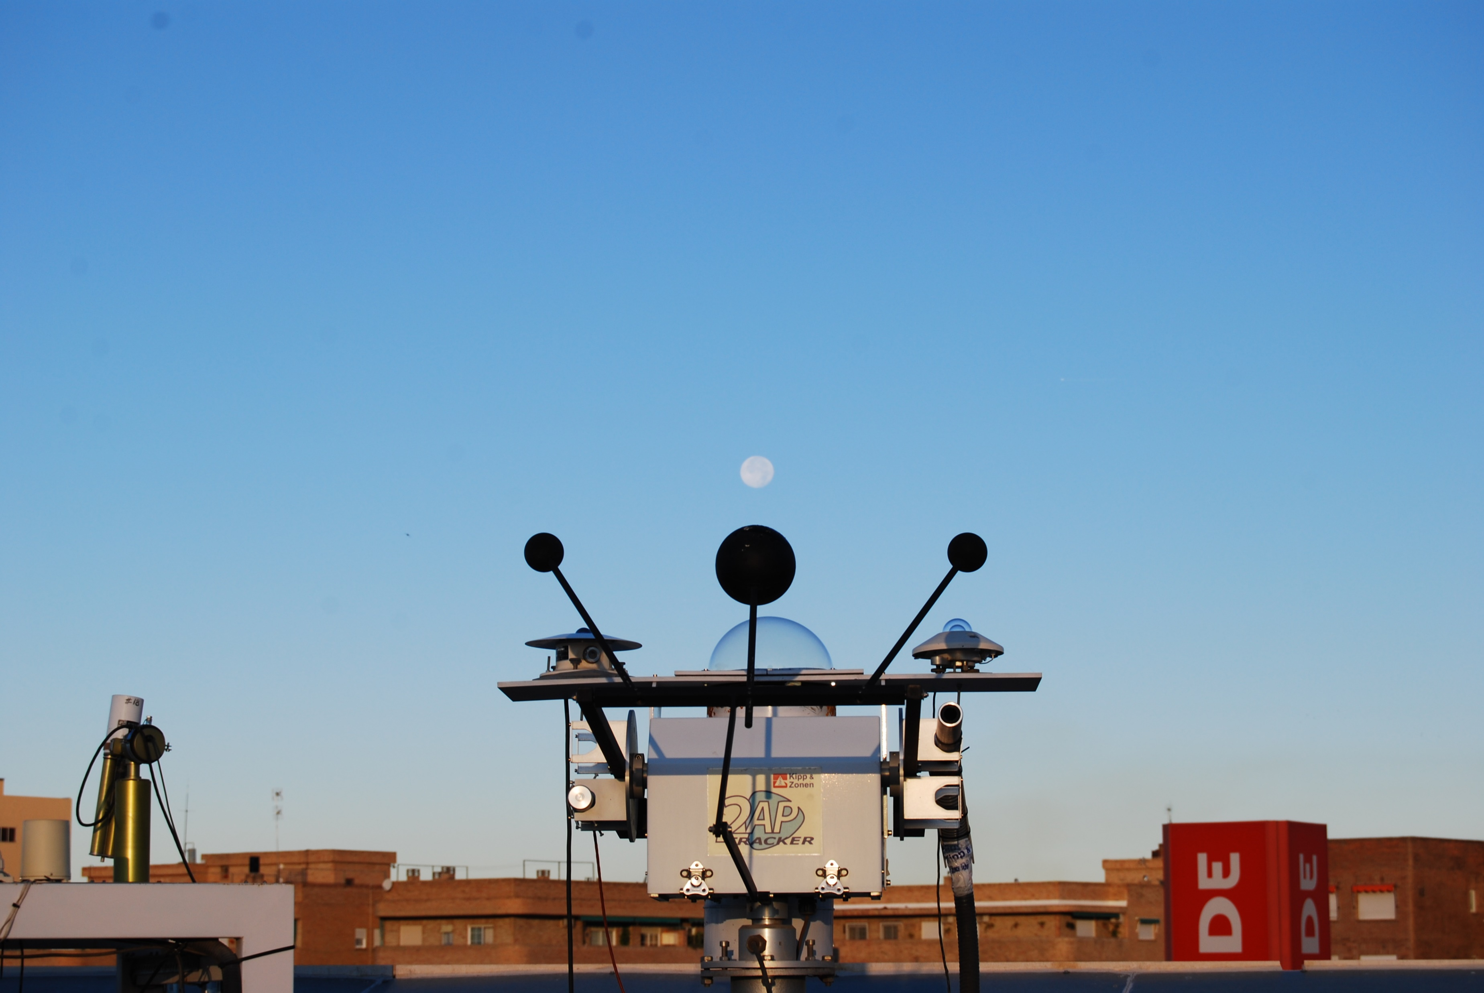
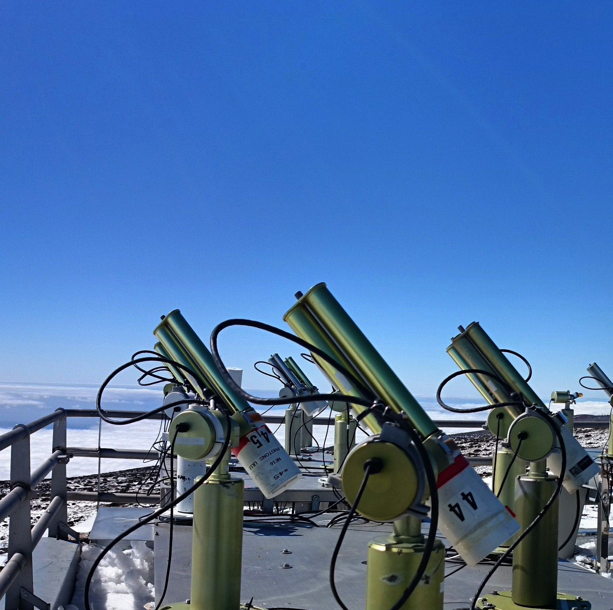
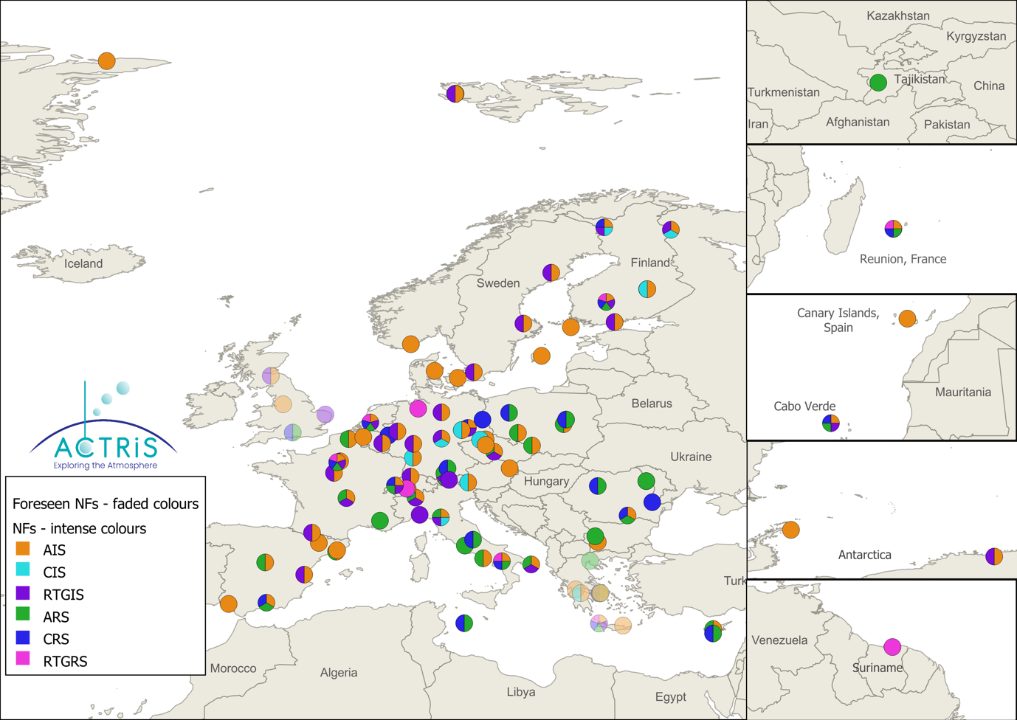
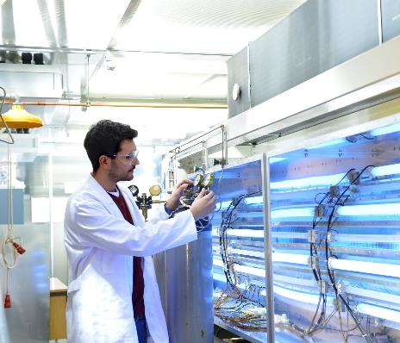
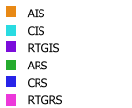
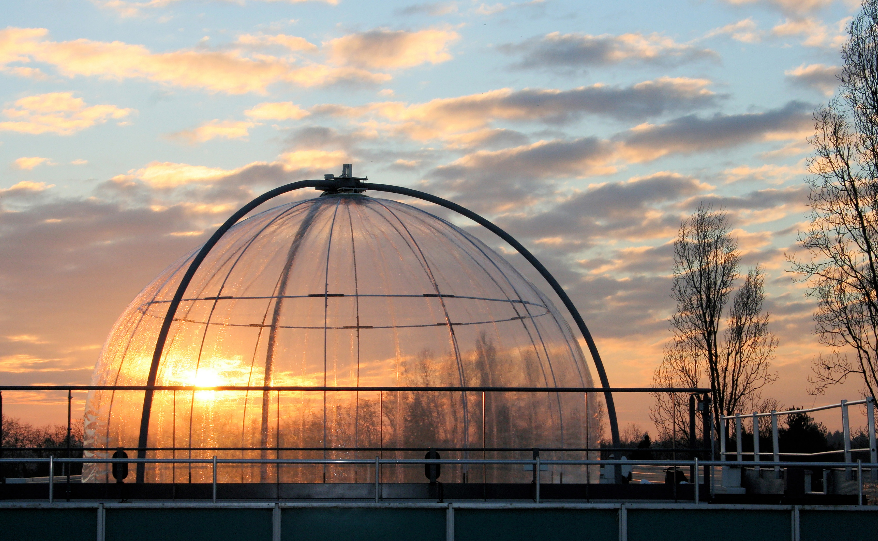
Core Asset: ACTRIS National Facilities
The National Facilities are the heart of atmospheric scientific excellence
Aerosol in-situ
Cloud in-situ
Reactive trace gas in-situ
Aerosol remote sensing
Cloud remote sensing
Trace gas remote sensing
Laj, Myhre, Riffault et al. BAMS 2024, https://doi.org/10.1175/BAMS-D-23-0064.1

Slide 5



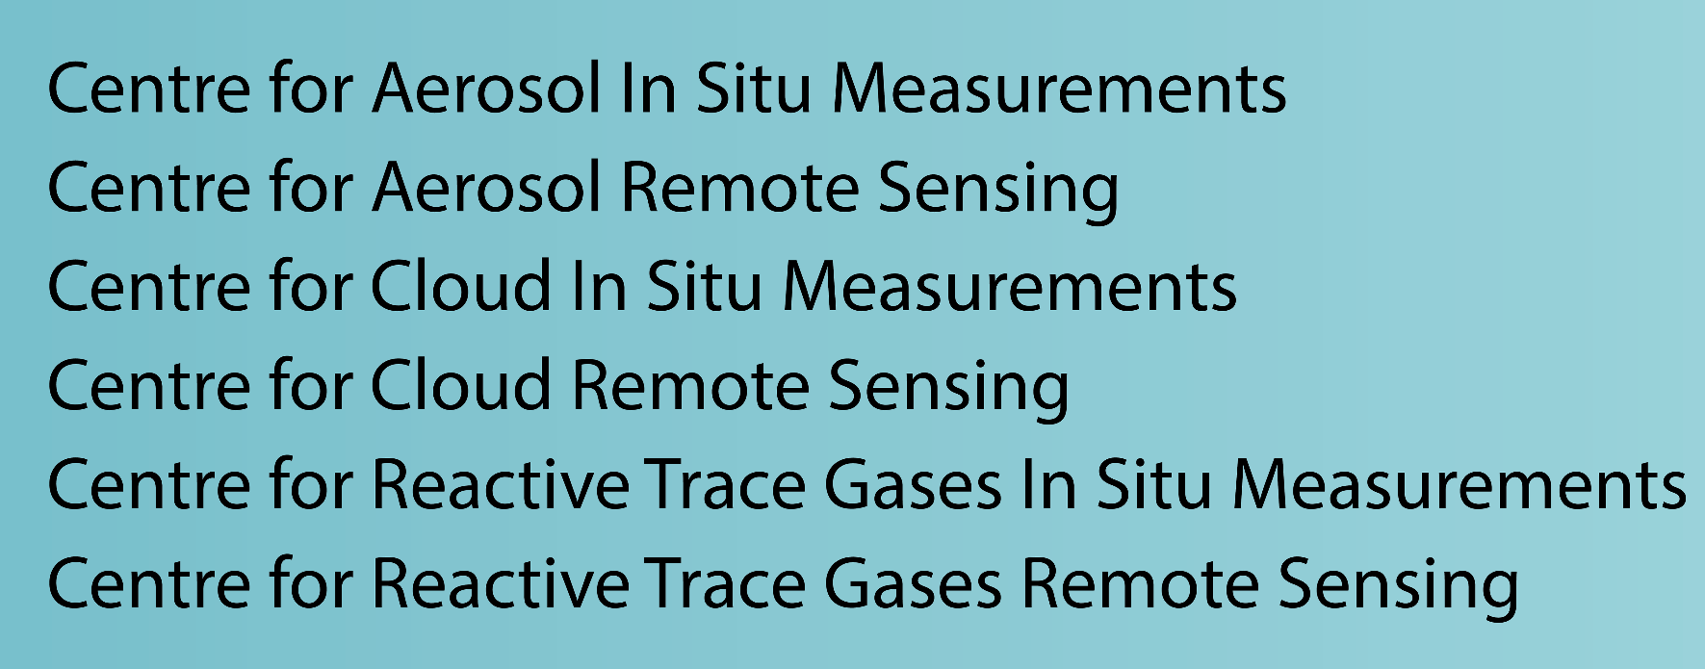
Harmonized methods
Calibrated instruments
Provision of data
Qualified data production
Curation of data
Access to users
In situ Data Centre Unit (In-Situ)
Aerosol remote sensing Data Centre Unit (ARES)
Cloud remote sensing Data Centre Unit (CLU)
Trace gas remote sensing Data Centre Unit (GRES)
Atmospheric simulation chamber Data Centre Unit (ASC)

Slide 6
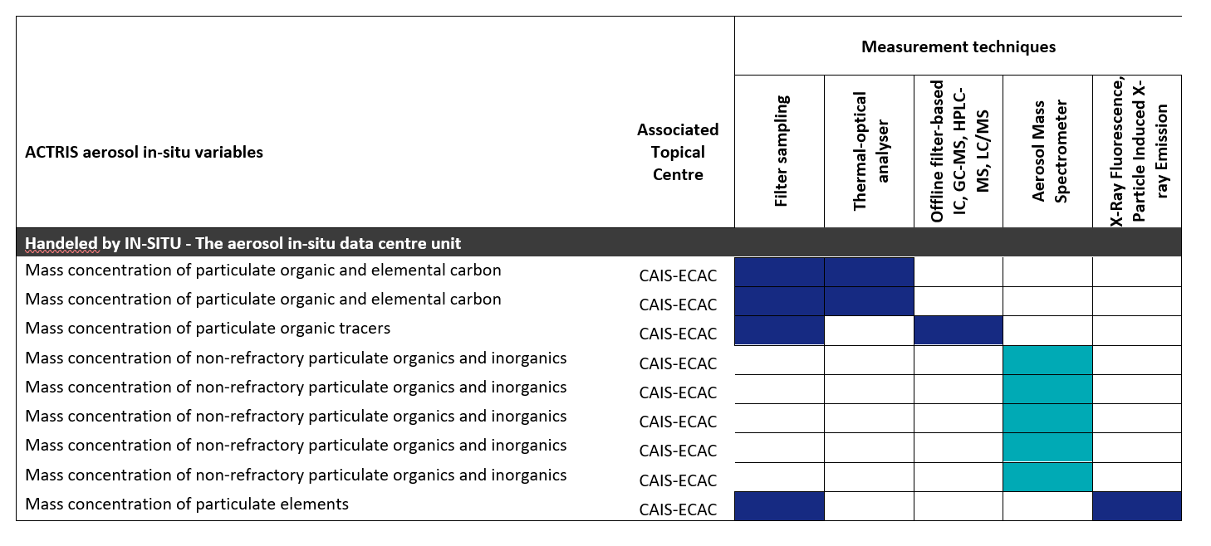
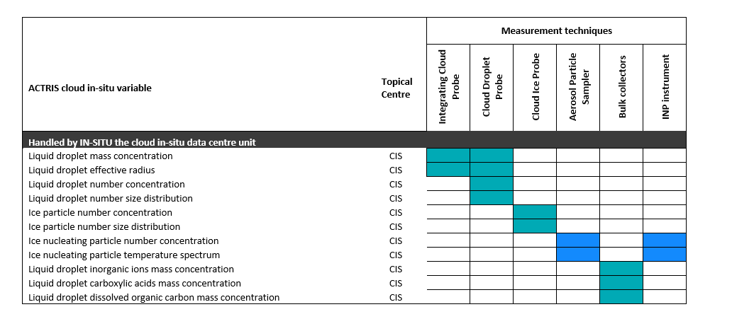
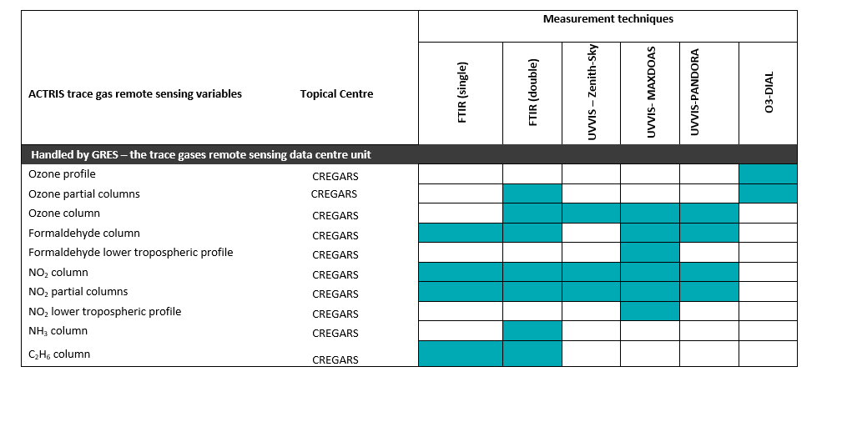
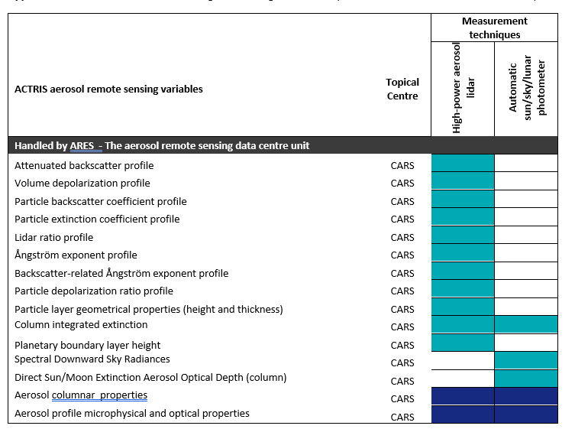
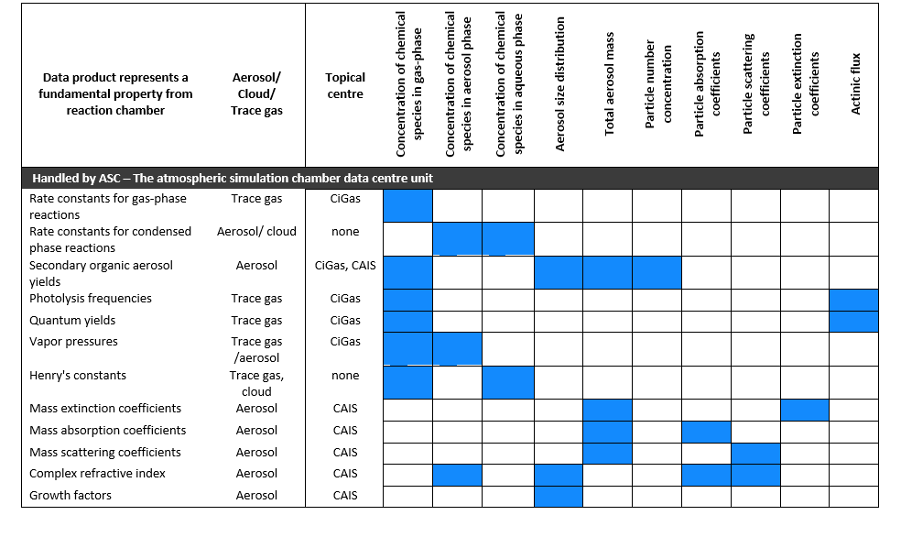
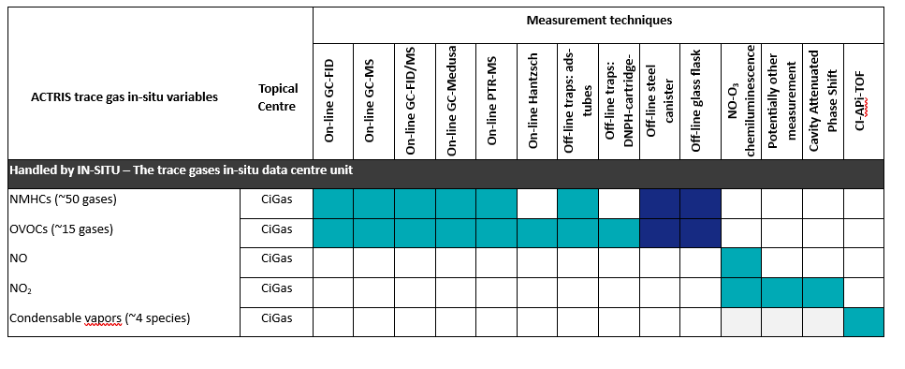
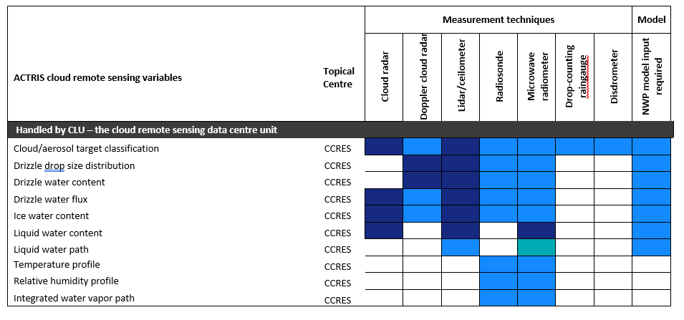
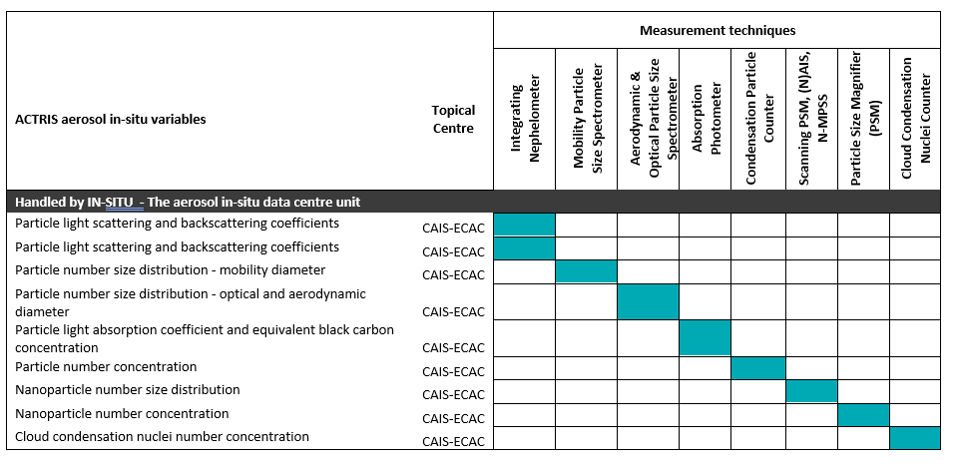
ACTRIS variables and associated methodologies
135 atmospheric variables
65 active sites
25 methodologies
time resolution ranging from seconds to 1 week.
150 atmospheric variables
ca 35 aerosol variables
65 trace gases,
20 cloud variables
58 methodologies
time resolution ranging from seconds to 1 week.
Increasing number of sites with NRT data
Laj, et al., Aerosol, Clouds and Trace Gases Research Infrastructure (ACTRIS): The European Research Infrastructure Supporting Atmospheric Science. Bull. Amer. Meteor. Soc., 105, E1098-E1136 (2024). https://doi.org/10.1175/BAMS-D-23-0064.1

Slide 7

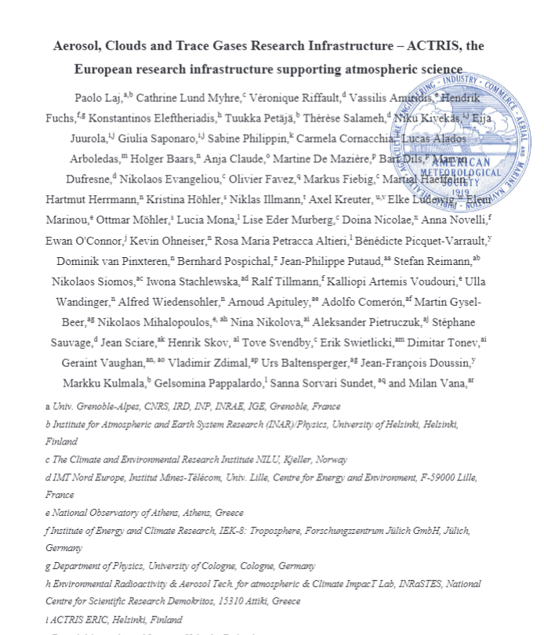
ACTRIS variables and associated methodologies
Laj, et al., Aerosol, Clouds and Trace Gases Research Infrastructure (ACTRIS): The European Research Infrastructure Supporting Atmospheric Science. Bull. Amer. Meteor. Soc., 105, E1098-E1136 (2024). https://doi.org/10.1175/BAMS-D-23-0064.1

Slide 8


ACTRIS
Data Centre
135 atmospheric variables
65 active sites
25 methodologies
time resolution ranging from seconds to 1 week.
150 atmospheric variables
ca 35 aerosol variables
65 trace gases,
20 cloud variables
58 methodologies
time resolution ranging from seconds to 1 week.
The mission of the ACTRIS Data Centre (DC) is to compile, archive and provide access to well documented and traceable ACTRIS measurement data and data products, including digital tools for data quality control, analysis, visualization, and research.
As a tool for science, the highest priorities for the ACTRIS DC are to maintain and increase the availability of ACTRIS data and data products relevant to climate and air quality research for all interested users.
Increasing number of sites with NRT data

Slide 9


ACTRIS Data Centre
ACTRIS Data Discovery, Virtual Access and Services
(DVAS)
In situ Data
Centre Unit
(In-Situ)
Aerosol remote sensing
Data Centre Unit
(ARES)
Cloud remote sensing
Data Centre Unit
(CLU)
Trace gas remote sensing
Data Centre Unit
(GRES)
Atmospheric
simulation chamber Data Centre Unit
(ASC)
National Facilities
Providing standardized and harmonised data. The extent of data contributions varies from each National Facility
Topical Centres
Ensuring compliance with ACTRIS requirements on data quality, methods, …

Slide 10
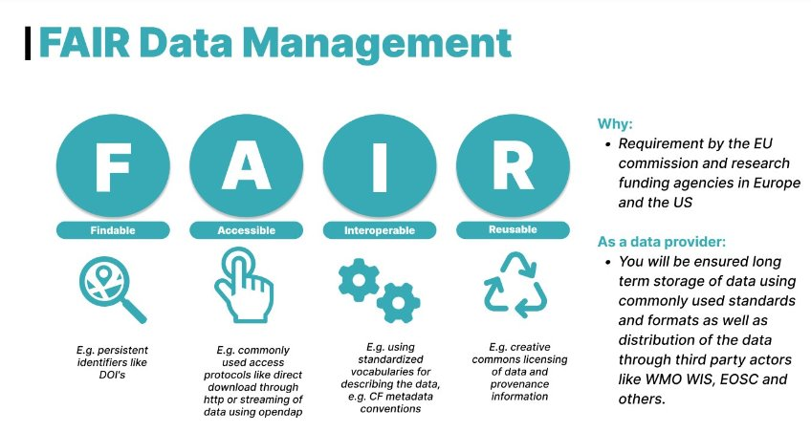
FAIR – Findable, Accessible, Interoperable, Reusable

Slide 11

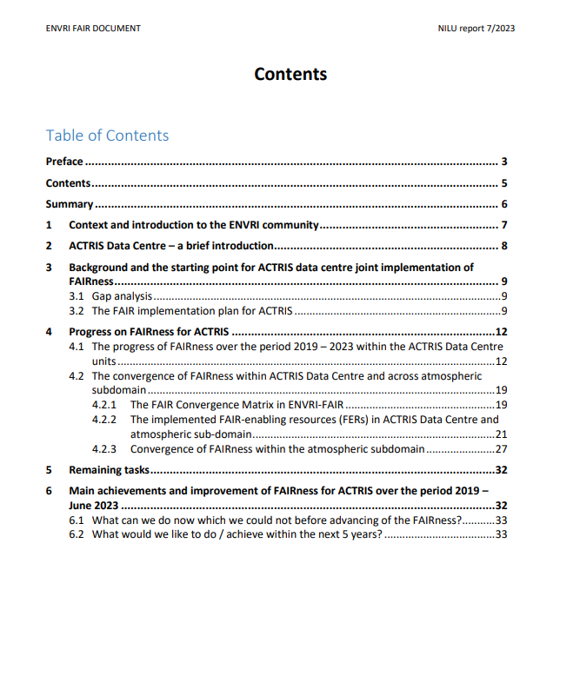
Report on FAIRness of ACTRIS Data Center
Implementation over 2019-2023
Document the achievements and convergence of FAIRness within ACTRIS Data Centre and across atmospheric subdomain (ACTRIS, ICOS-atm, SIOS-atm, IAGOS, EISCAT-3d)
Explains
FAIR Implementation Profile (FIP)
FAIR-enabling resources (FERs) in ACTRIS Data Centre and full atmospheric sub-domain
FAIRness gap analysis and assessments
Convergence of FAIRness within the atmospheric subdomain and common solutions
Implementation as part of ENVRI-FAIR and ACTRIS-Norway
Lund Myhre et al, 2024 NILU Brage: The FAIRness of ACTRIS Data Centre (unit.no)

Slide 12
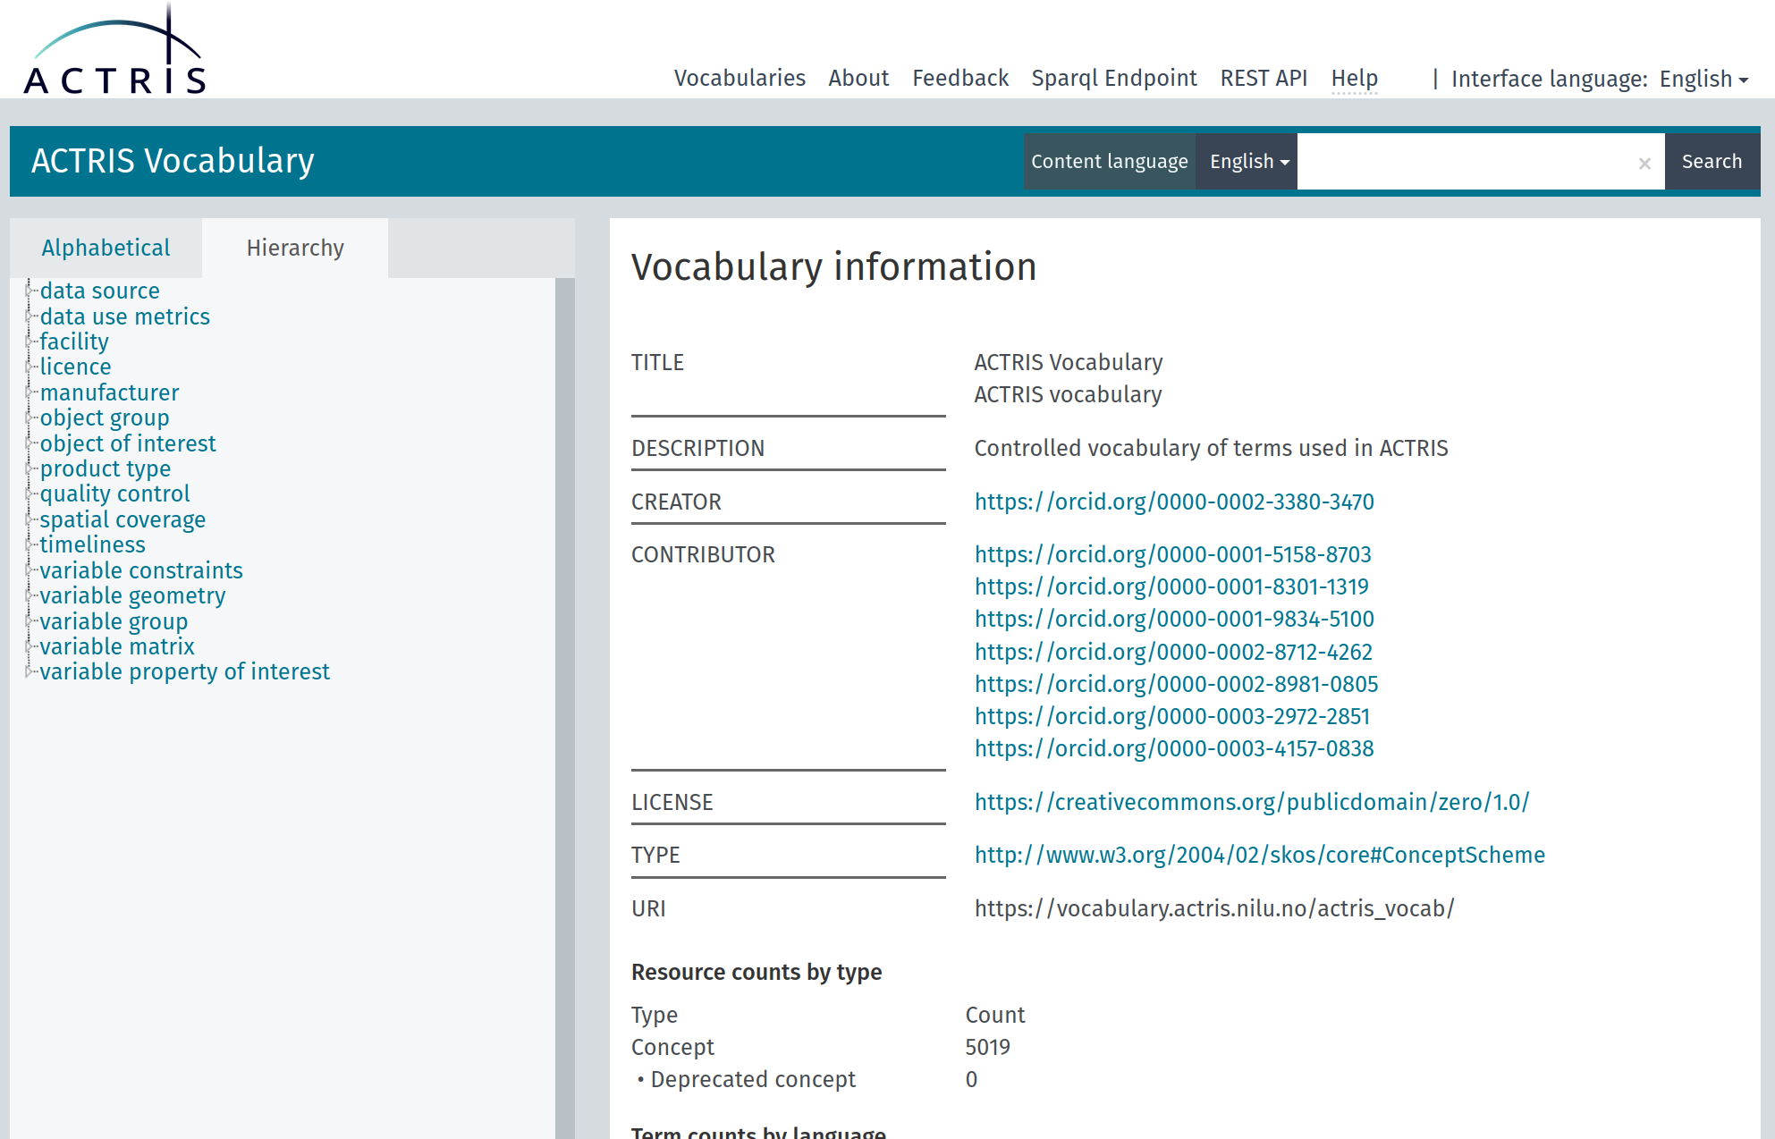
ACTRIS Vocabulary
Needed improved vocabulary to be able to talk across the units and with user communites
Avoid misunderstandings in communication, data exchange, …
Skosmos: ACTRIS Vocabulary (nilu.no)

Slide 13
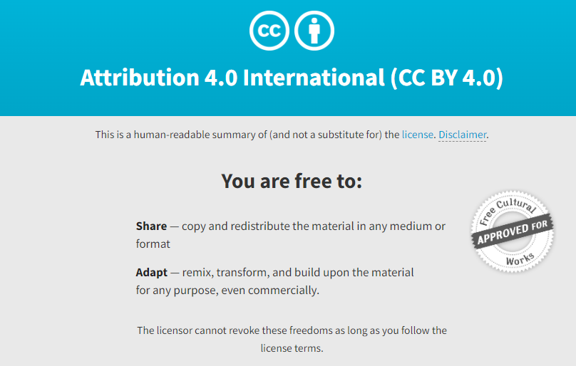
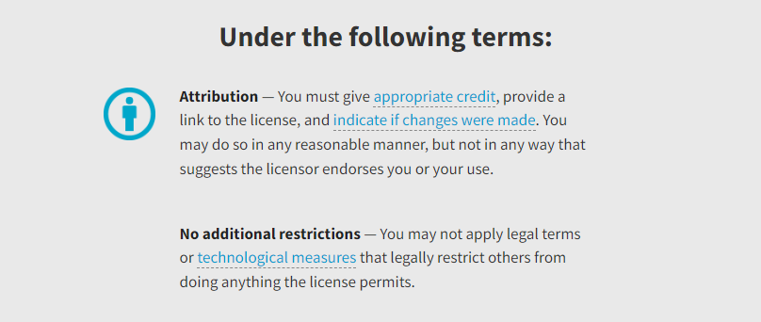
ACTRIS Data and Data Policy
ACTRIS Data are data from observational National Facilities and exploratory National Facilities complying with the procedures established within ACTRIS.
ACTRIS Data Policy: “As open as possible, as closed as necessary”
Access to ACTRIS data is free-of-charge and ACTRIS data should be fully available for others to use with as few restrictions as possible.
License: It is intended to use Creative Commons license CC BY 4.0 for ACTRIS data and metadata and AGPL for software and digital tools developed by Topic Centre and/or Data Centre.
ACTRIS Data are data from observational National Facilities and exploratory National Facilities complying with the procedures established within ACTRIS.
ACTRIS Data Policy: “As open as possible, as closed as necessary”
Access to ACTRIS data is free-of-charge and ACTRIS data should be fully available for others to use with as few restrictions as possible.
License: It is intended to use Creative Commons license CC BY 4.0 for ACTRIS data and metadata and AGPL for software and digital tools developed by Topic Centre and/or Data Centre.
ACTRIS Data are data from observational National Facilities and exploratory National Facilities complying with the procedures established within ACTRIS.
ACTRIS Data Policy: “As open as possible, as closed as necessary”
Access to ACTRIS data is free-of-charge and ACTRIS data should be fully available for others to use with as few restrictions as possible.
License: It is intended to use Creative Commons license CC BY 4.0 for ACTRIS data and metadata and AGPL for software and digital tools developed by Topic Centre and/or Data Centre.

Slide 14
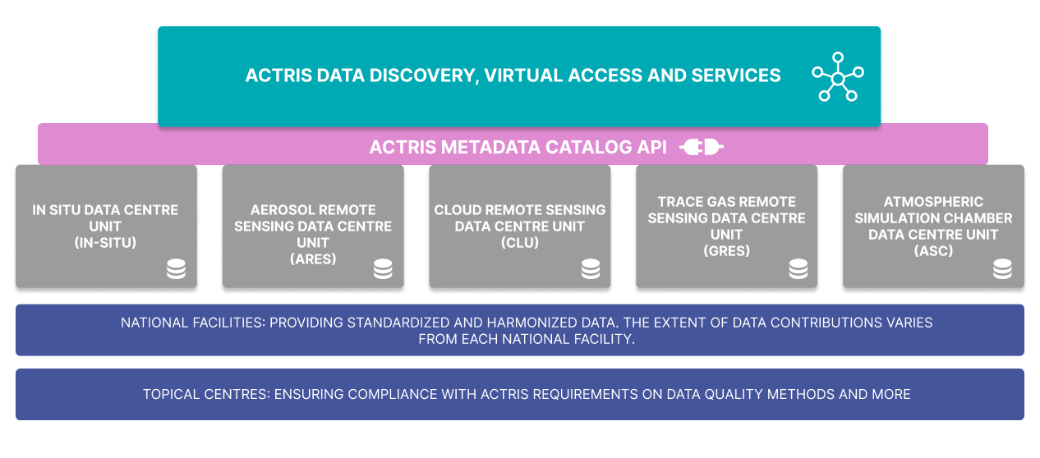
Architecture of ACTRIS Data Centre

Slide 15
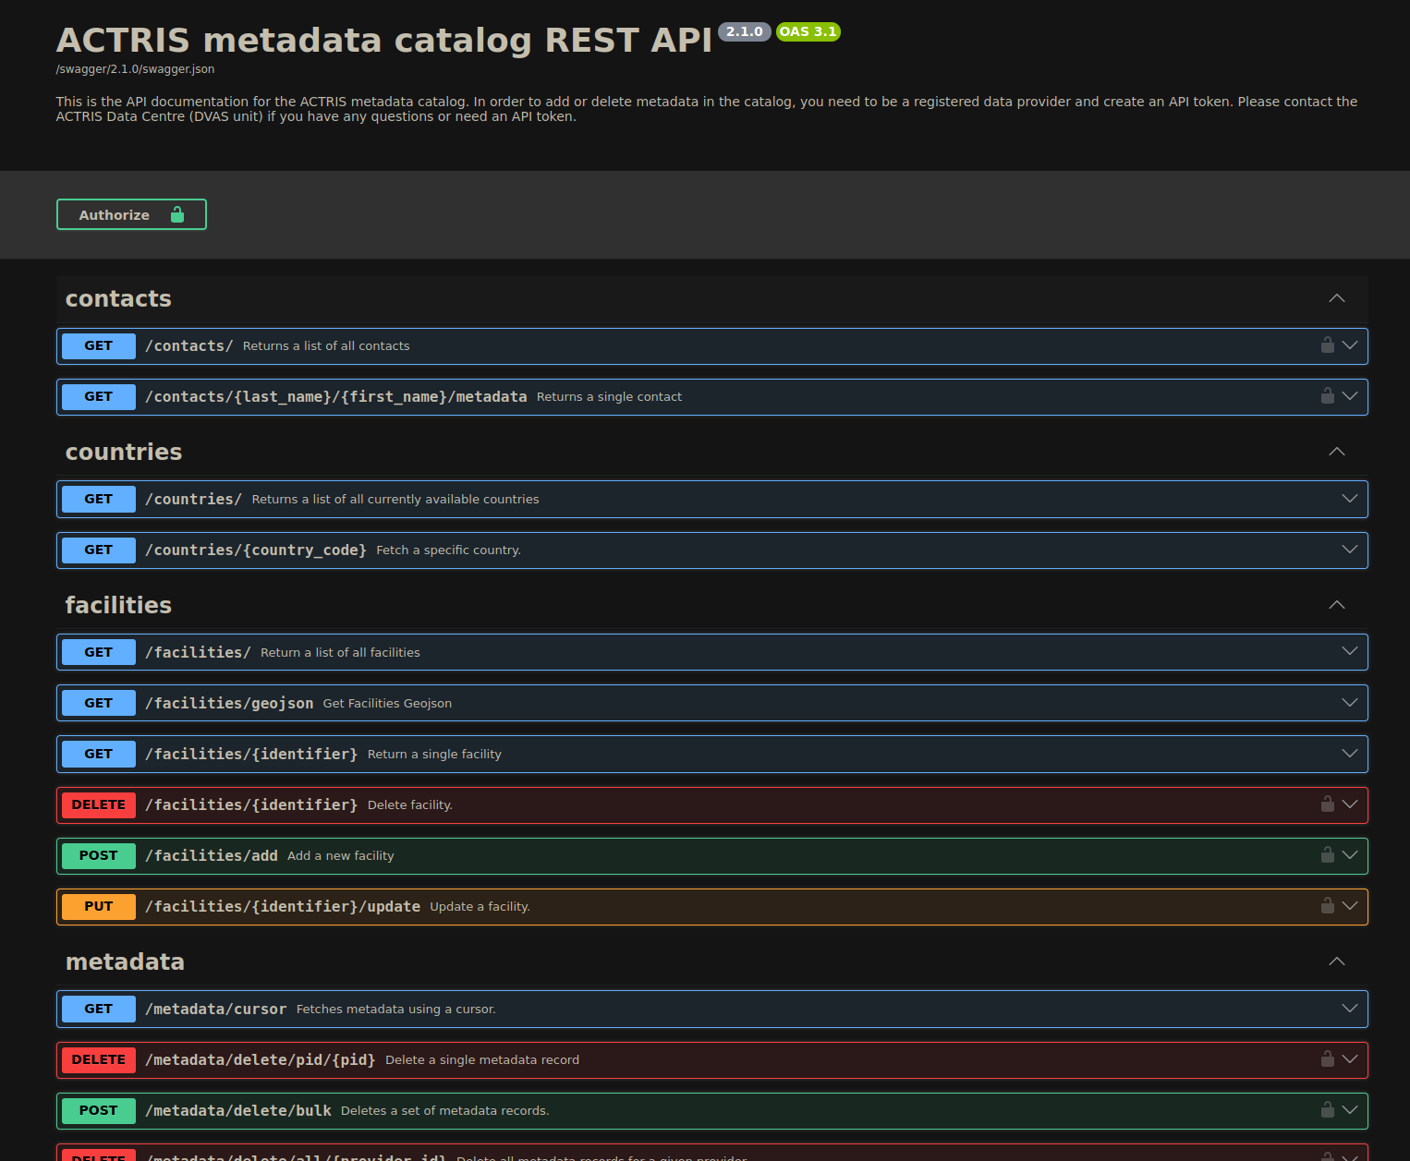



ACTRIS metadata catalog REST API
https://prod-actris-md2.nilu.no/index.html
Data stored in netCDF file format
All data downloadable with HTTPS protocol
Large amount of data available with streaming through OPeNDAP protocol

Slide 16
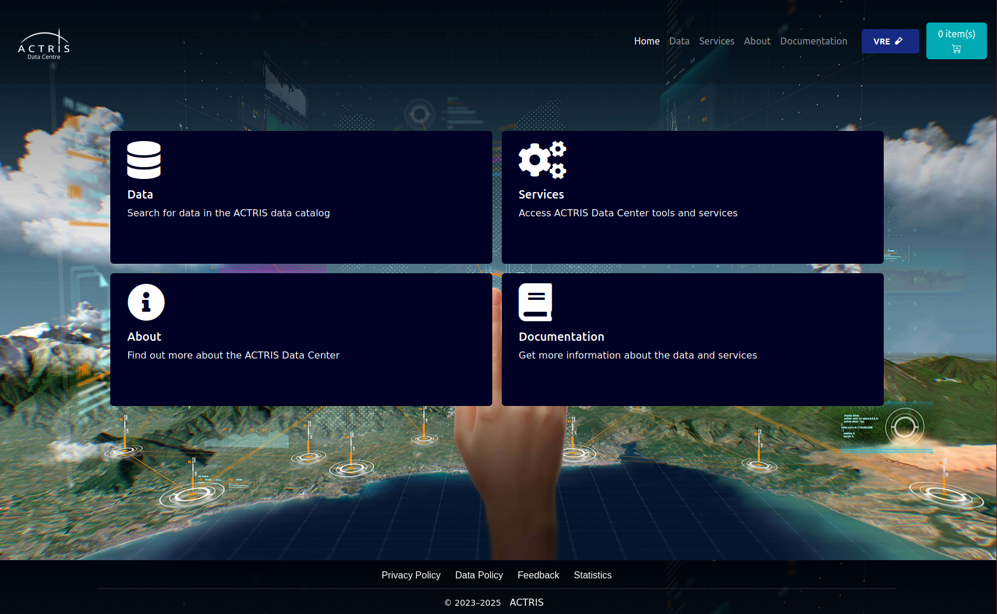
ACTRIS Data Portal - DEMO
https://data.actris.eu/

Slide 17
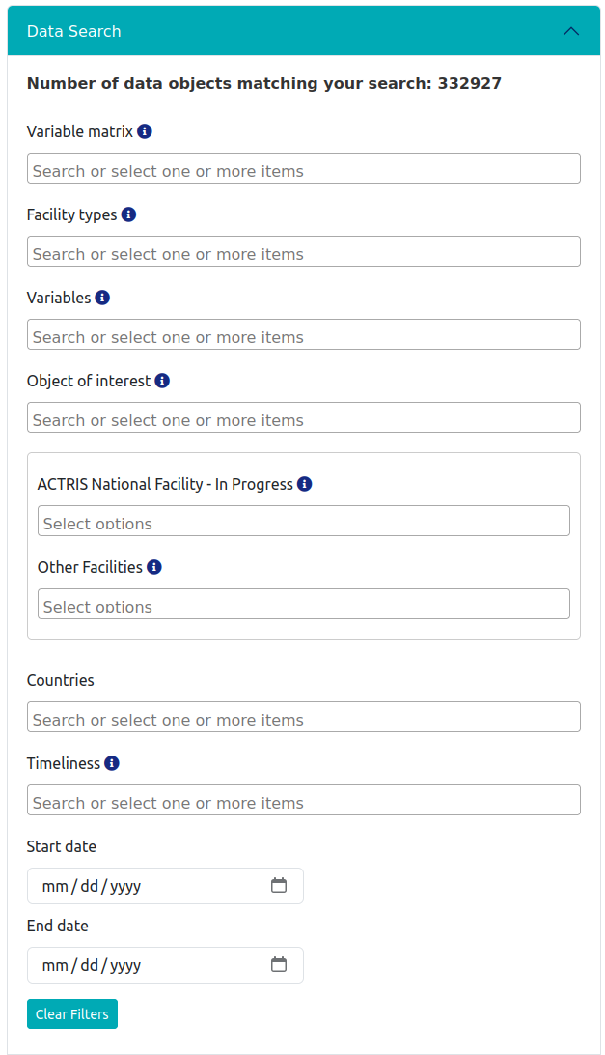
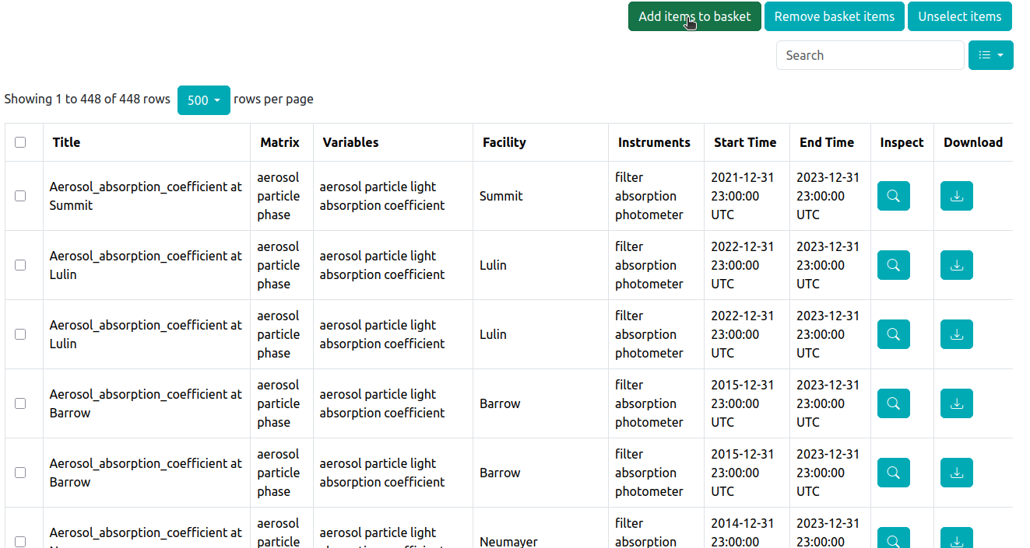
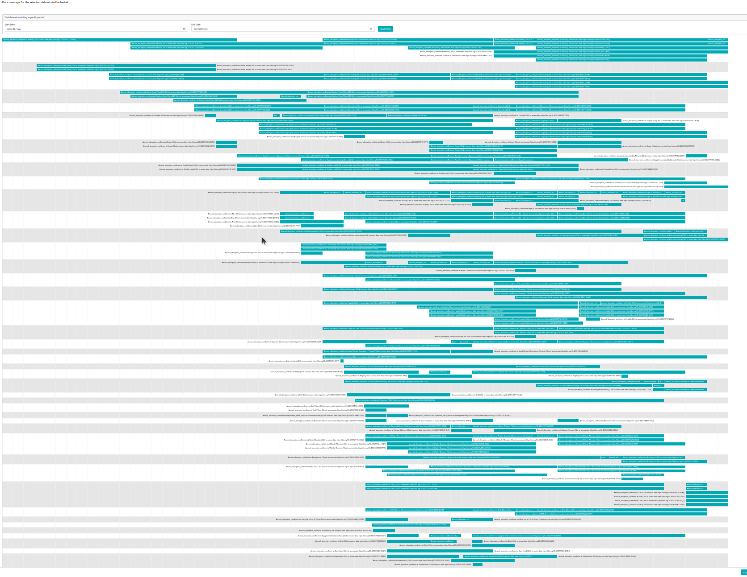
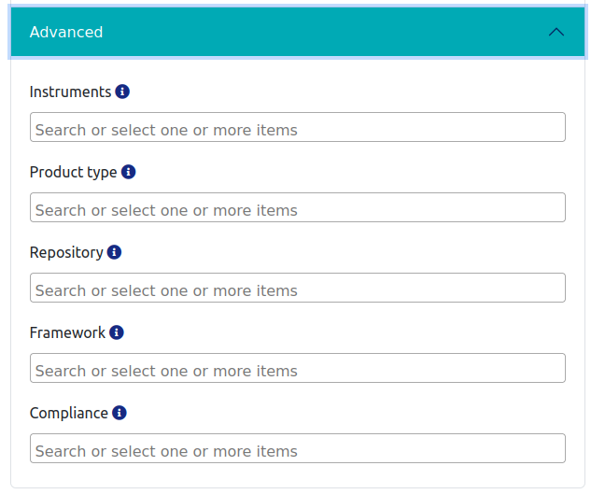
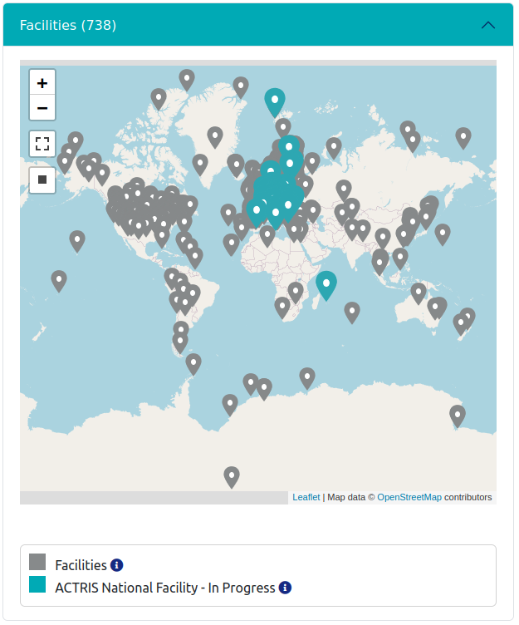
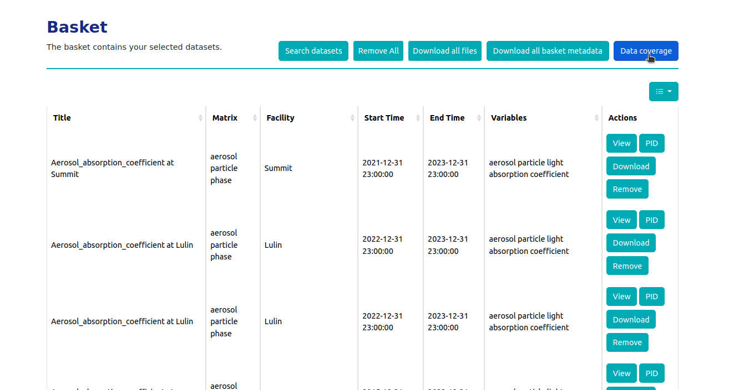
Data portal – some quick functionalities
https://data.actris.eu/

Slide 18
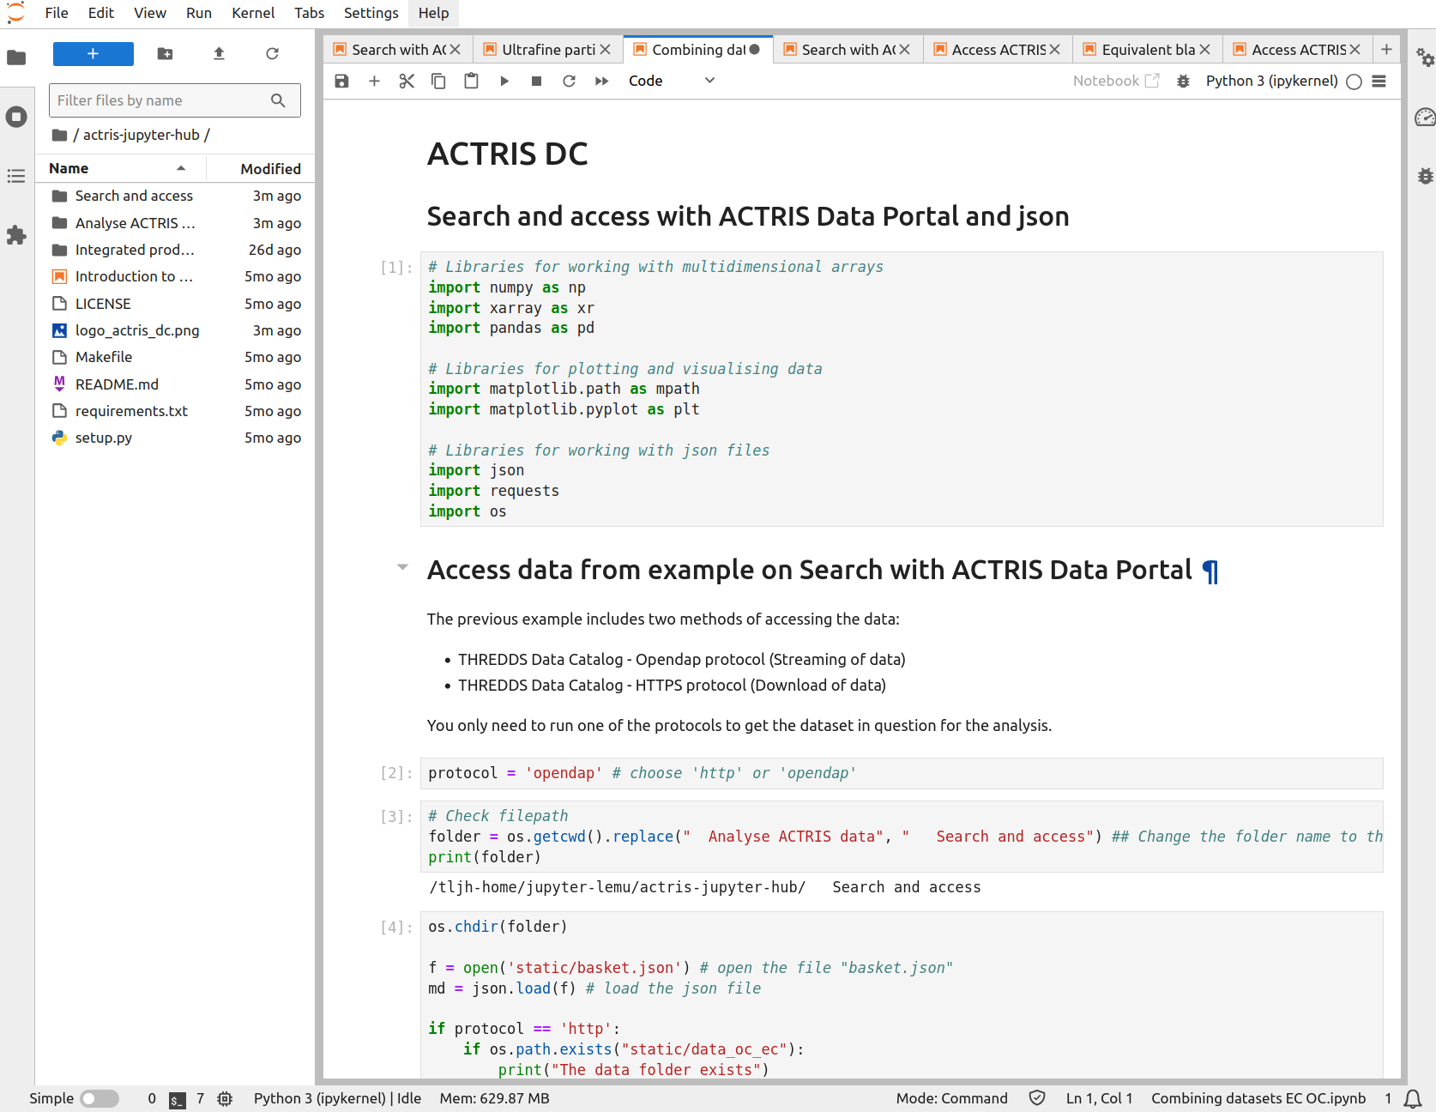
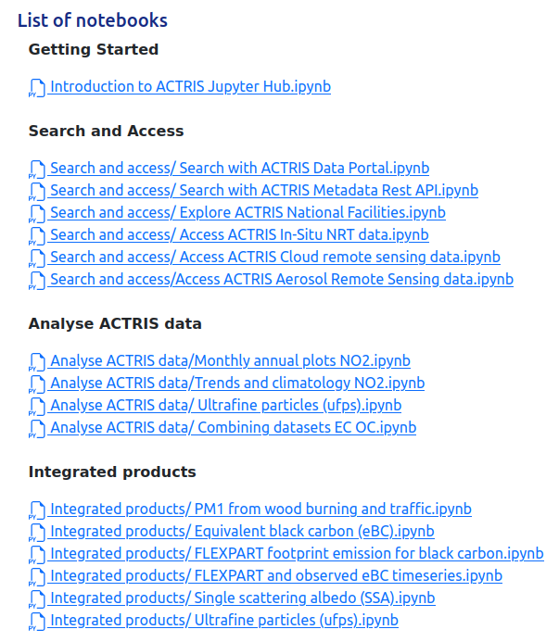
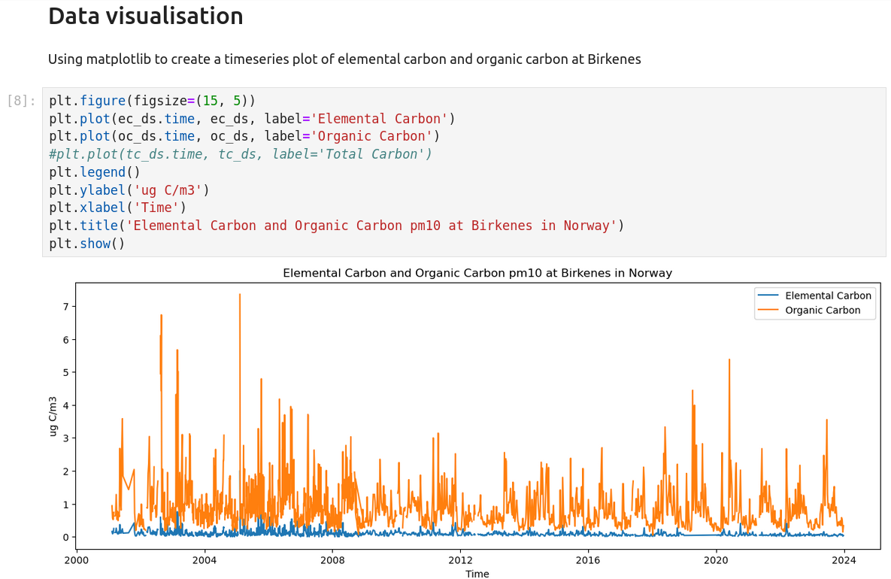
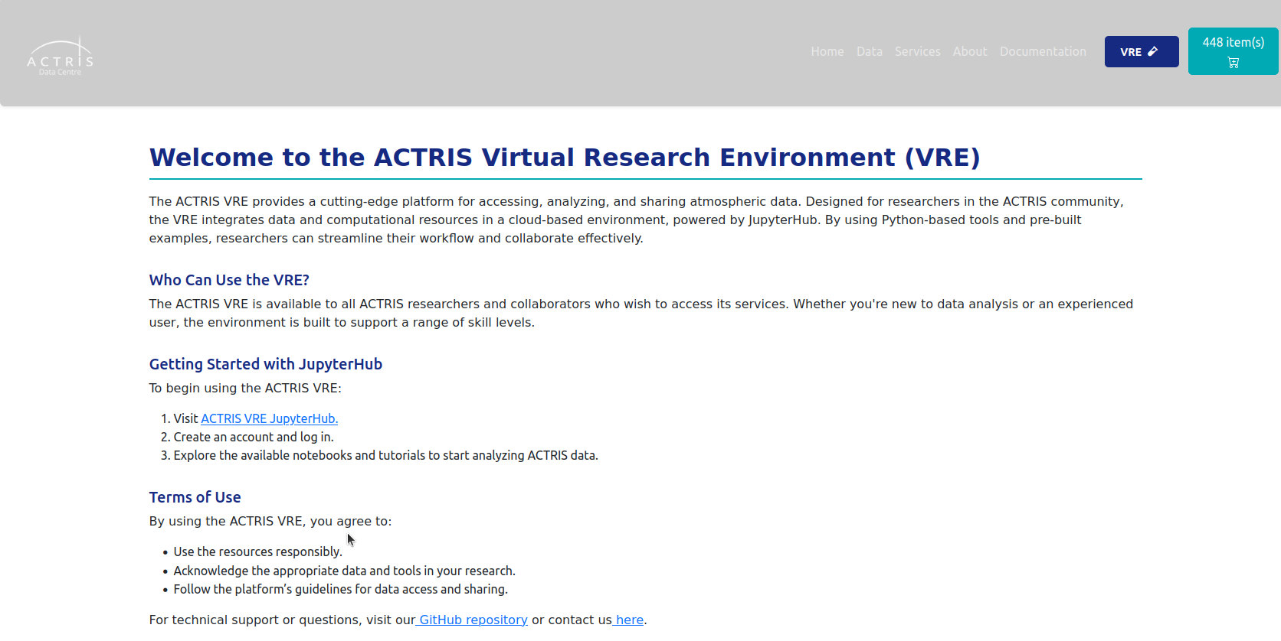
DEMO: Virtual Research Environment – VRE
https://data.actris.eu/vre

