Slide 1
NILU Atmospheric Data Training for Next-Gen Scientists & Managers
Lise Eder Murberg and NILU team

Slide 2


Topics
Data Access
EBAS Data Portal
ACTRIS Data Portal
Machine-2-Machine (M-2-M) Access with ACTRIS Metadata API and Thredds
Services and tools incl. NRT and model products
ACTRIS Virtual Research Environment
Short DEMO

Slide 3
Data Access
The vast majority of EBAS data is freely and openly accessible worldwide, with access policies defined by the dataset framework; EBAS supports both open and restricted data, including embargo periods.
All open data are distributed under the CC BY 4.0 licence.
Accessible through:
Human interfaces -> Data Portals
M-2-M interfaces -> API, streaming
EBAS Data Formats:
NasaAmes1001
NetCDF

Slide 4
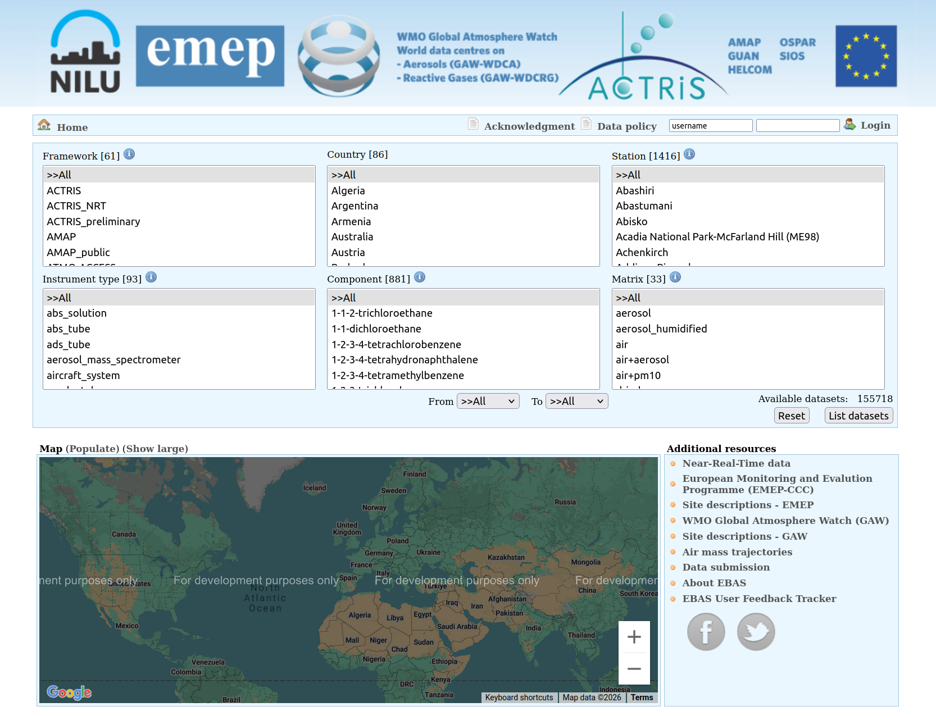
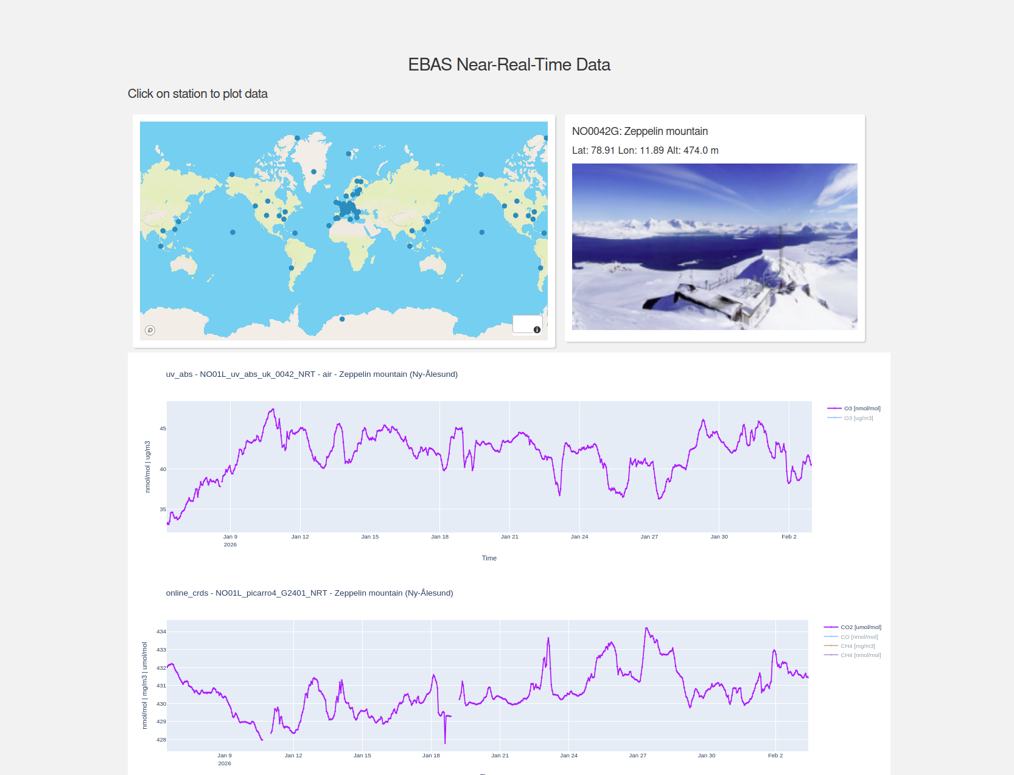
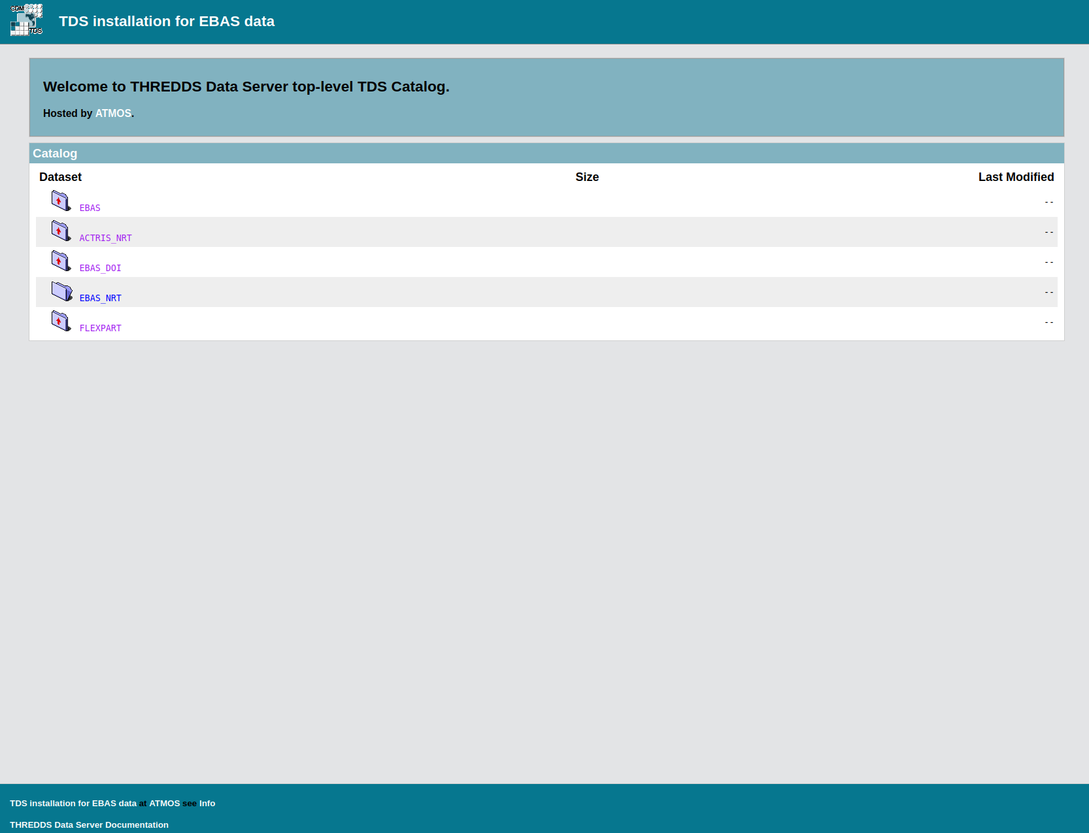
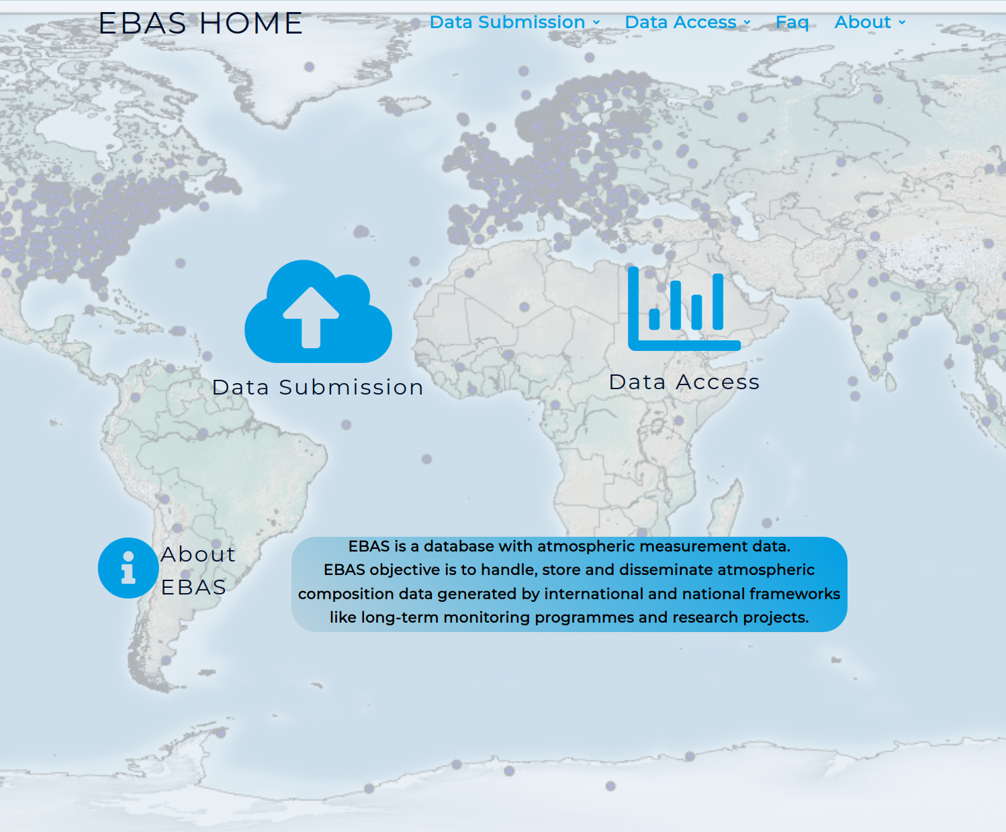
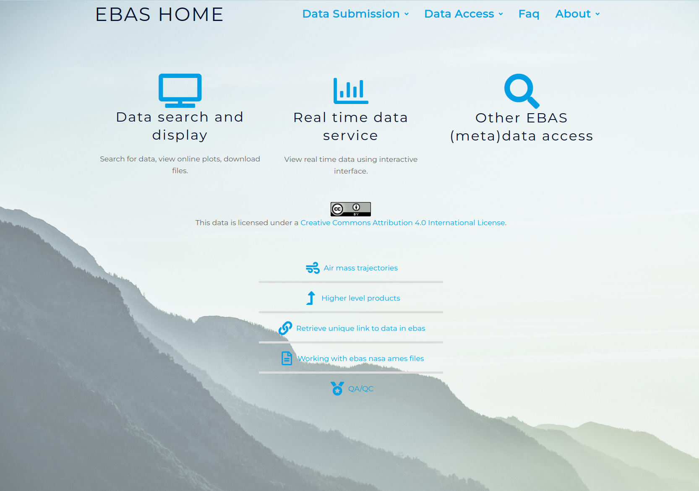
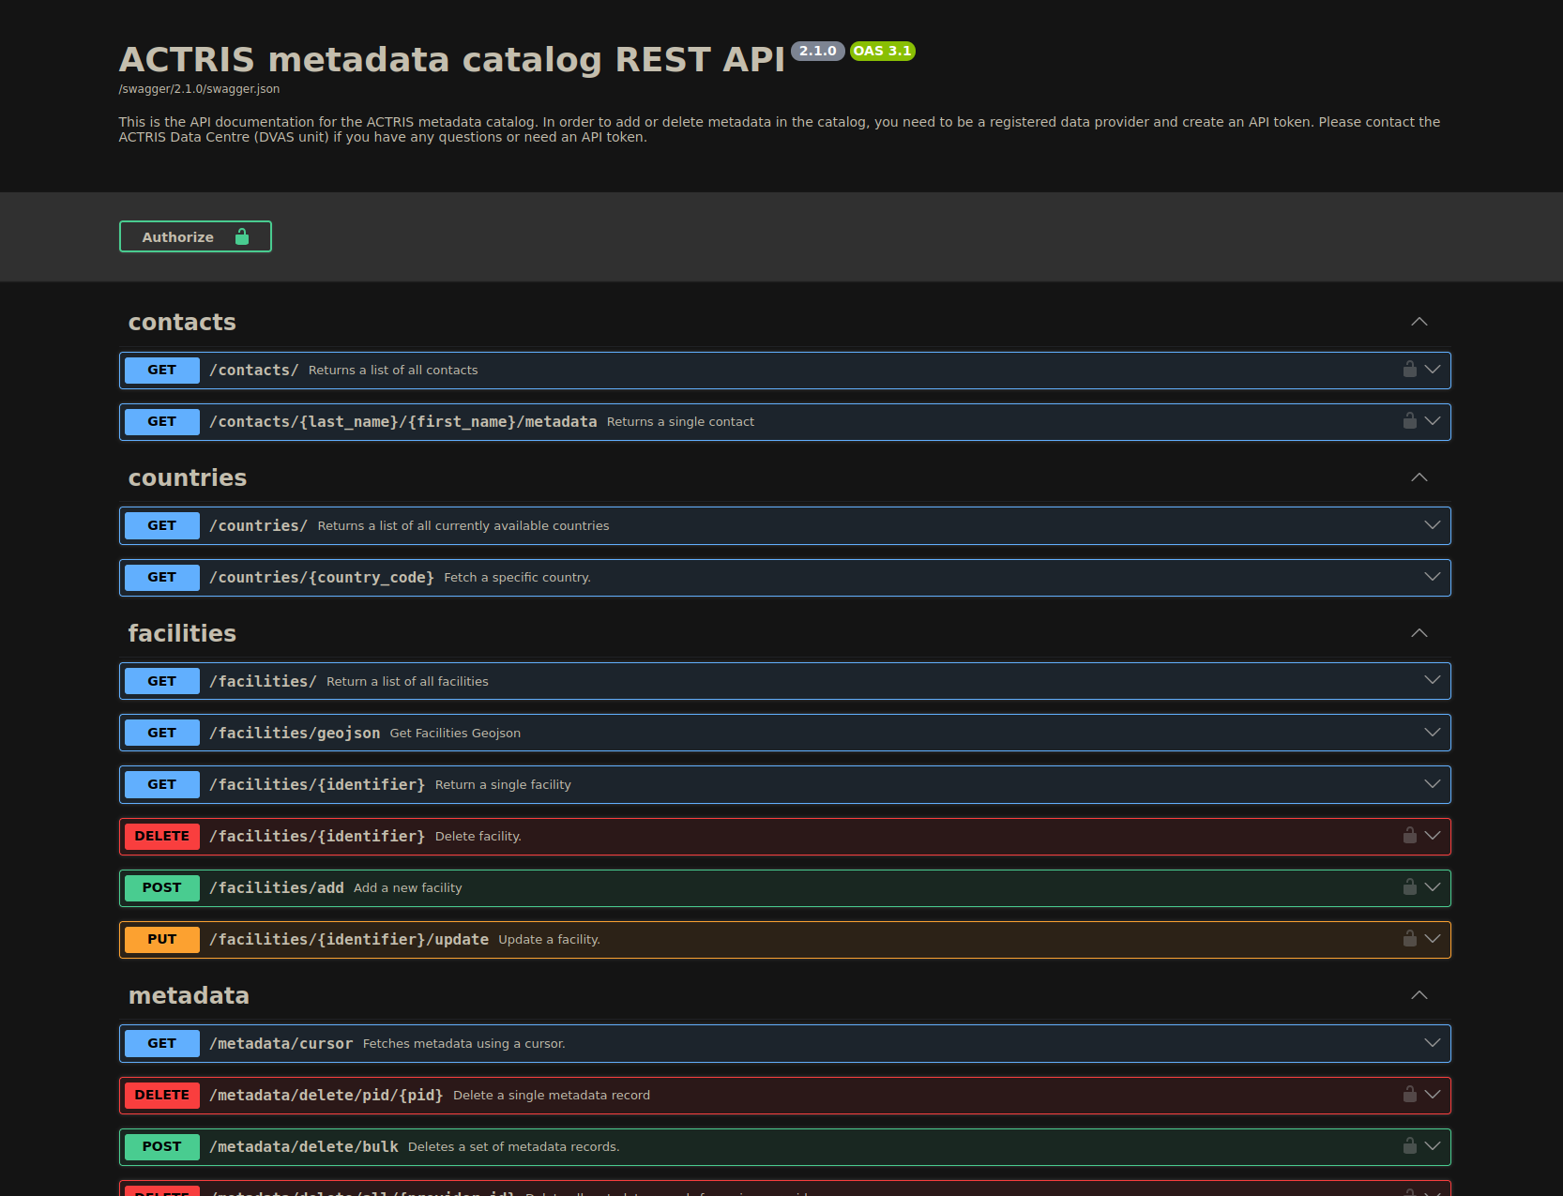
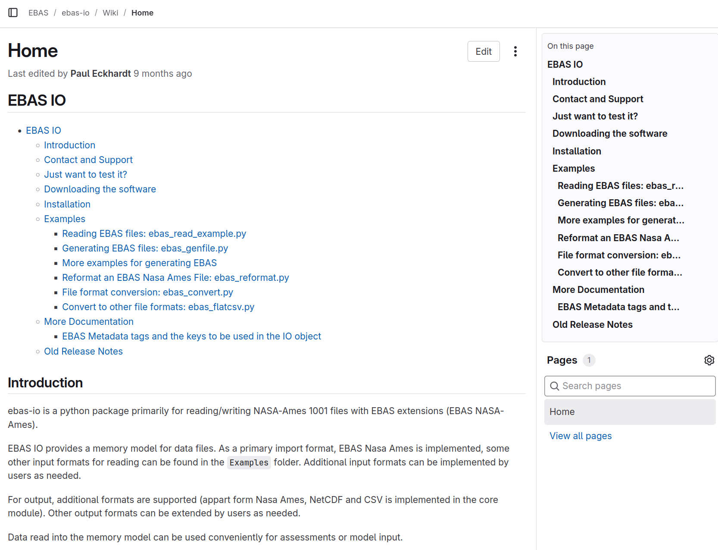
EBAS Home ebas.nilu.no

Slide 5

EBAS Data Portal
Access to data from:
61 frameworks
86 countries
1416 stations
93 instrument types
881 components
https://ebas-data.nilu.no/
EBAS web-interface functions:
Search datasets by criteria: Framework, country, station, matrix, instrument type, component.
Manage access restricted data.
Links to other resources, e.g. trajectory calculations for station
Plot, browse, compare datasets
Download data
Notes:
EBAS web-interface functions:
Search datasets by criteria: Framework, country, station, matrix, instrument type, component.
Visualise distribution of stations on map.
Manage access restricted data.
Links to other resources, e.g. trajectory calculations for station
Plot, browse, compare datasets
Download data.

Slide 6
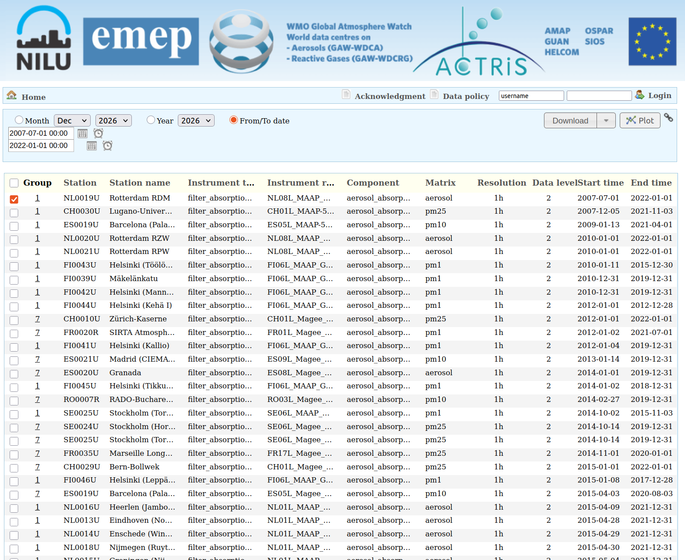
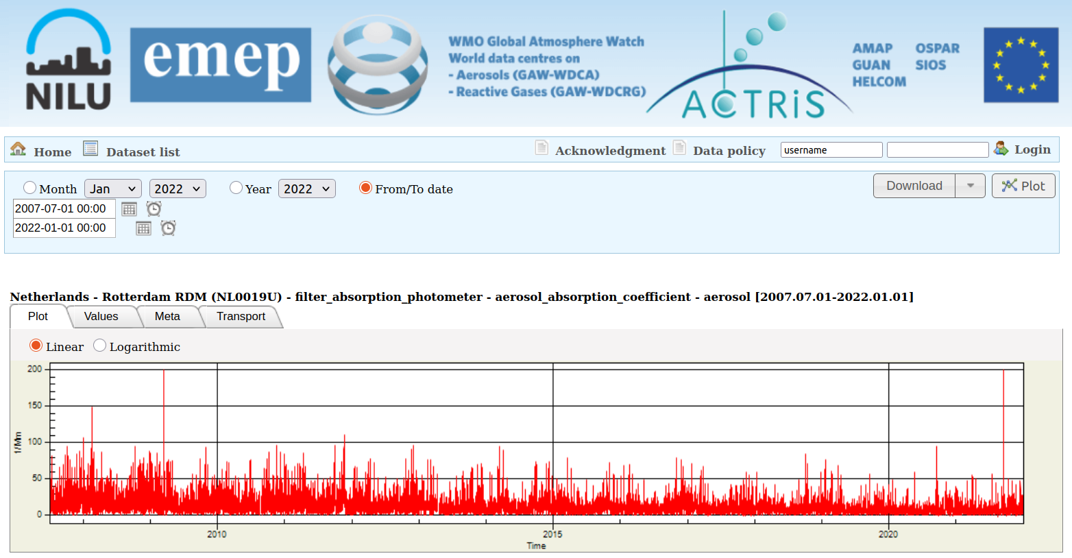
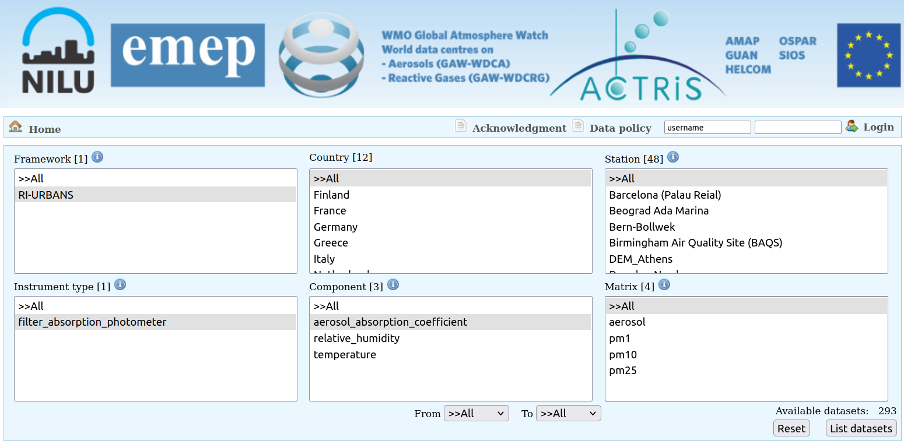
EBAS Data Portal
https://ebas-data.nilu.no/
Notes:
Search result page :
Lists datsets that meet search criteria set on home page.
Datasets that are present, but access restricted, are displayed in grey.
Time period for plotting or download to be selected on top (select appropriate radio button!).
Plot page for selected datasets:
Screen, evaluate, compare between instruments, compare between stations, …
Download datasets (data is automatcally grouped by instrument).

Slide 7
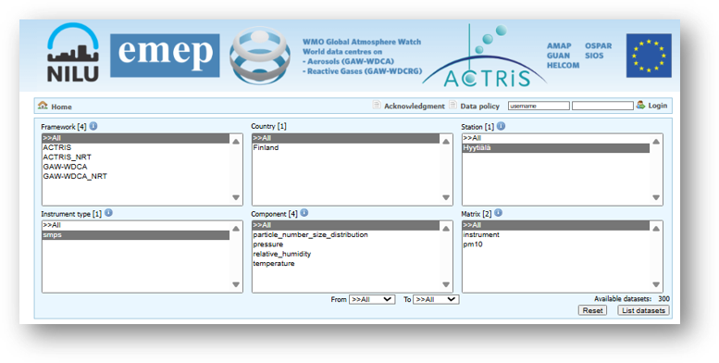
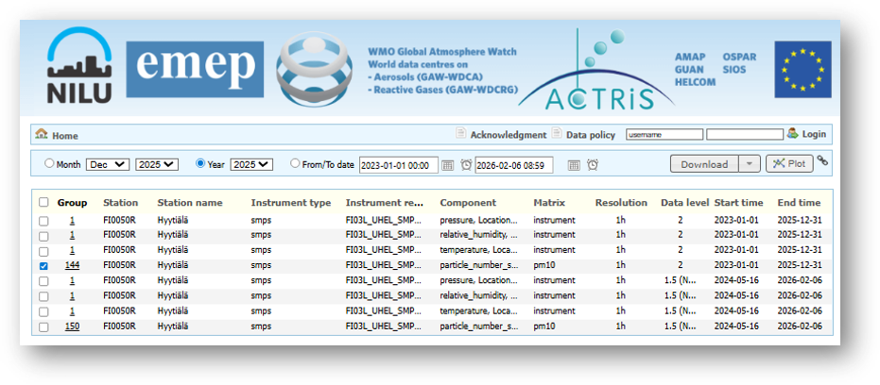
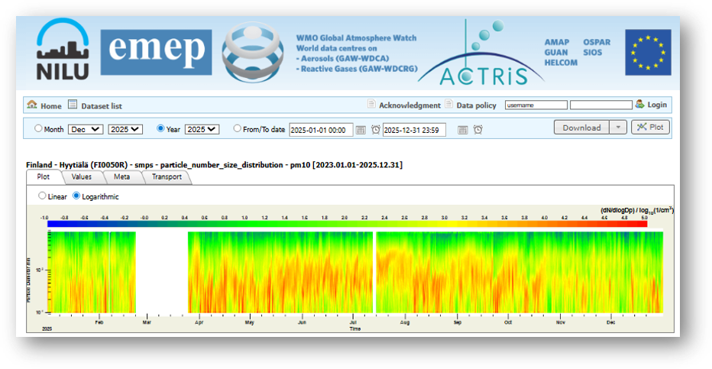
EBAS Data Portal
https://ebas-data.nilu.no/

Slide 8
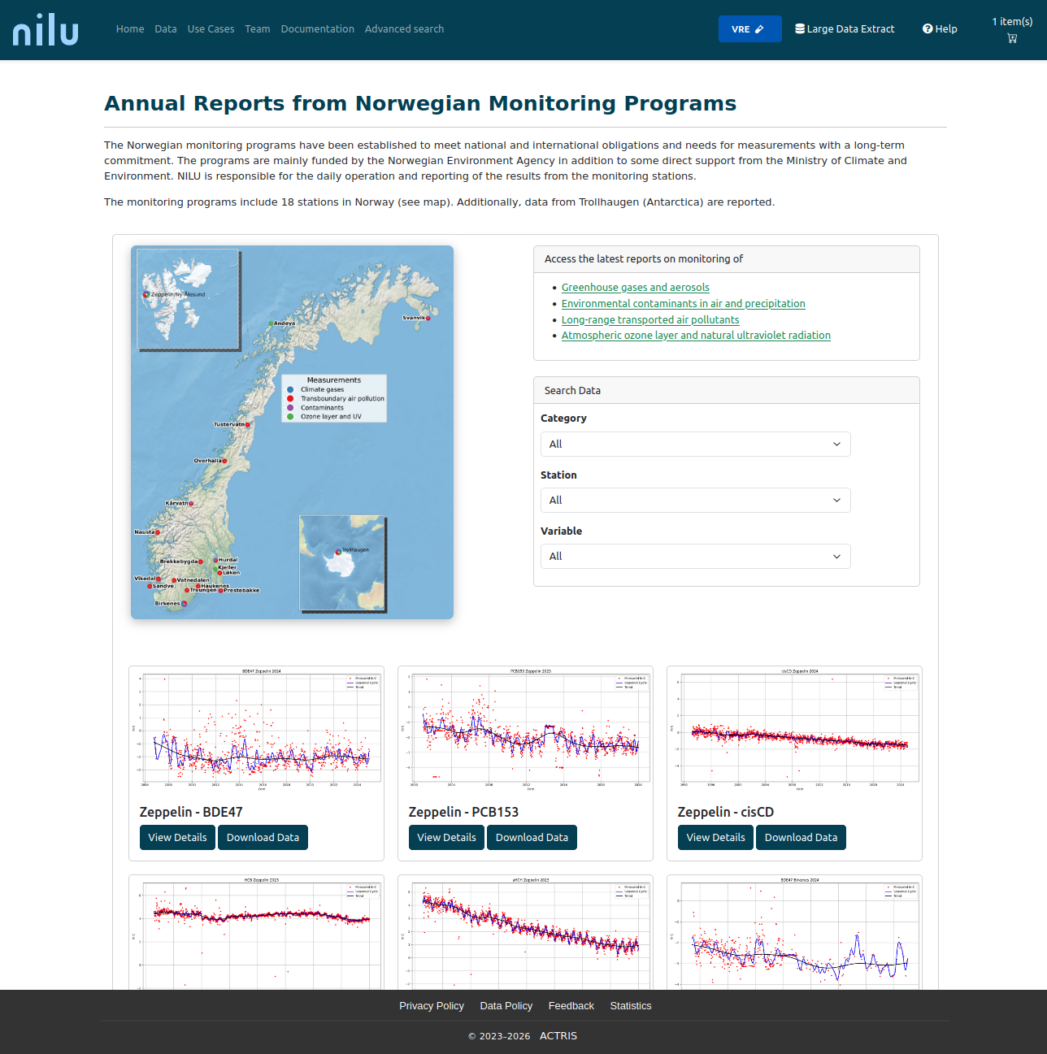
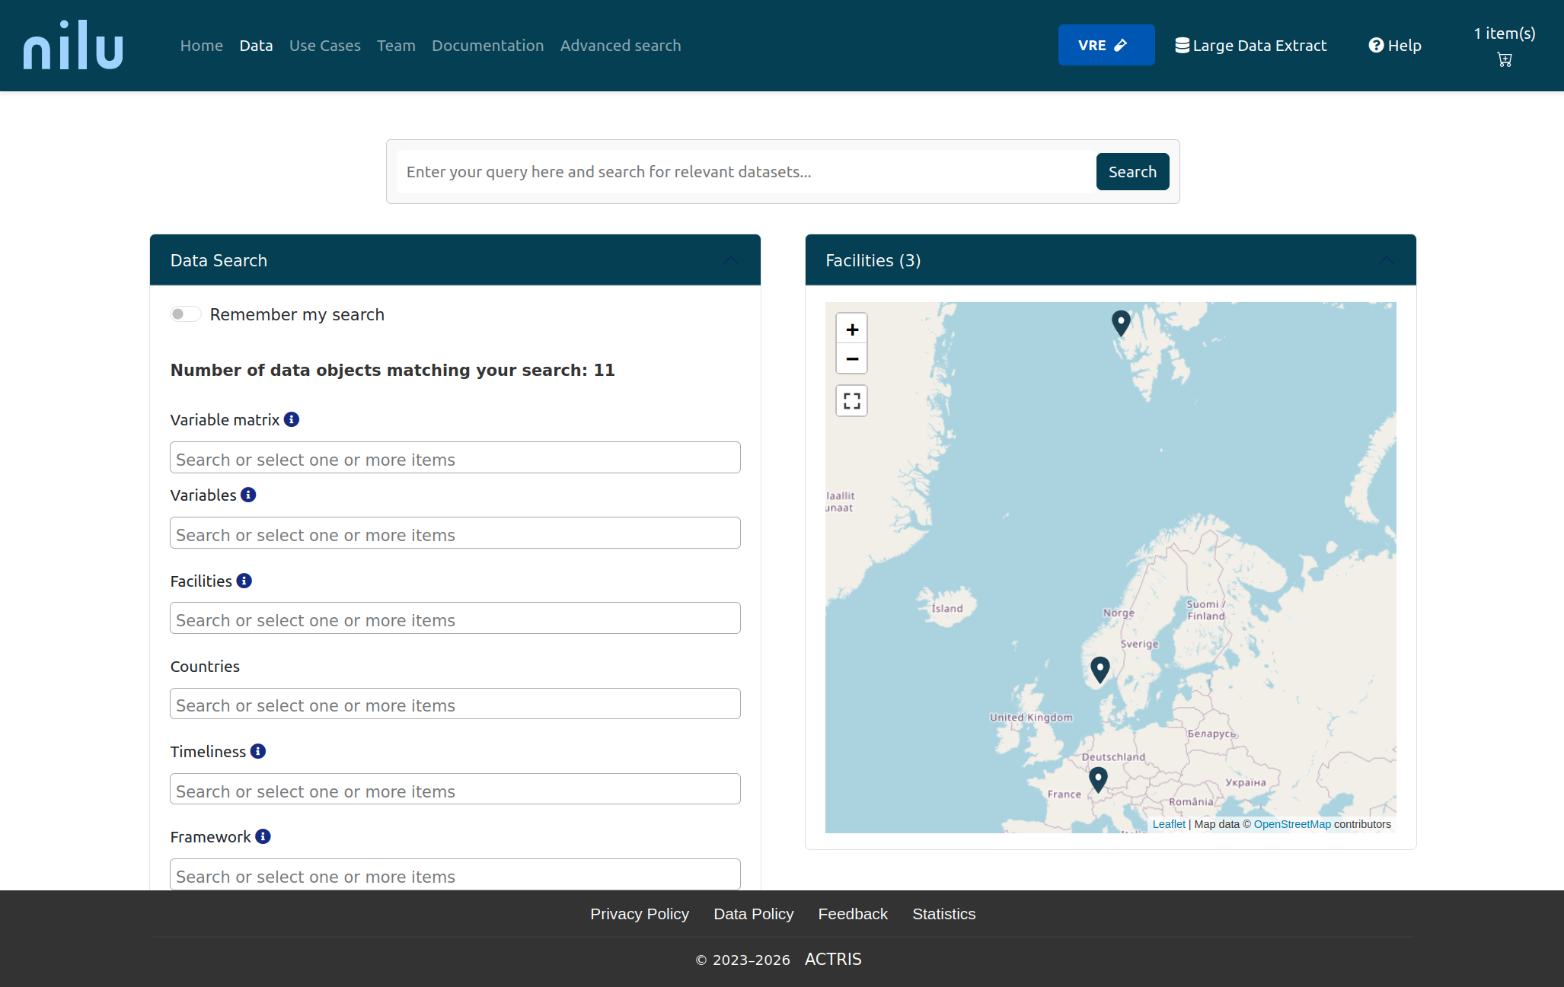
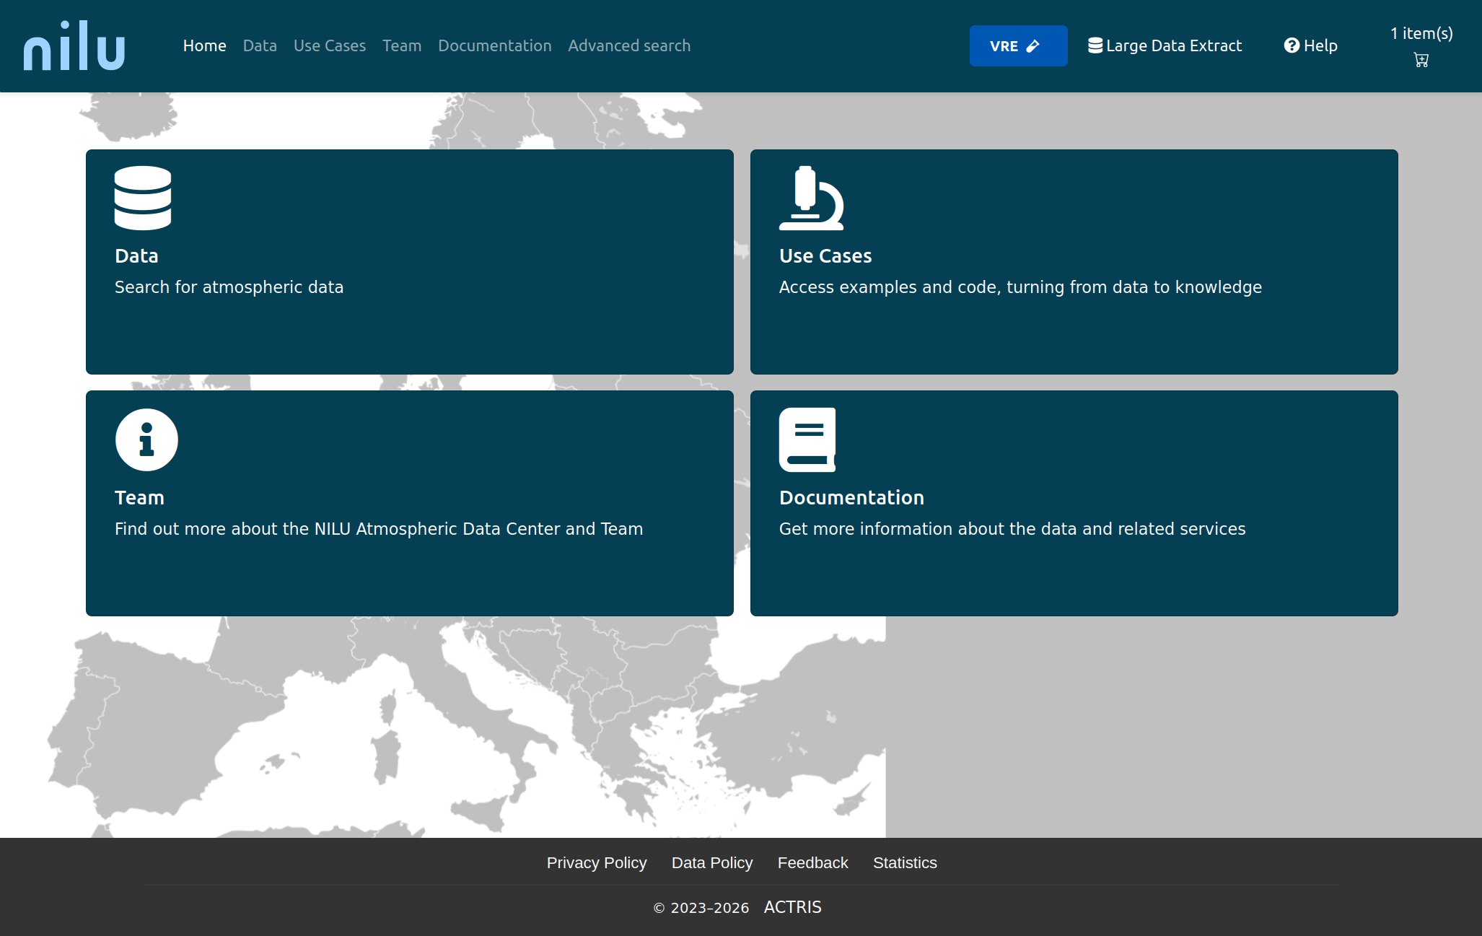
New EBAS Data Portal
Launch in autumn/winter 2026

Slide 9
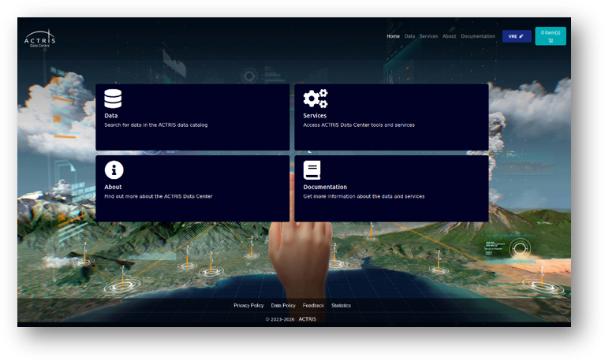
ACTRIS Data Portal
Access to data:
Aerosol, trace gas & clouds
Remote sensing and in-situ
Simulation chambers
https://data.actris.eu/
ACTRIS Data Portal functions:
Search datasets by criteria: Matrix, Facility type, Variables, Object of Interest, ACTRIS National Facility, Other facilities, Timeliness, Start time, End time.
Advanced search by: Instruments, Product type, Repository, Framework, Compliance.
Basket function and coverage plots
Access to ACTRIS related services such as: NRT, Quicklooks, APIs, Visualisation services, Model products etc.
Download data

Slide 10
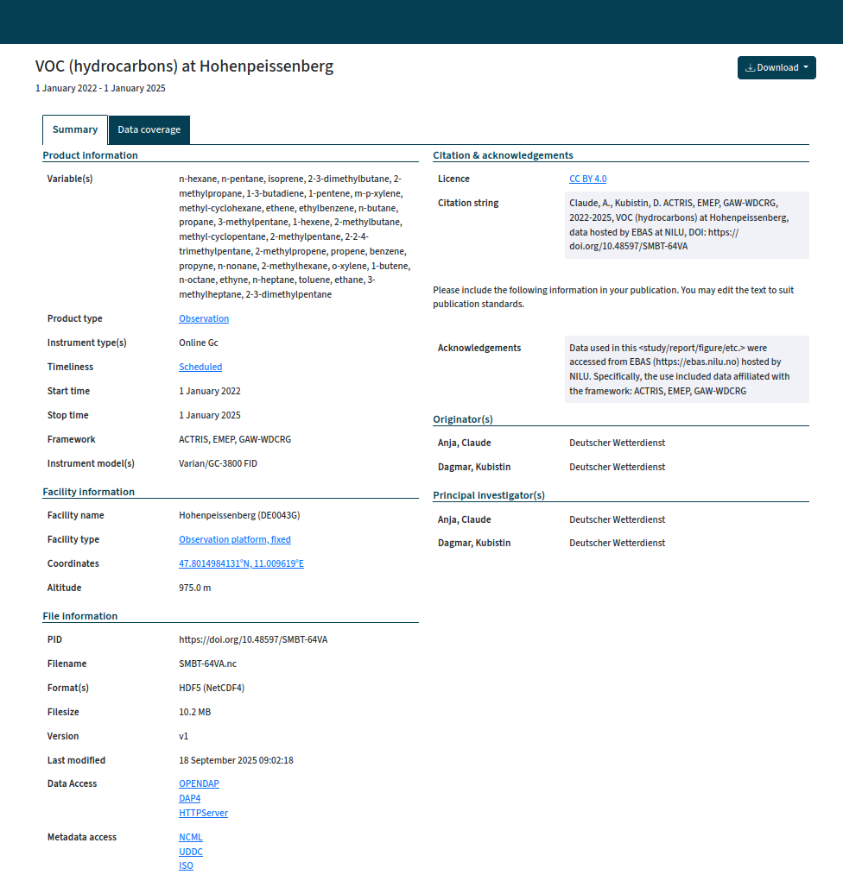
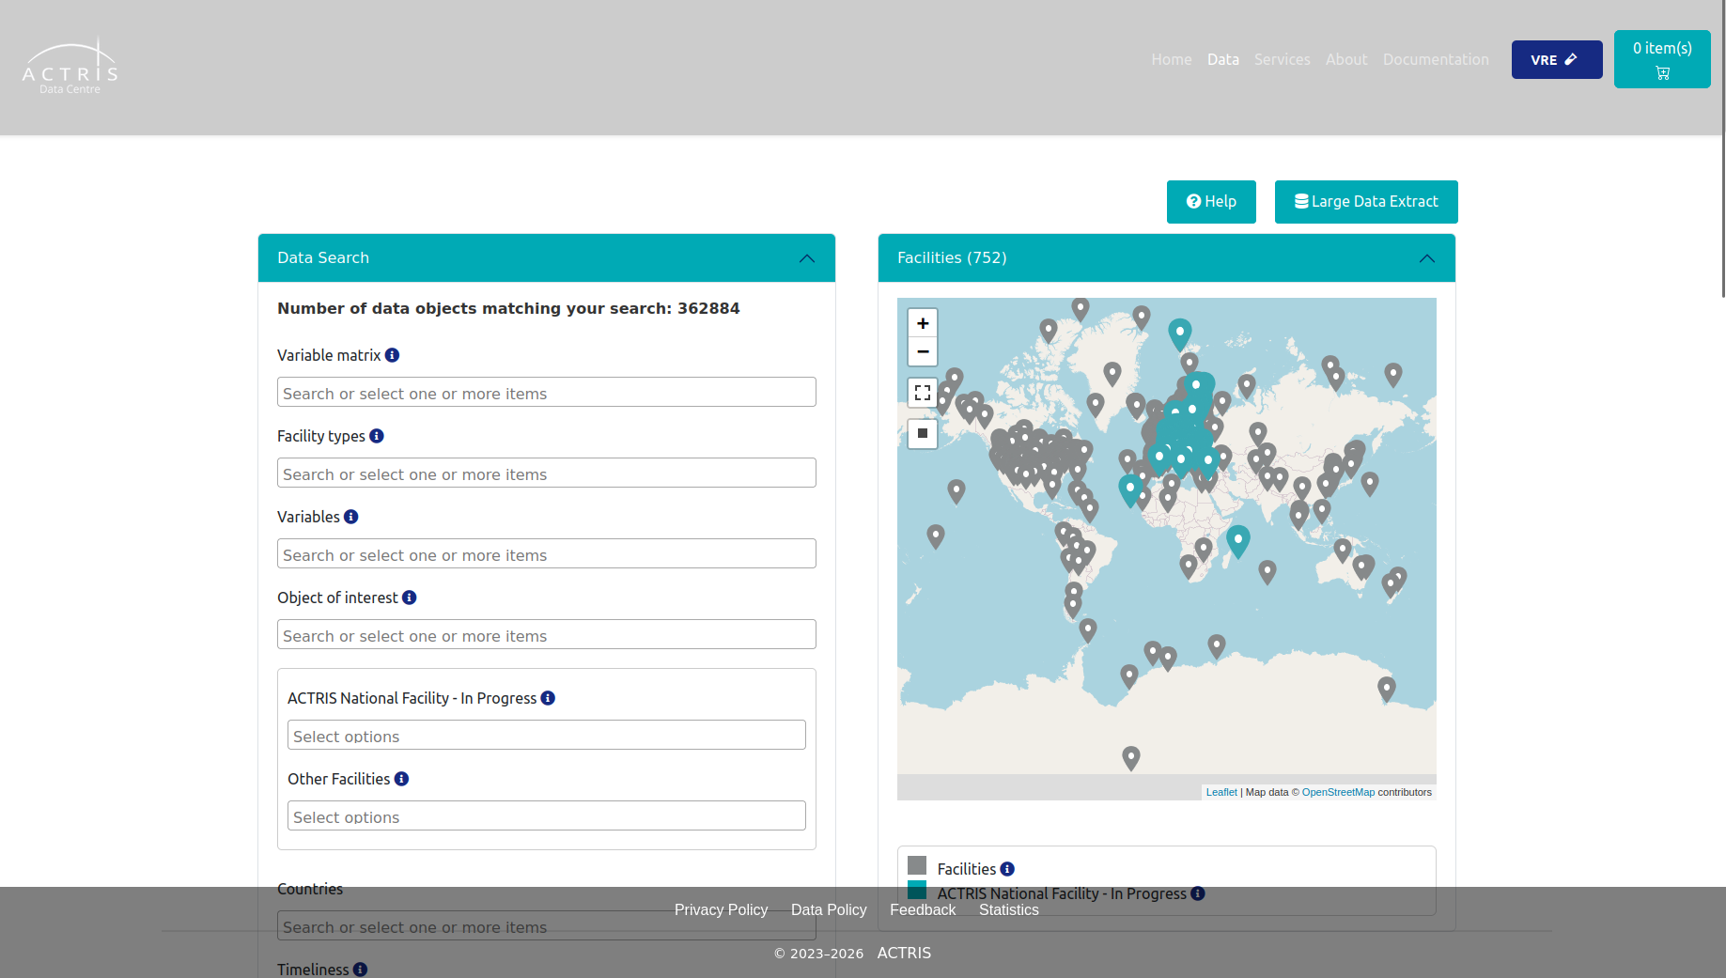
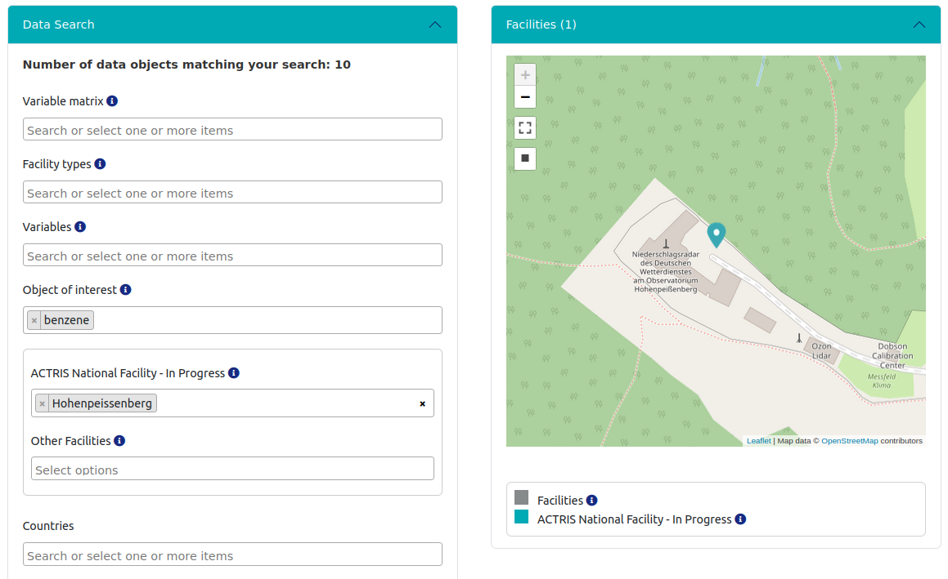
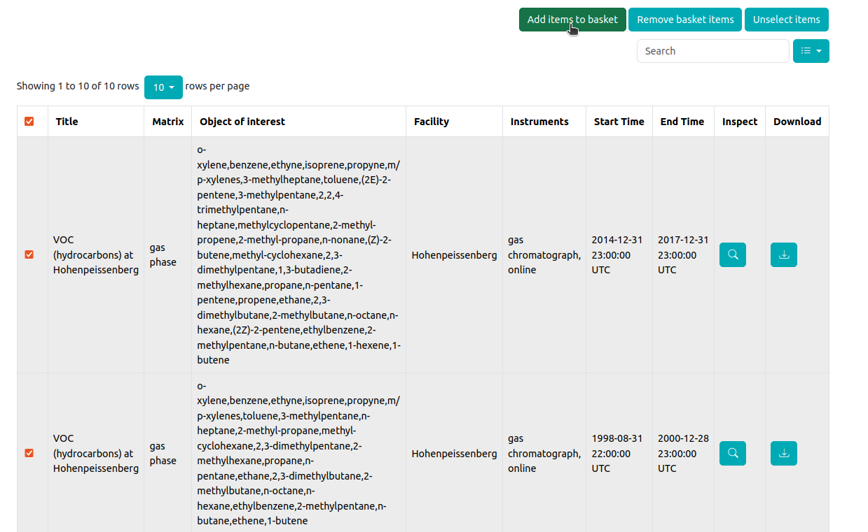
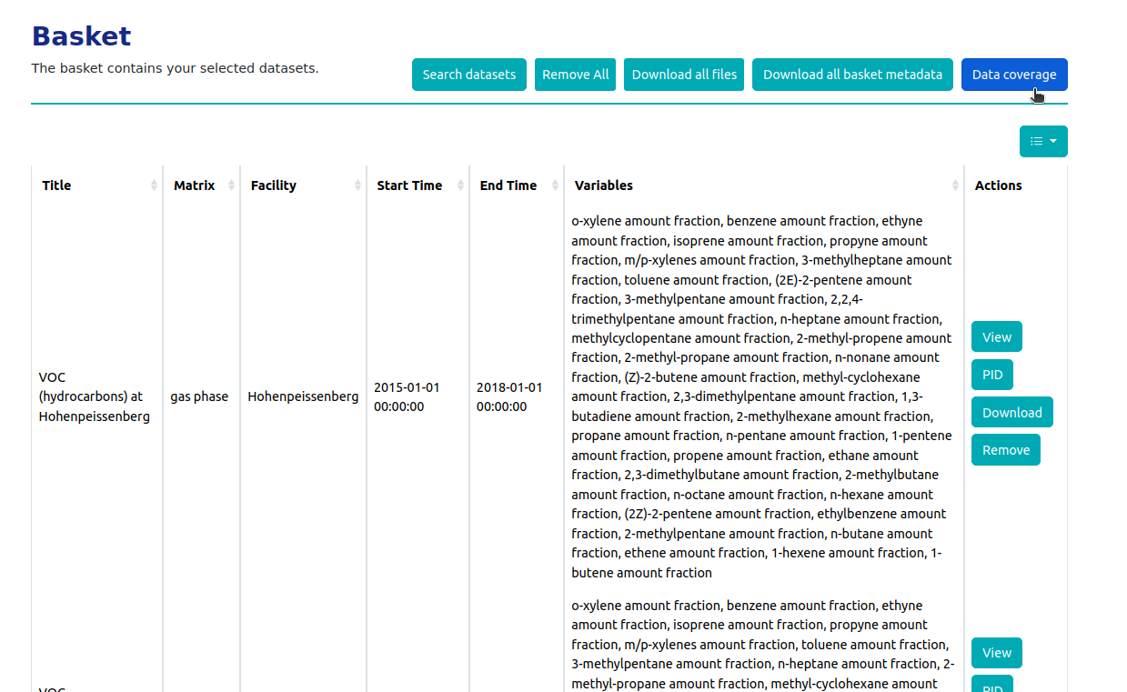
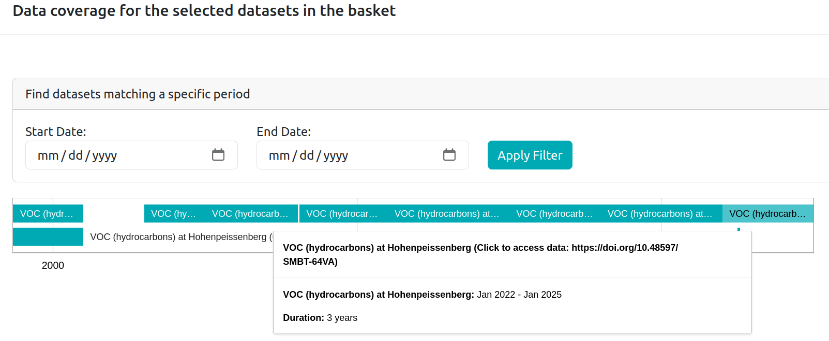
ACTRIS Data Portal
https://data.actris.eu/

Slide 11
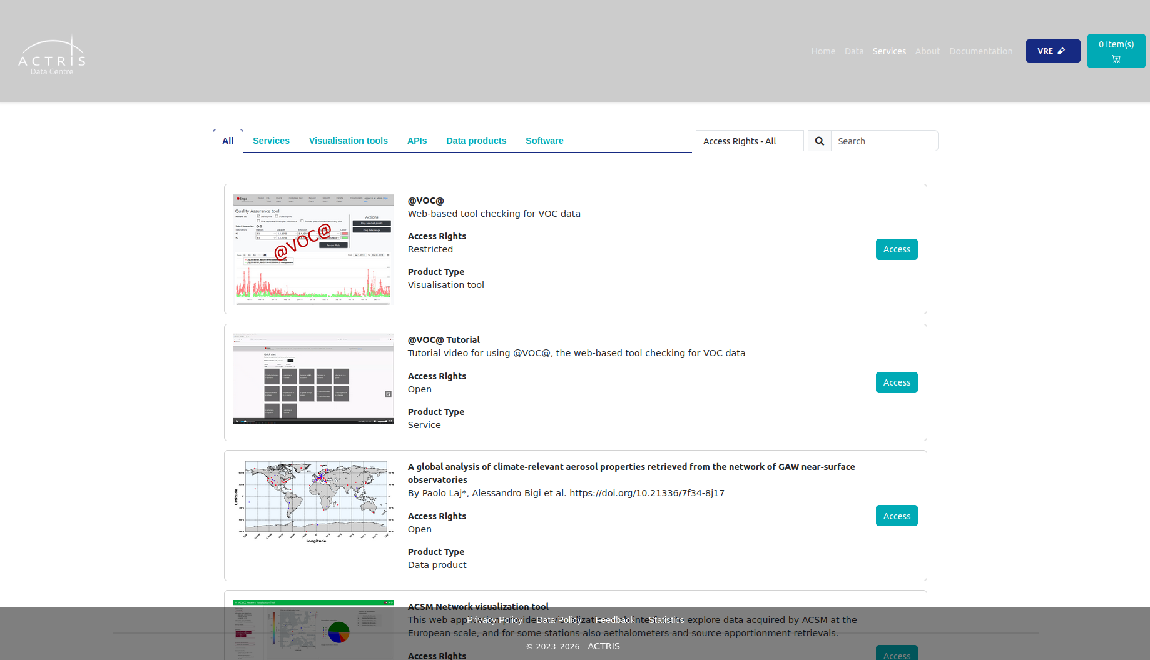
ACTRIS Virtual Services
https://data.actris.eu/services

Slide 12
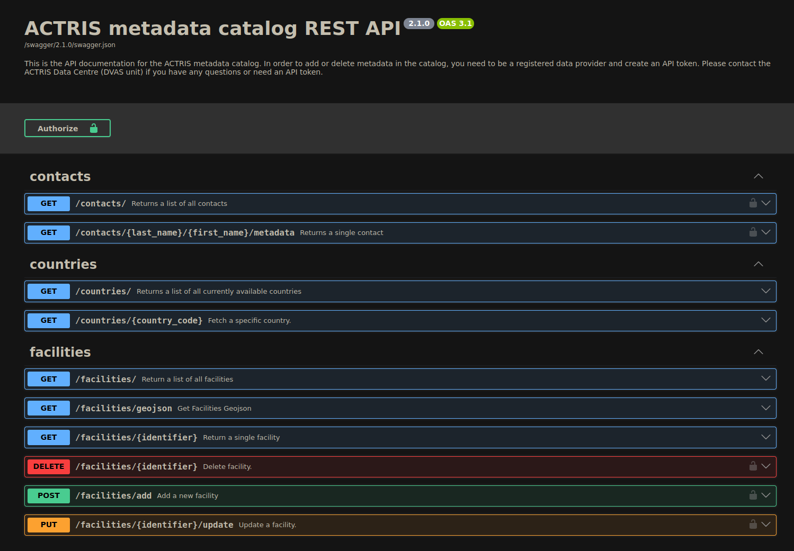
ACTRIS metadata catalog REST API
https://prod-actris-md2.nilu.no/index.html
API:
Makes Metadata M-2-M accessible
Base for ACTRIS Data Portal

Slide 13
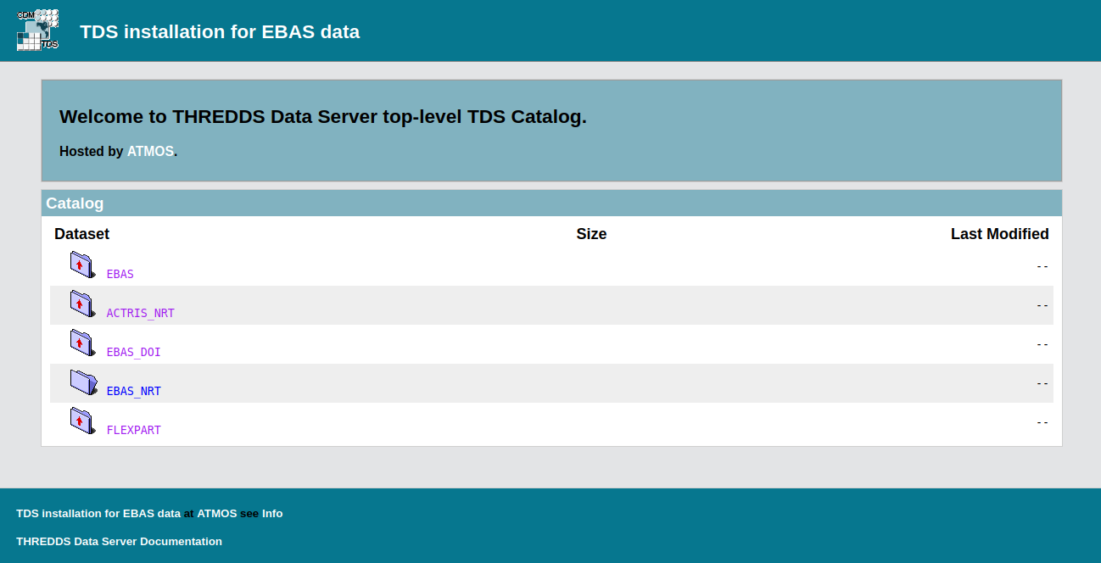
EBAS THREDDS Data Server
https://thredds.nilu.no/
THREDDS:
NetCDF data format
  Only open data so far, but will include restricted data soon.
Data access protocols:
  OPeNDAP
  File download (HTTP)
Metadata access protocols:
  NCML
  ISO 19115

Slide 14
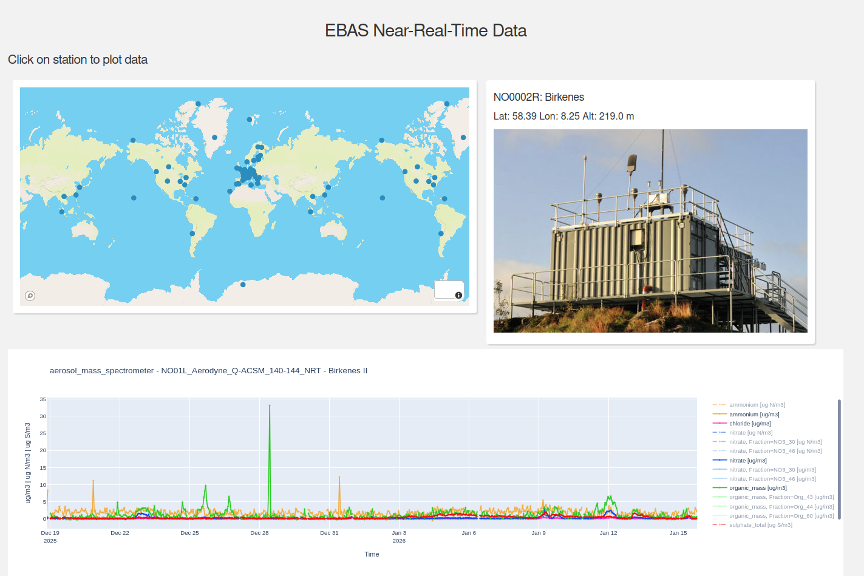
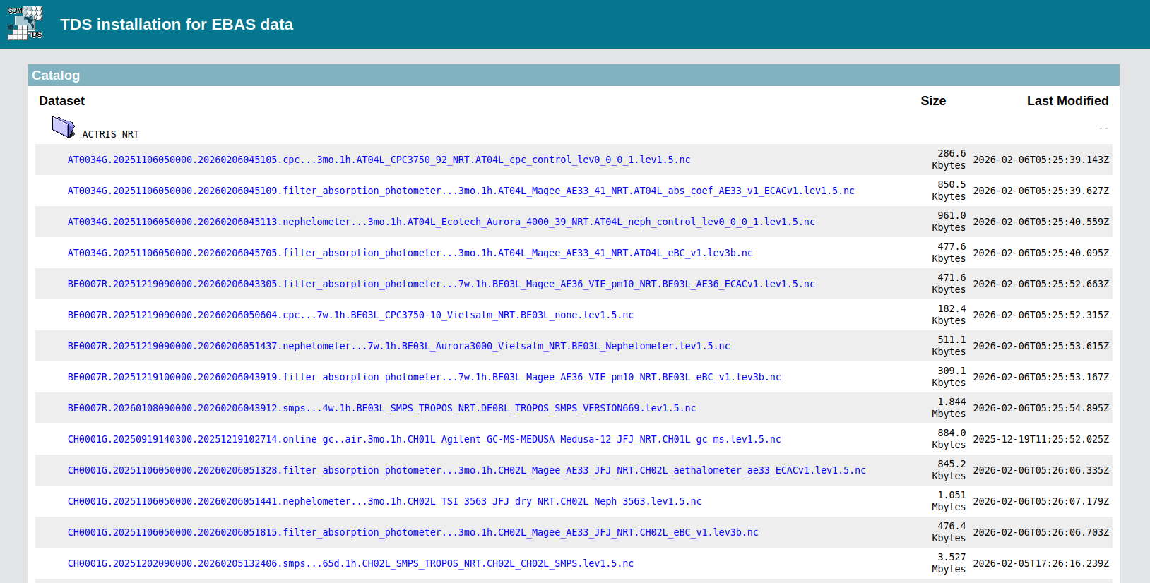
EBAS Near-Real-Time Data
EBAS NRT:
Visualization tool for NRT data
Click on station and find the NRT data available there.
Data is available through THREDDS

Slide 15
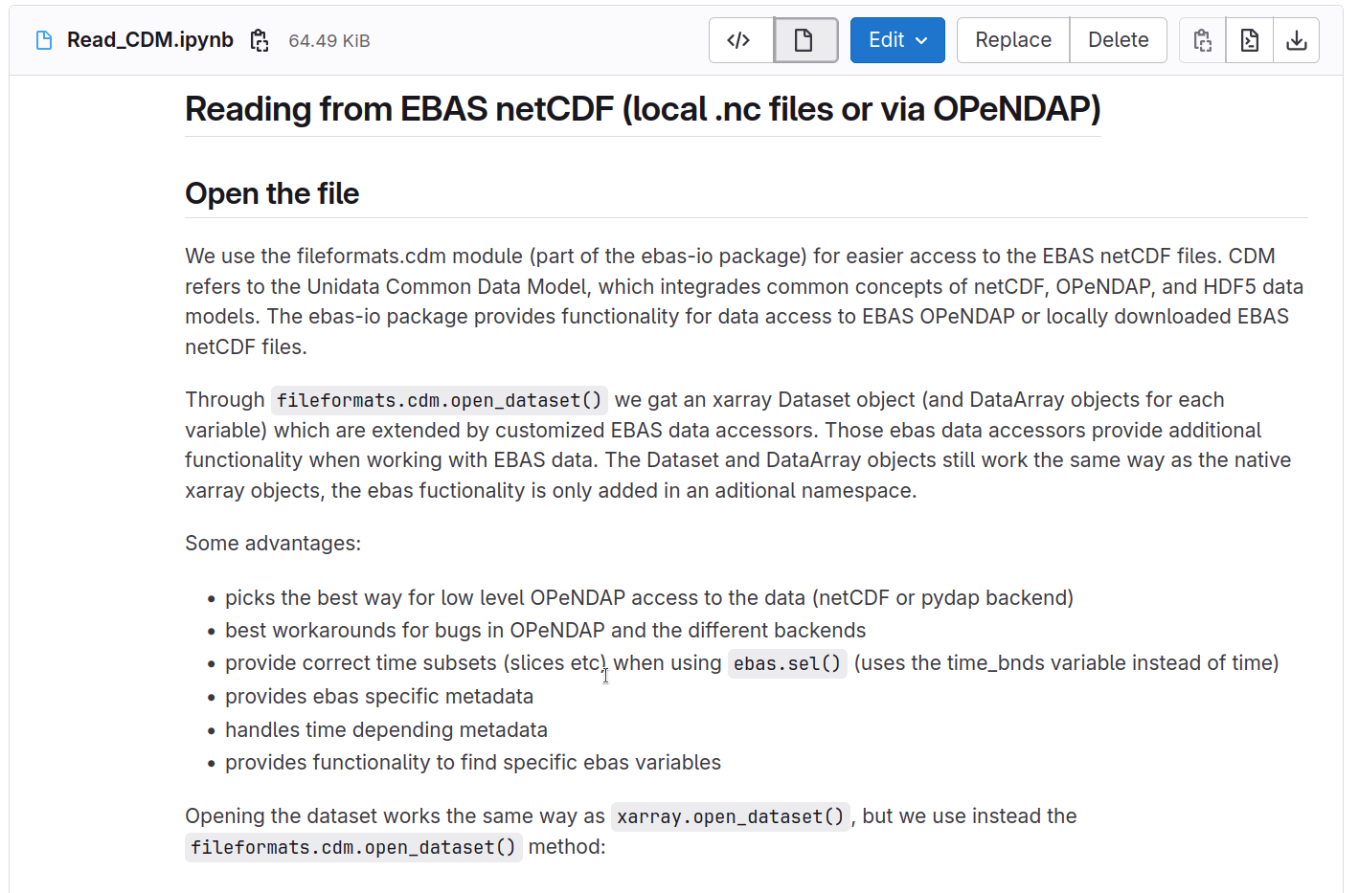
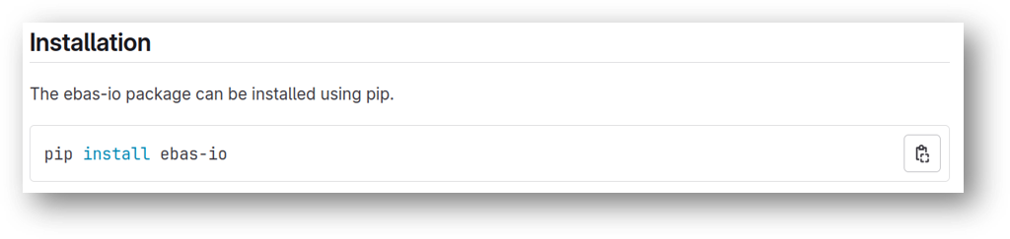
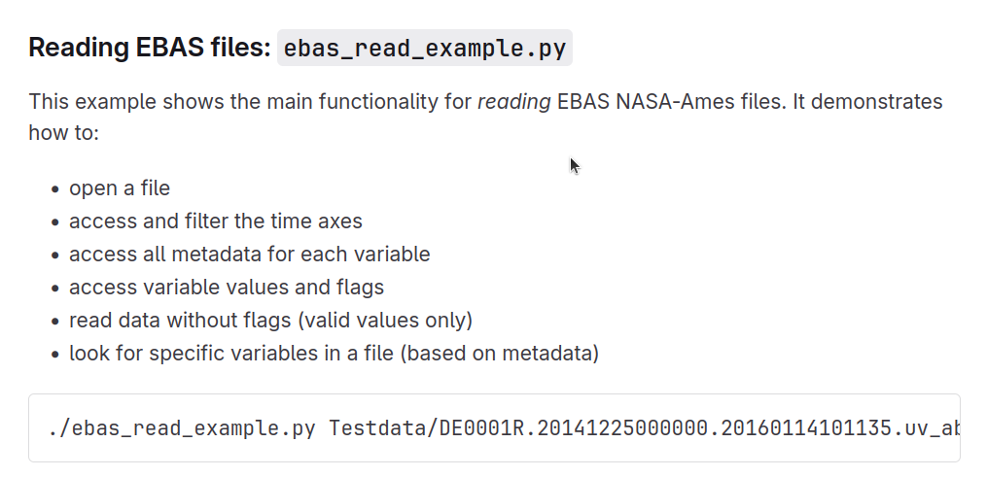
EBAS-io
https://git.nilu.no/ebas/ebas-io/-/wikis/home

Slide 16
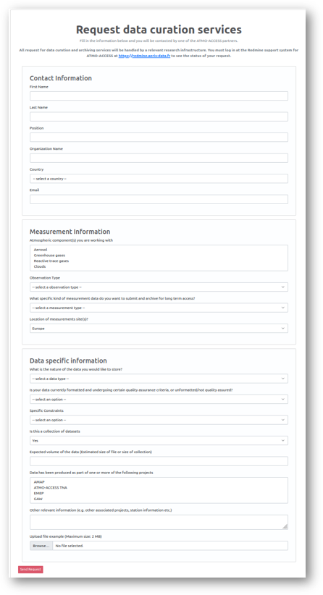
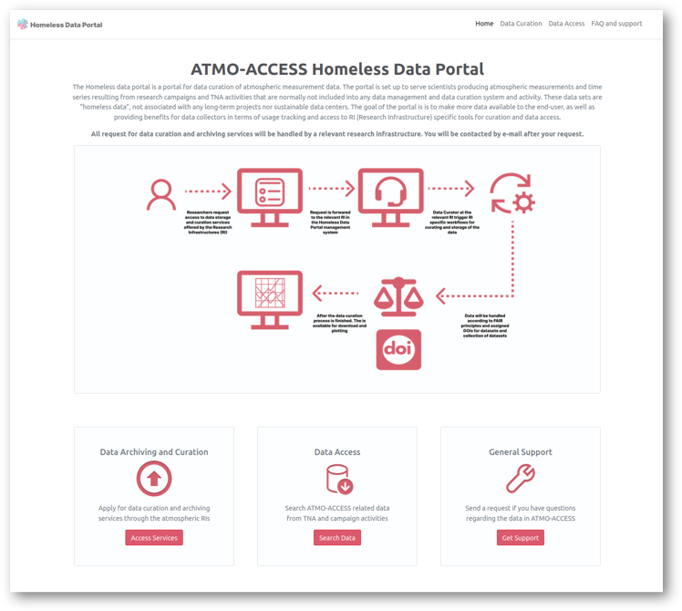
Homeless Data Portal
135 atmospheric variables
65 active sites
25 methodologies
time resolution ranging from seconds to 1 week.
I. Long term, sustainable (FAIR) storage of atmospheric project and campaign data.
II. Access to RI specific tools for curation and data access
III. More data available for end users
“homeless data”? measurement data not associated with any long-term projects/networks nor sustainable data centres.
Developed in ATMO-ACCESS,
Service will continue in ATMO-SERV

Slide 17
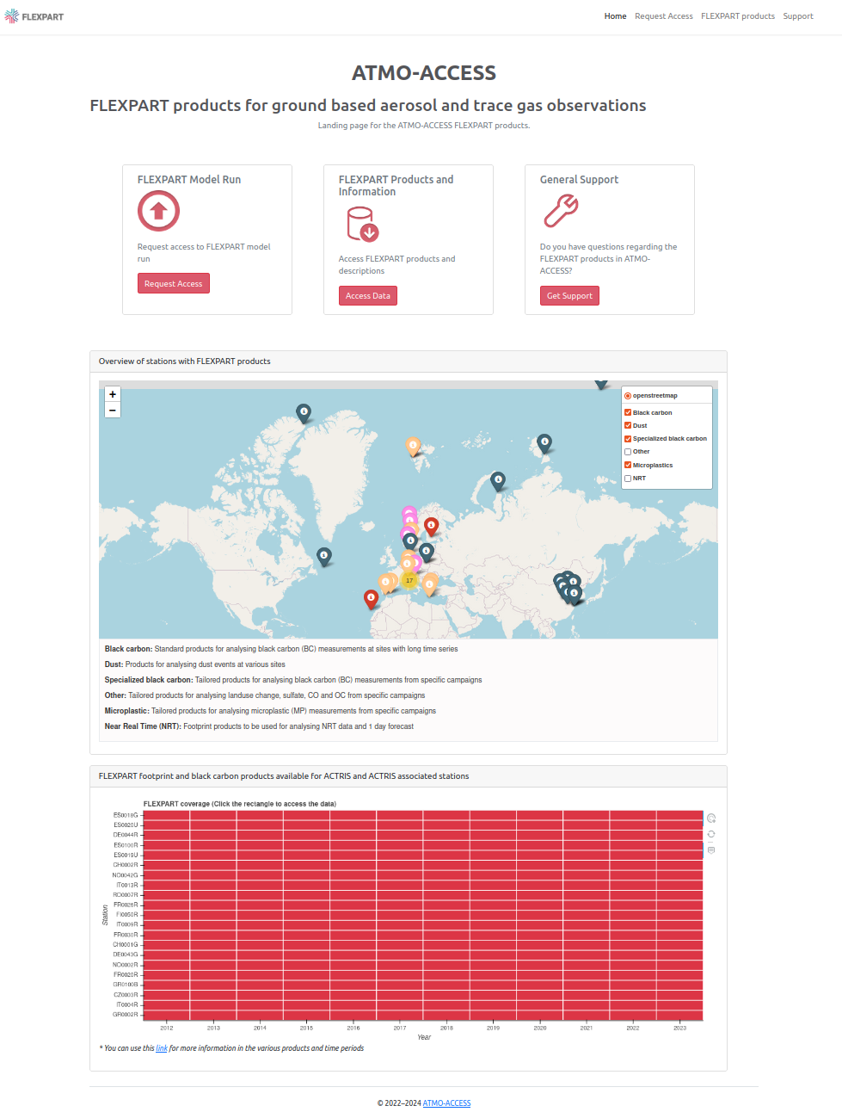
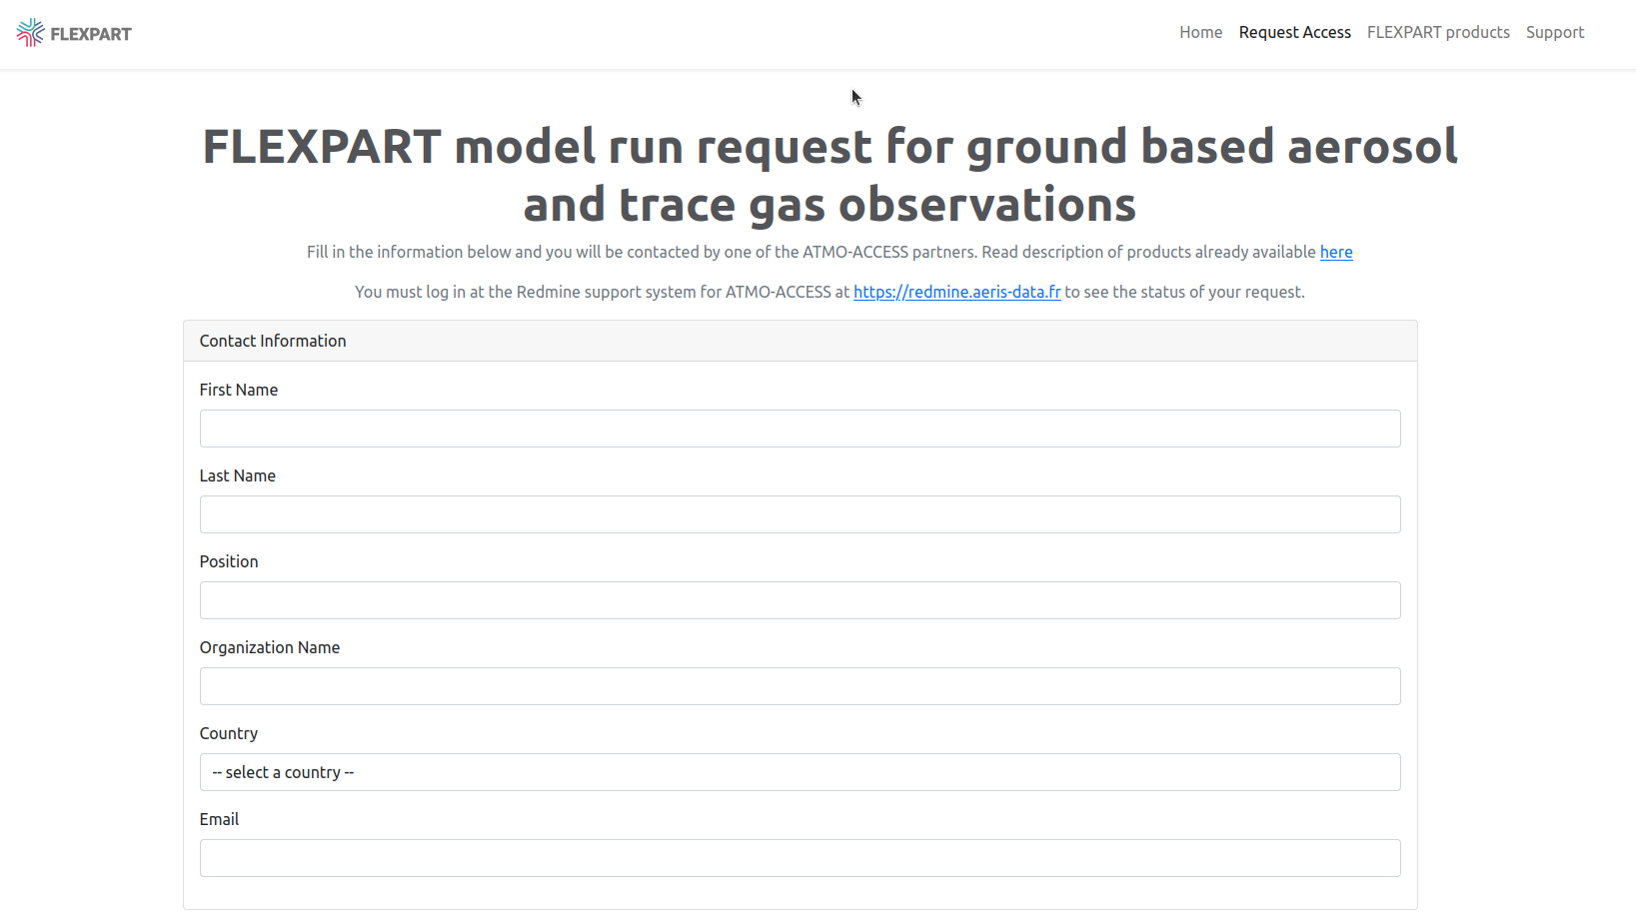
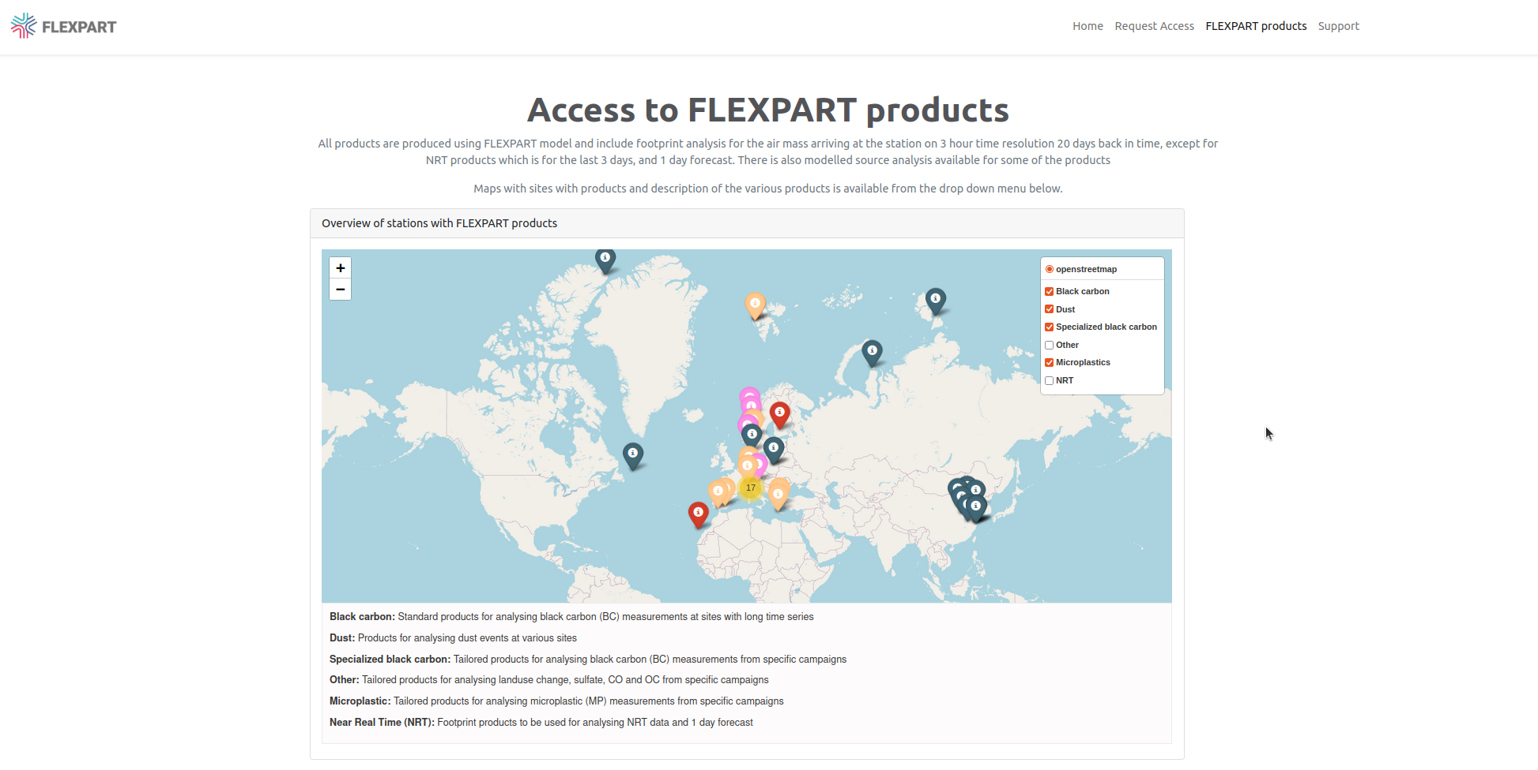
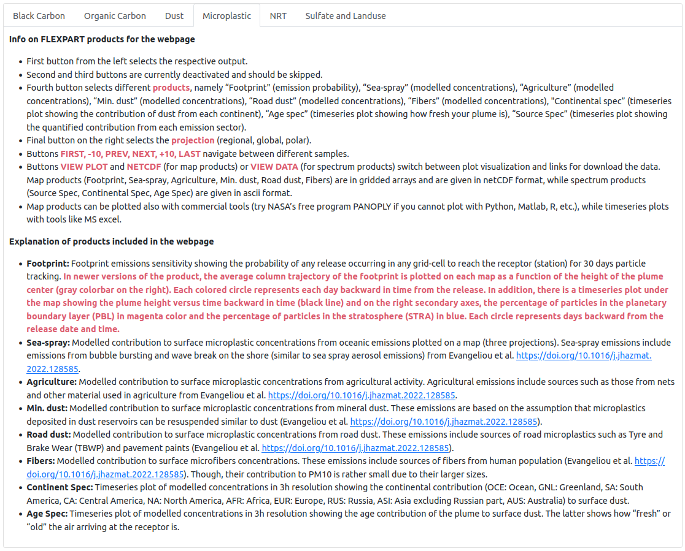
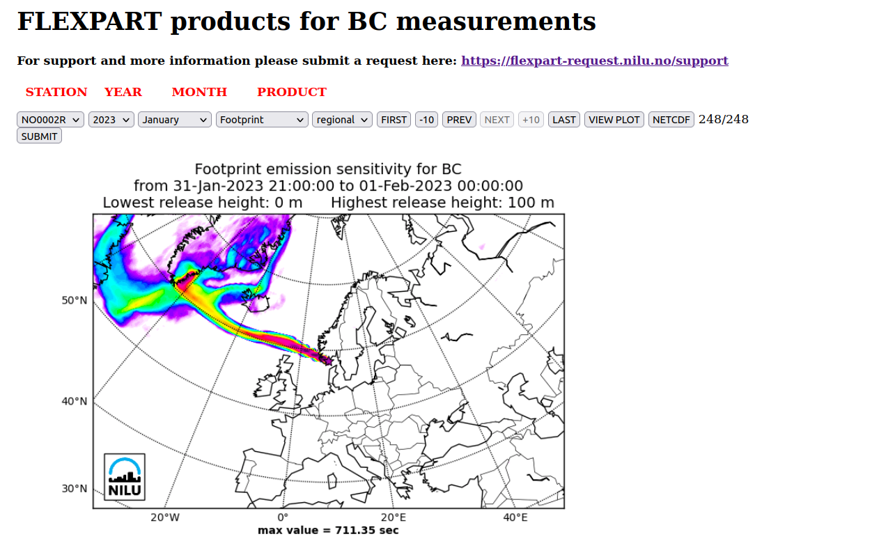
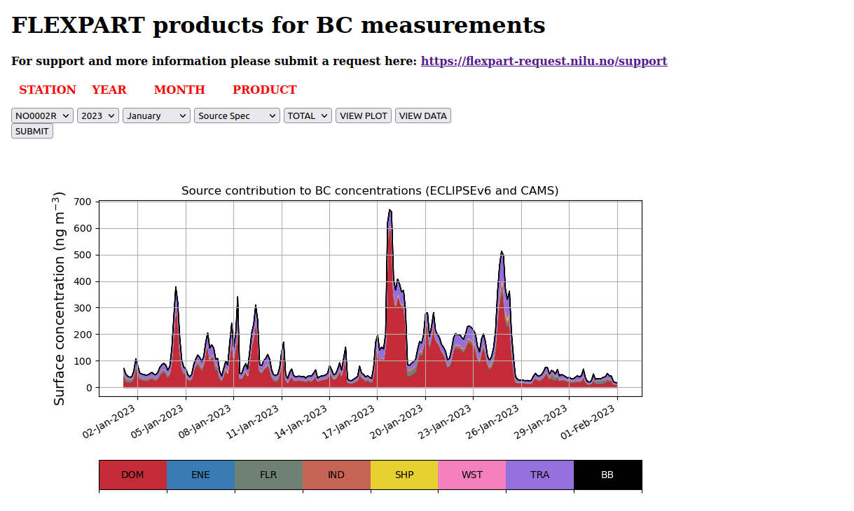
ATMO-ACCESS: Aerosol distribution and source analysis
Products:
Black carbon, dust, microplastics
near real-time (NRT), organic carbon, sulfate and landuse and others
Developed by N. Evangeliou (ne@nilu.no) and S. Eckhardt (sec@nilu.no) (NILU) under ATMO-ACCESS, EU grant agreement No 101008004.
Service will get continued funding in ATMO-SERV

Slide 18
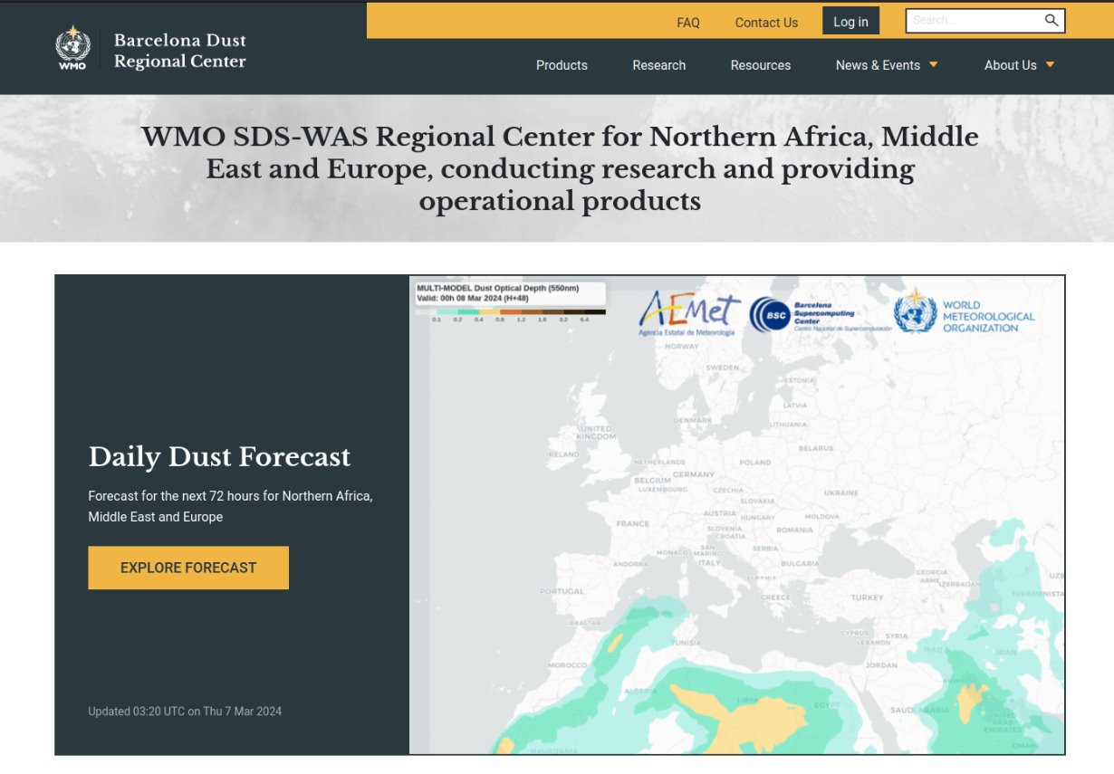
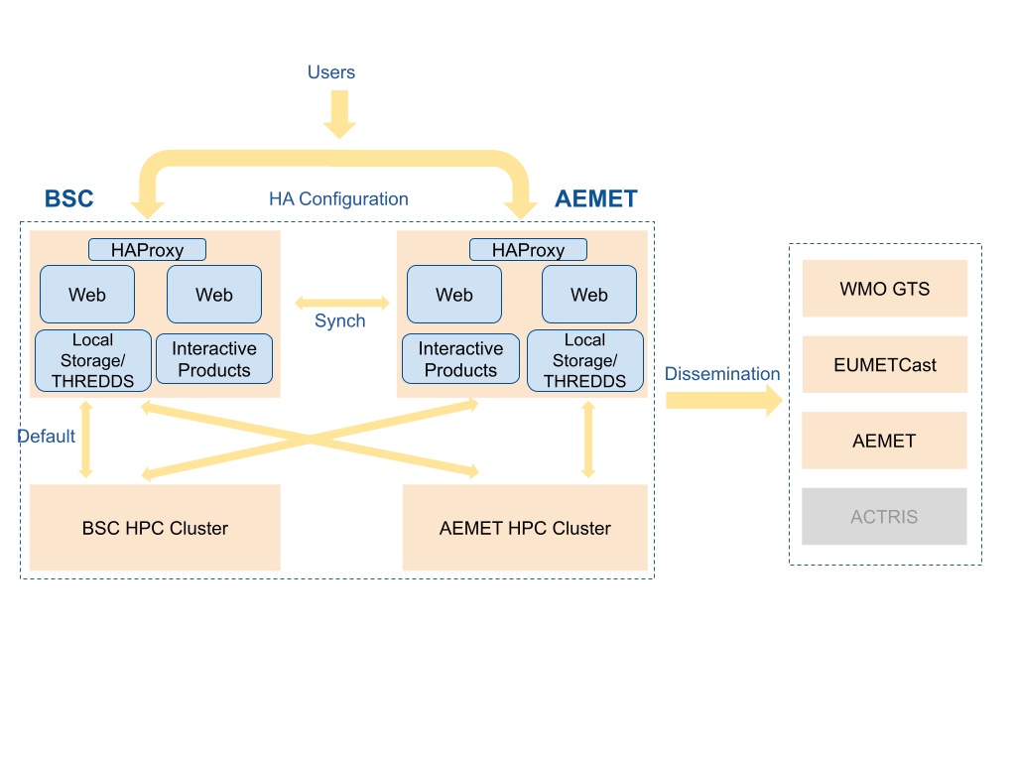
BSC Dust Products
Web Portal: https://dust.aemet.es
16 models operationally provided by partners from 13 different countries
3 multi-model products: median, probability maps, warning advisory system
Evaluation against 2 observation types: AERONET (in-situ), MODIS (satellite)
Layers with ACTRIS national facilities and GAW stations
Francesco Benincasa, Elliott Rose, Carlos Pérez García-Pando​
Barcelona Supercomputing Center

Slide 19

What is a VRE - Virtual Research Environment?
Online environment helping researches collaborate and perform data-driven research.
Features usually include:
  Collaboration support (web forums and wikis)
  Document hosting: Examples etc.
  Discipline-specific tools: Data analysis, Visualization etc.
  Teaching tools: Presentations, Slides, Videos etc.
Does not require the user to setup anything or download any inputs!
  Example: The user is not required to download python itself or any python packages needed for examples, this is already available on the VRE.

Slide 20
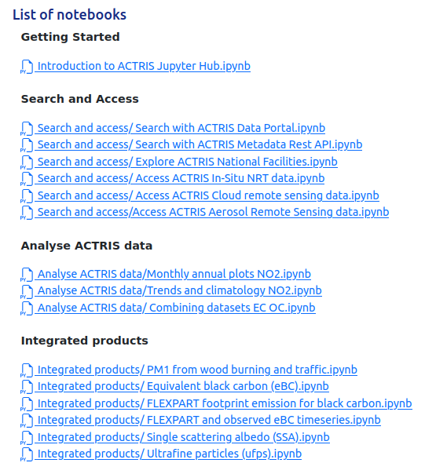
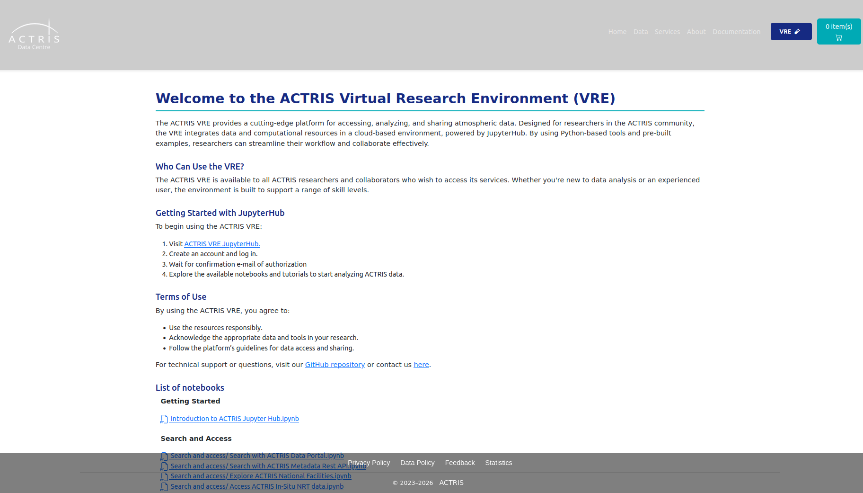
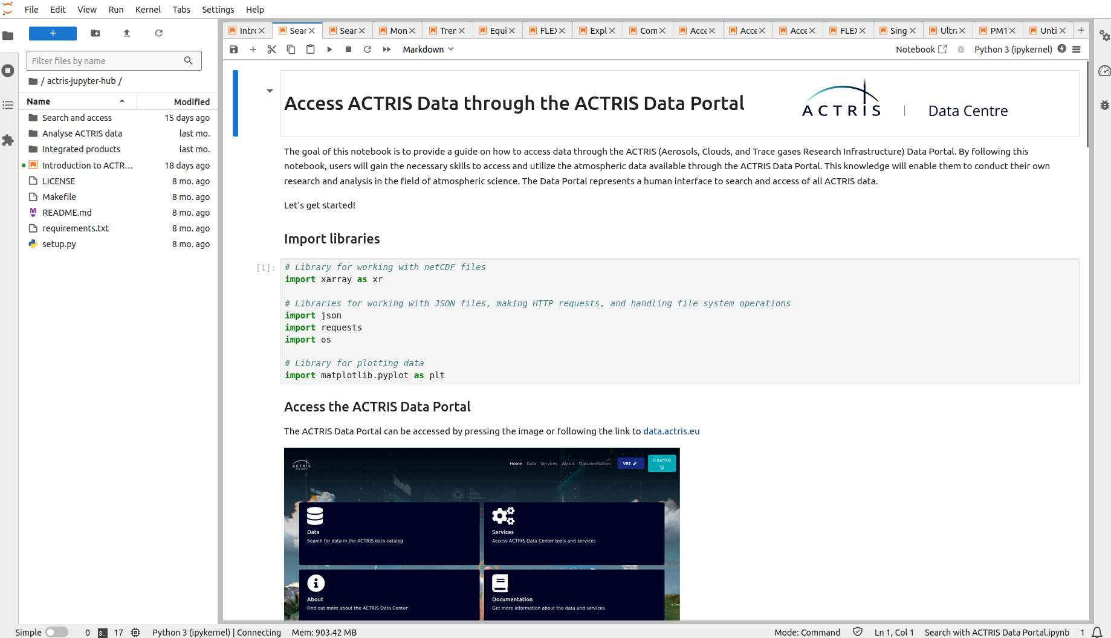
ACTRIS VRE Jupyter Hub
VRE page on ACTRIS Data Portal – possible to see all examples without running them. (https://data.actris.eu/vre)
ACTRIS VRE Jupyter Hub – python workspace where you can run and edit the ACTRIS notebook examples and create your own code.
Github repository for examples https://github.com/ACTRIS-Data-Centre/actris-jupyter-hub
  Using nbgitpuller to pull workspace: https://nbgitpuller.readthedocs.io/en/latest/link.html
  Merging behavior: https://nbgitpuller.readthedocs.io/en/latest/topic/automatic-merging.html

Slide 21
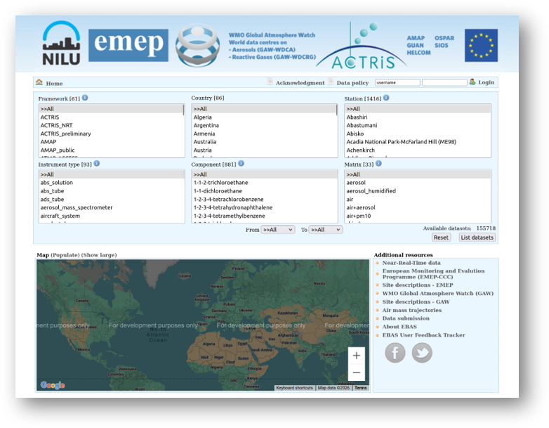
Demonstration of portals & show case of services and VRE
Notes:
Find dataset in EBAS, showcase search, choosing of datasets and plotting.
Find same dataset in ACTRIS, showcase search, vocabulary, dataset list, basket (incl coverage) and metadata information pages + facility pages.
Showcase FLEXPART for the same station.
Then open VRE and showcase some examples:
Stations
Data Portal vs Metadata
Combine data, trends
FLEXPART example.
EBAS-io?

Slide 22
The end

