Slide 1
ACTRIS Landing pages
Lise Eder Murberg, ATMOS, NILU
Notes:
Welcome to General In-Situ Data Submission Procedures.

Slide 2
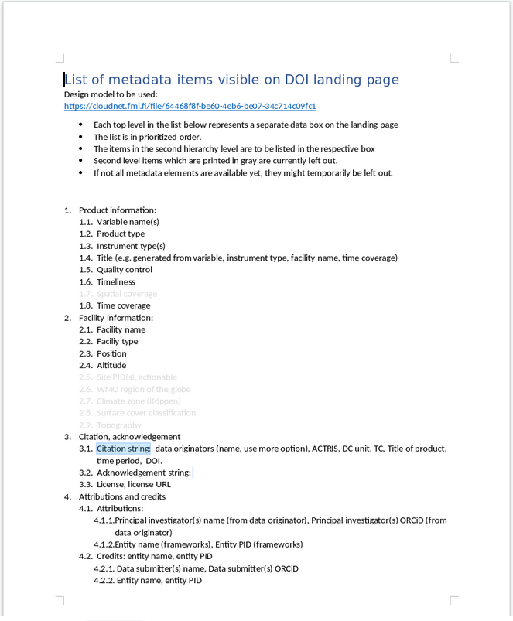
List of metadata items visible on DOI landing page
Background from ACTRIS DC Workshop in Paris:
2022-09-21_ACTRIS_data_landing_page_content.docx
Last workshop we decided on several metadata elements that should be visible on the DOI landing pages.
Notes:
Welcome to General In-Situ Data Submission Procedures.

Slide 3
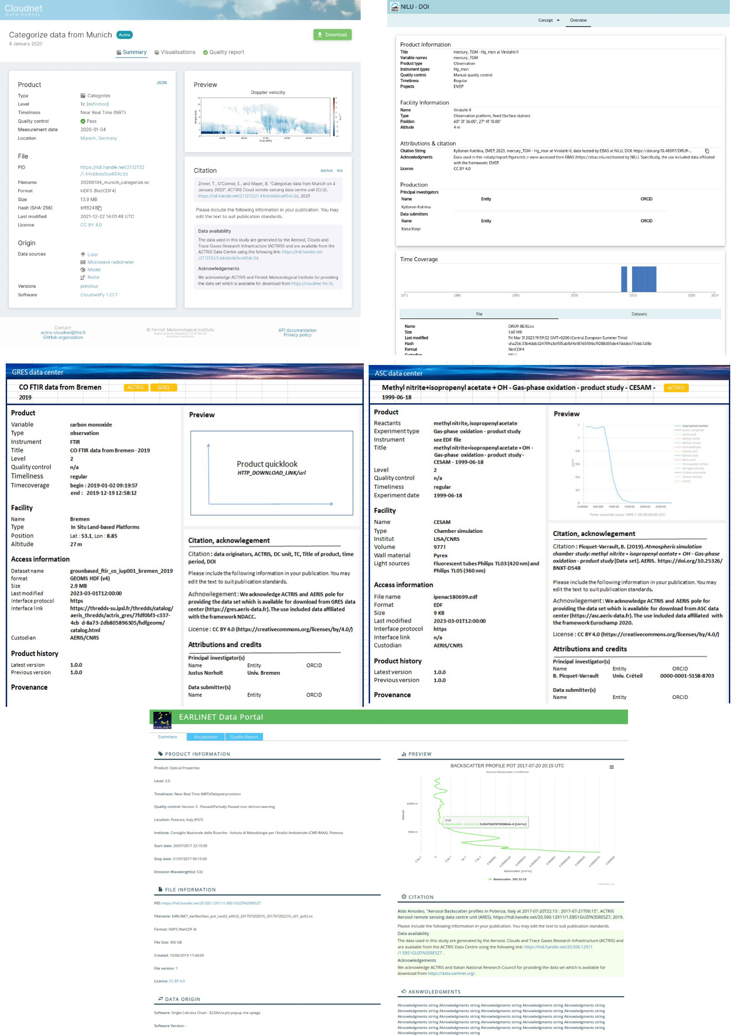
Landing pages mosaic and check of landing pages
Progress since ACTRIS DC Workshop in Paris:
Mosaic of landing pages
Graphic layout of all DC units draft landing pages
Check of landing pages
Checked from the mosaic with possibility to comment for all units
Open questions:
Harmonization and adjustments, design requirements
Selection of unit colors?
Review of metadata items visible on DOI landing page
Are citation string ok as visibility for some metadata elements?
Any metadata elements needed that are not a part of the list? (software, level etc)
Any elements that are hard to include? (Entity PID?)
Notes:
Welcome to General In-Situ Data Submission Procedures.

Slide 4
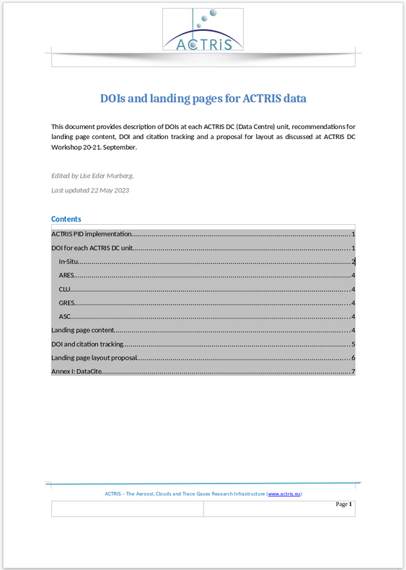
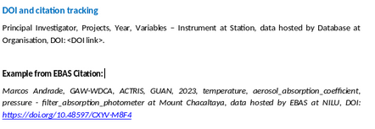
DOIs and landing pages for ACTRIS data
Progress since ACTRIS DC Workshop in Paris:
DOI and landing pages document
Open questions:
DOI and citation tracking
Recommendations from ENVRI-FAIR.
Notes:
Welcome to General In-Situ Data Submission Procedures.

Slide 5
Other topics to discuss
Now:
The use of the landing-pages: Plotting and harmonization of content in relation to the ACTRIS Data Portal
Ex. Is it enough for the Data Portal if visualization are part of landing pages?
Tags of frameworks and projects at the landing pages and within the data bases.
Notes:
Welcome to General In-Situ Data Submission Procedures.

